Slide 1
Information Visualization:
Tasks, Techniques, & Tools
SWEN422
Human Computer Interaction
Dr Craig Anslow
craig.anslow@ecs.vuw.ac.nz

Slide 2
SWEN 422 – Lecture Schedule
Week 1 – Information Visualization
Week 2 – Information Visualization
Week 3 – Information Visualization
Week 4 – Gestural Interfaces
Week 5 - AR/VR
Week 6 - AR/VR
https://ecs.wgtn.ac.nz/Courses/SWEN422_2025T1/LectureSchedule

Slide 3
Assignment 1
Design (e.g. personas, paper, Figma) and Develop visualizations (e.g. D3 / Unity / Unreal)
x3 visualizations minimum
Work in teams 2-4 people
  Team Signup by 2359 Wednesday 5 March
No individuals
Data set: from Stats NZ
Assessment Weighting: 40%
Due: 2359 Friday 11 April (End of Week 7)
https://ecs.wgtn.ac.nz/Courses/SWEN422_2025T1/Assignment1

Slide 4
Assignment 1 Rubric
Team Project Code Grade: 15%
  Visualizations (60%)
  Code Base (20%)
  Video (20%)
Individual Final Report Grade: 25%
  Written Communication (25%)
  Key Design Decisions (25%)
  Justifications / Alternative Designs (25%)
  Development Tools Critique (25%)
https://ecs.wgtn.ac.nz/Courses/SWEN422_2025T1/Assignment1

Slide 5
How Do We Visualize?
Know the Data
  Number of attributes
  Date types: ordinal vs ordered (ordinal or quantitative)
  Trustworthiness: bad fields, inaccuracies, missing values
Know your purpose (& audience)
  What do you/they want to see?
  What might you/they want to focus on?
Decide how to use visual variables to encode the data
  Requires awareness of:
    Human perceptual system
    Display capacity
    Characteristics of data (size, type)
    Task

Slide 6
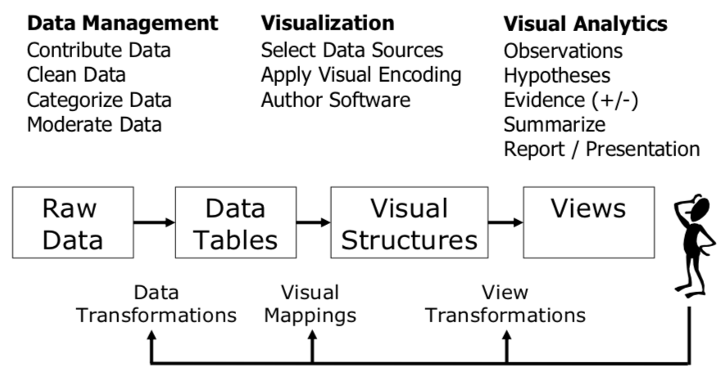
Information Visualization Reference Model
Readings in Information Visualization: Using Vision to Think Card, Mackinlay, Shneiderman, 1999

Slide 7
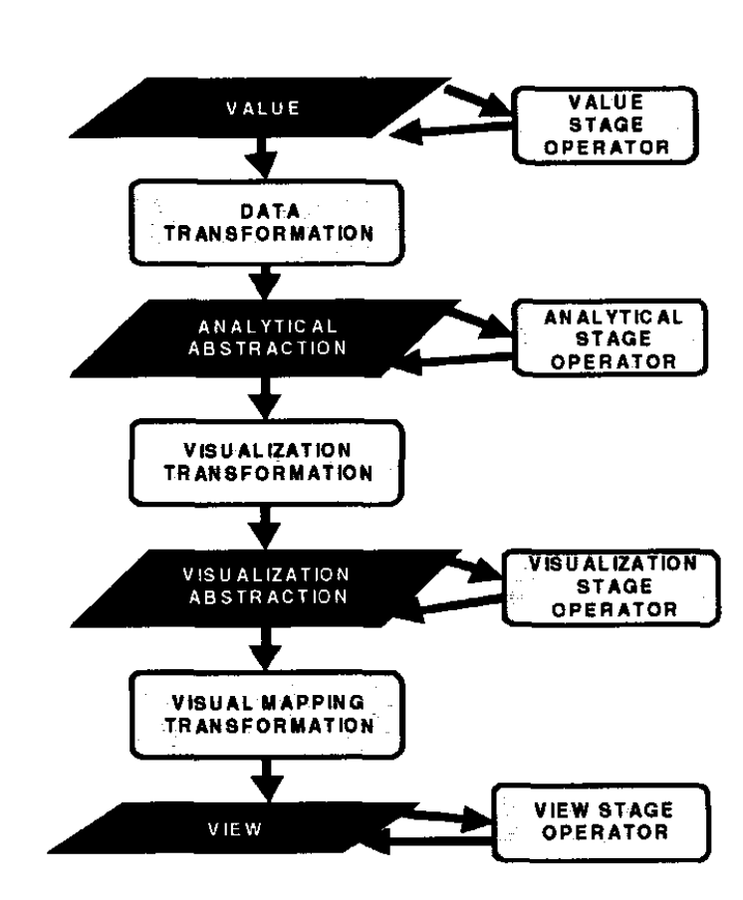
Data State Model
https://ieeexplore.ieee.org/document/729560

Slide 8
Data Visualization Tasks
Information Seeking Mantra
Overview: Gain an overview of the entire collection.
Zoom : Zoom in on items of interest.
Filter: Filter out uninteresting items.
Details-on-demand: Select an item or group and get details when needed.
Relate: View relationships among items.
History: Keep a history of actions to support undo, replay, and progressive refinement.
Extract: Allow extraction of sub-collections and of the query parameters.
https://www.cs.umd.edu/~ben/papers/Shneiderman1996eyes.pdf

Slide 9
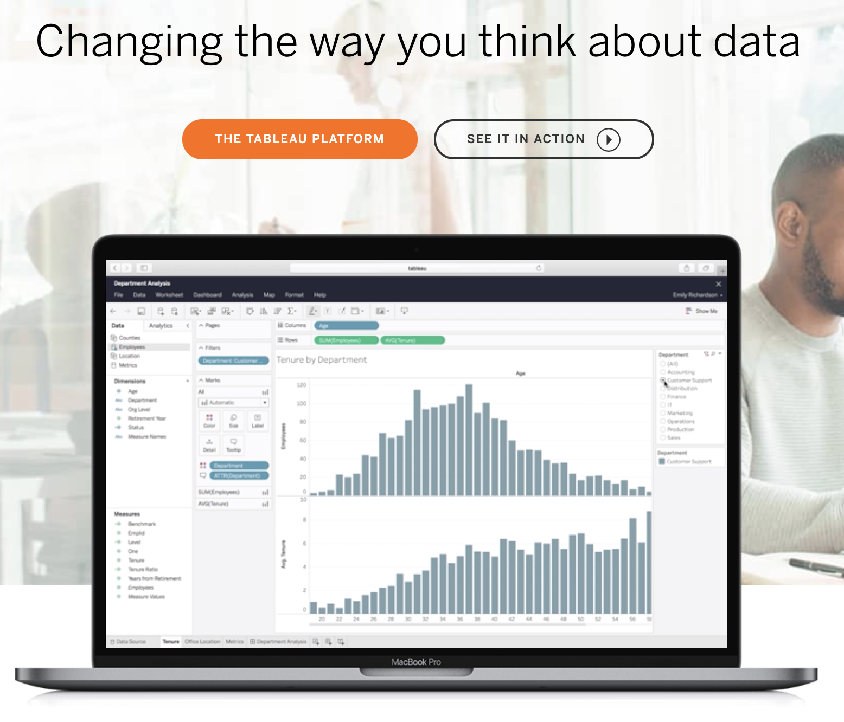
Tableau
https://www.tableau.com/
https://www.tableau.com/academic/students
https://public.tableau.com/app/discover

Slide 10
PowerBI
https://powerbi.microsoft.com/

Slide 11
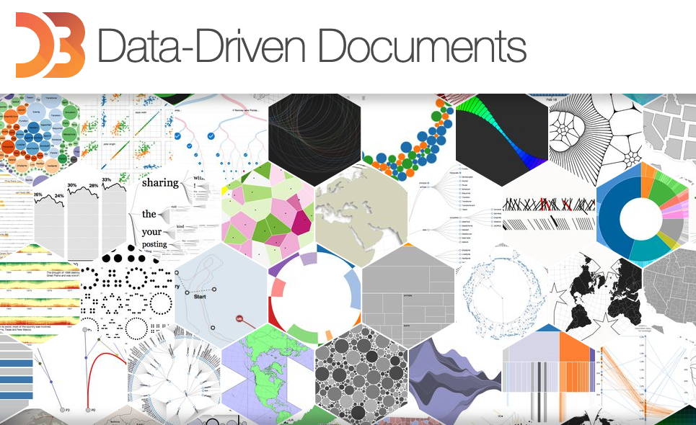
D3.js
https://d3js.org/
https://dl.acm.org/citation.cfm?id=2068631
https://observablehq.com/@uwdata/introduction-to-d3
https://courses.cs.washington.edu/courses/cse442/17au/lectures/CSE442-D3-Tutorial.pdf

Slide 12
Tour Through Visualization Zoo
Time-Series Data: index charts, stacked charts, small multiples, horizon graphs
Statistical Distributions: histograms, stem and leaf, Q-Q plots, scatter plot matrix, parallel coordinates
Maps: cartography, flowmaps, choropleth, graduated symbol maps, cartograms
Hierarchies: node-link, indented trees, adjaceny diagrams, enclosure diagrams, dendogram, sunburst, treemaps
Networks: graphs, force-directed, arc diagrams, matrix diagrams
https://queue.acm.org/detail.cfm?id=1805128
A Brief History of Data Visualization - https://www.youtube.com/watch?v=N00g9Q9stBo

Slide 13
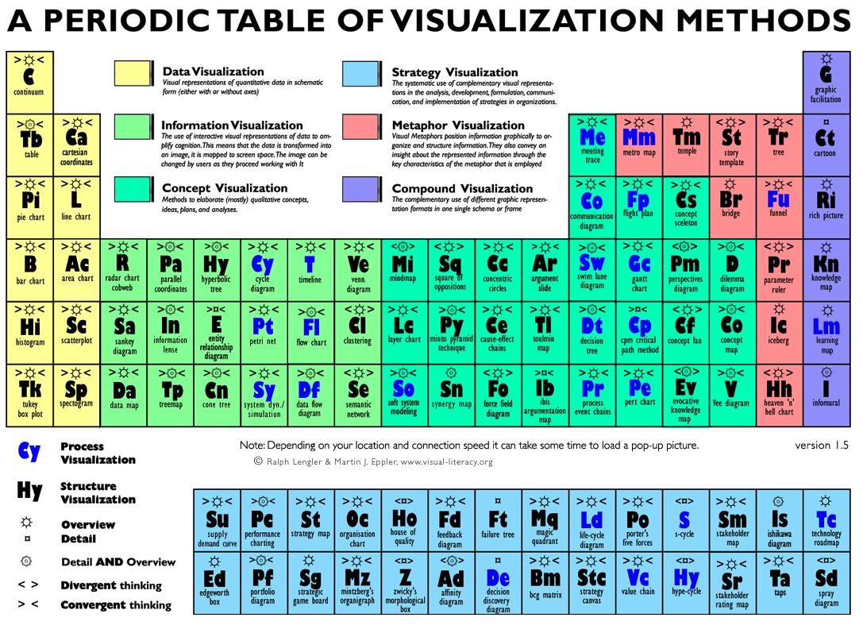
https://www.visual-literacy.org/periodic_table/periodic_table.html

Slide 14
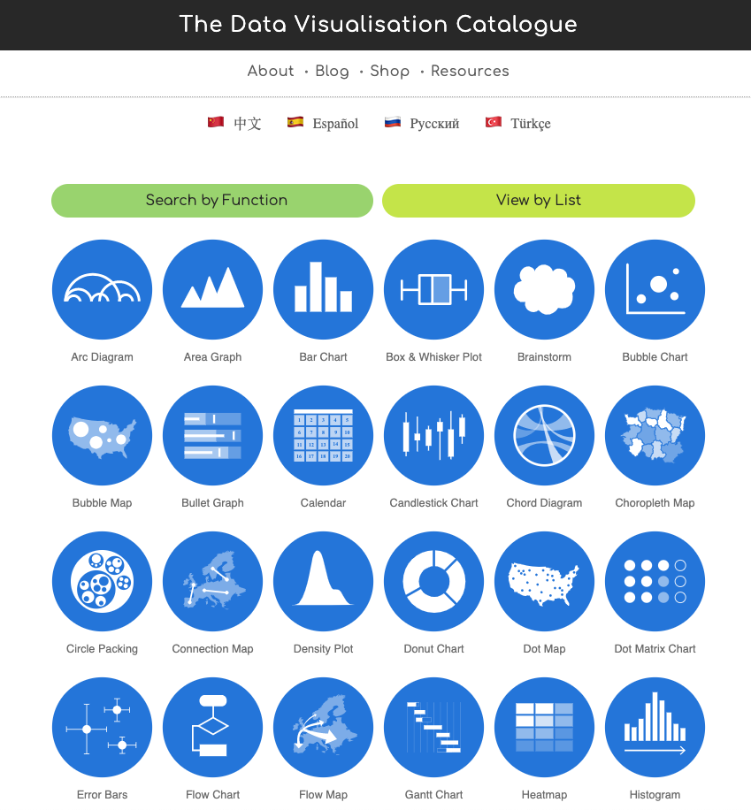
DataViz Catalogue
Graphs/Plots
Diagrams
Tables
Other
Maps/Geographical
https://datavizcatalogue.com

Slide 15
Line Graph
https://datavizcatalogue.com/methods/line_graph.html

Slide 16
Area Chart
https://datavizcatalogue.com/methods/area_graph.html

Slide 17
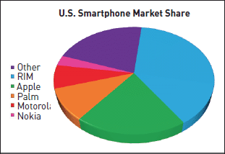
Pie Chart
https://datavizcatalogue.com/methods/pie_chart.html
Notes:
Example of 3D pie graph that is misleading due to the green slice being closer (it isn’t really bigger than the purple slice)

Slide 18
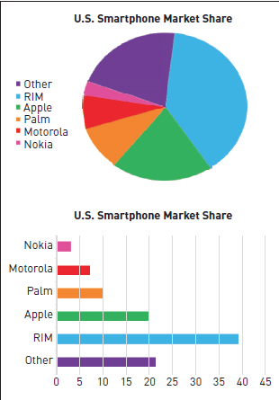
Pie Chart
Cannot show more then a few values, because as the number of values shown increases, the size of each segment/slice becomes smaller.
They take up more space then their alternatives, due to their size and for the usual need for a legend.
They are not great for making accurate comparisons between groups of Pie Charts. This being that it is harder to distinguish the size of items via area when it is for length.
Notes:
Example of 3D pie graph that is misleading due to the green slice being closer (it isn’t really bigger than the purple slice)

Slide 19
Donut Chart
https://datavizcatalogue.com/methods/donut_chart.html

Slide 20
Bubble Chart
https://datavizcatalogue.com/methods/bubble_chart.html

Slide 21
Box and Whisker Plot
https://datavizcatalogue.com/methods/box_plot.html

Slide 22
Error Bars
https://datavizcatalogue.com/methods/error_bars.html

Slide 23
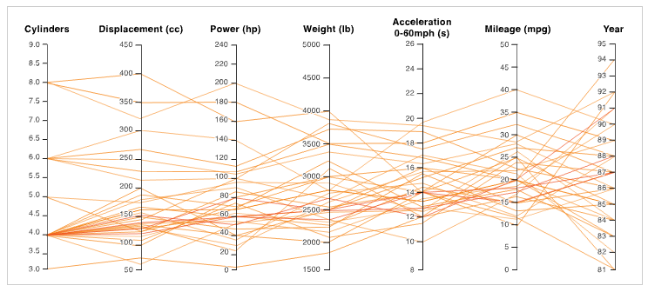
Parallel Coordinates Plot
https://datavizcatalogue.com/methods/parallel_coordinates.html
https://datavizcatalogue.com/methods/parallel_sets.html

Slide 24
Radar Chart
https://datavizcatalogue.com/methods/radar_chart.html

Slide 25
Radial Chart
https://datavizcatalogue.com/methods/radial_column_chart.html

Slide 26
Stacked Bar Graph
https://datavizcatalogue.com/methods/stacked_bar_graph.html

Slide 27
Steam Graphs
https://datavizcatalogue.com/methods/stream_graph.html

Slide 28
Arc Diagams
https://datavizcatalogue.com/methods/arc_diagram.html

Slide 29
Chord Diagram
https://datavizcatalogue.com/methods/chord_diagram.html

Slide 30
Network Diagram
https://datavizcatalogue.com/methods/network_diagram.html

Slide 31
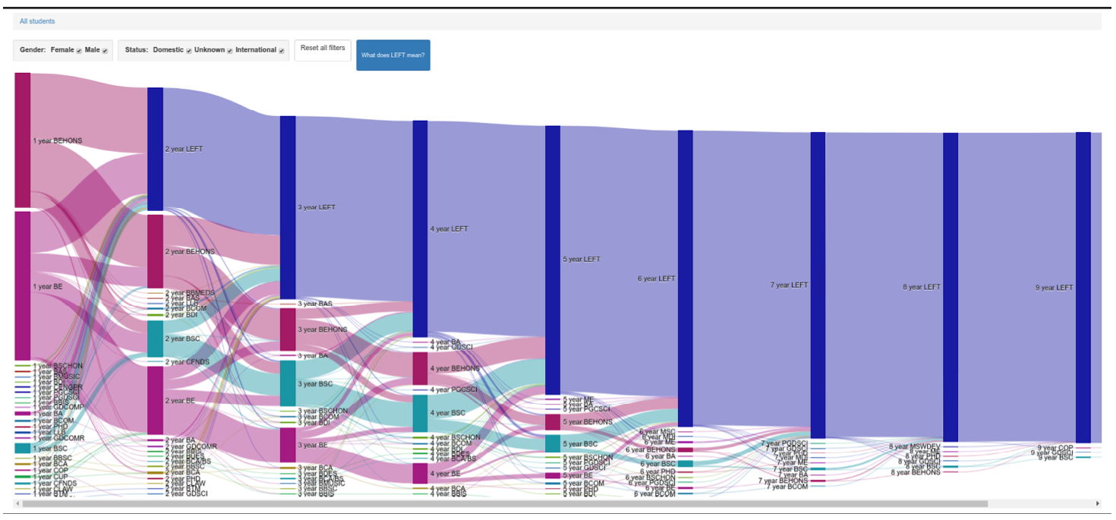
Sankey Diagram
https://datavizcatalogue.com/methods/sankey_diagram.html

Slide 32
Tree Diagram
https://datavizcatalogue.com/methods/tree_diagram.html

Slide 33
Heatmap (Matrix)
https://datavizcatalogue.com/methods/heatmap.html

Slide 34
Stem and Leaf Plot
https://datavizcatalogue.com/home_list.html

Slide 35
Word Cloud
Long words are emphasized over short words.
They're not great for analytical accuracy, so used more for aesthetic reasons instead.
https://datavizcatalogue.com/methods/wordcloud.html

Slide 36
Dot Matrix Chart
https://datavizcatalogue.com/methods/dot_matrix_chart.html

Slide 37
TreeMap
https://datavizcatalogue.com/methods/treemap.html
http://www.cs.umd.edu/hcil/treemap-history/index.shtml
Tree visualization with tree-maps: 2-d space-filling approach
https://doi.org/10.1145%2F102377.115768

Slide 38
Circle Packing
https://datavizcatalogue.com/methods/circle_packing.html

Slide 39
Rose Chart
https://datavizcatalogue.com/methods/nightingale_rose_chart.html

Slide 40
Sunburst Diagram
https://datavizcatalogue.com/methods/sunburst_diagram.html

Slide 41
Choropleth Map
https://datavizcatalogue.com/methods/choropleth.html

Slide 42
Dot Map
https://datavizcatalogue.com/methods/dot_map.html

Slide 43
Bubble Map
https://datavizcatalogue.com/methods/bubble_map.html

Slide 44
Connection Map
https://datavizcatalogue.com/methods/connection_map.html

Slide 45
Flow Map
https://datavizcatalogue.com/methods/flow_map.html

Slide 46

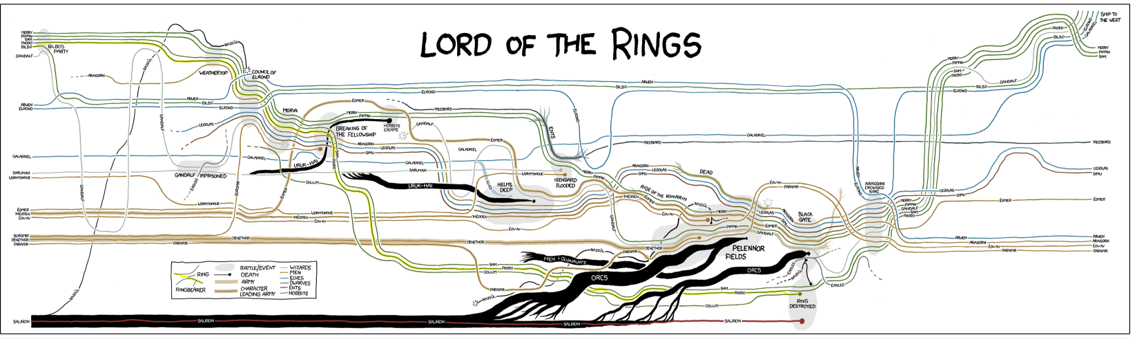
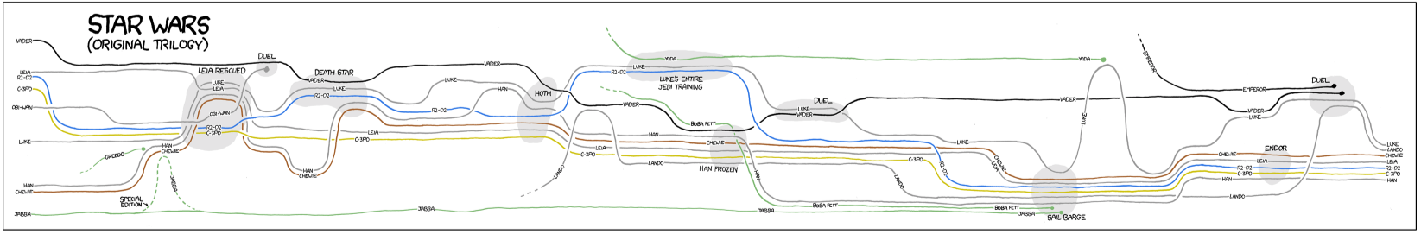
StoryLines
https://xkcd.com/657/

Slide 47
Next Steps
Readings:
  Considering Visual Variables as a Basis for Information Visualisation. Sheelagh Carpendale. Research report 2001-693-16, Department of Computer science, University of Calgary, Calgary, AB, Canada, 2003.
Team Signup: work in teams 2-4 people by 2359 Wednesday 5 March

