Slide 1
SWEN422 Human Computer Interaction Introduction
SWEN422 - 2025
Dr Jennifer Ferreira Dr Craig Anslow

Slide 2
Agenda
Safety Briefing
Background
Course Details
Human Computer Interaction (HCI)
HCI Research
Class Rep Election

Slide 3
Safety Briefing
https://www.youtube.com/watch?v=97jIkp-XyFg
Notes:
Video updated for 2020

Slide 4
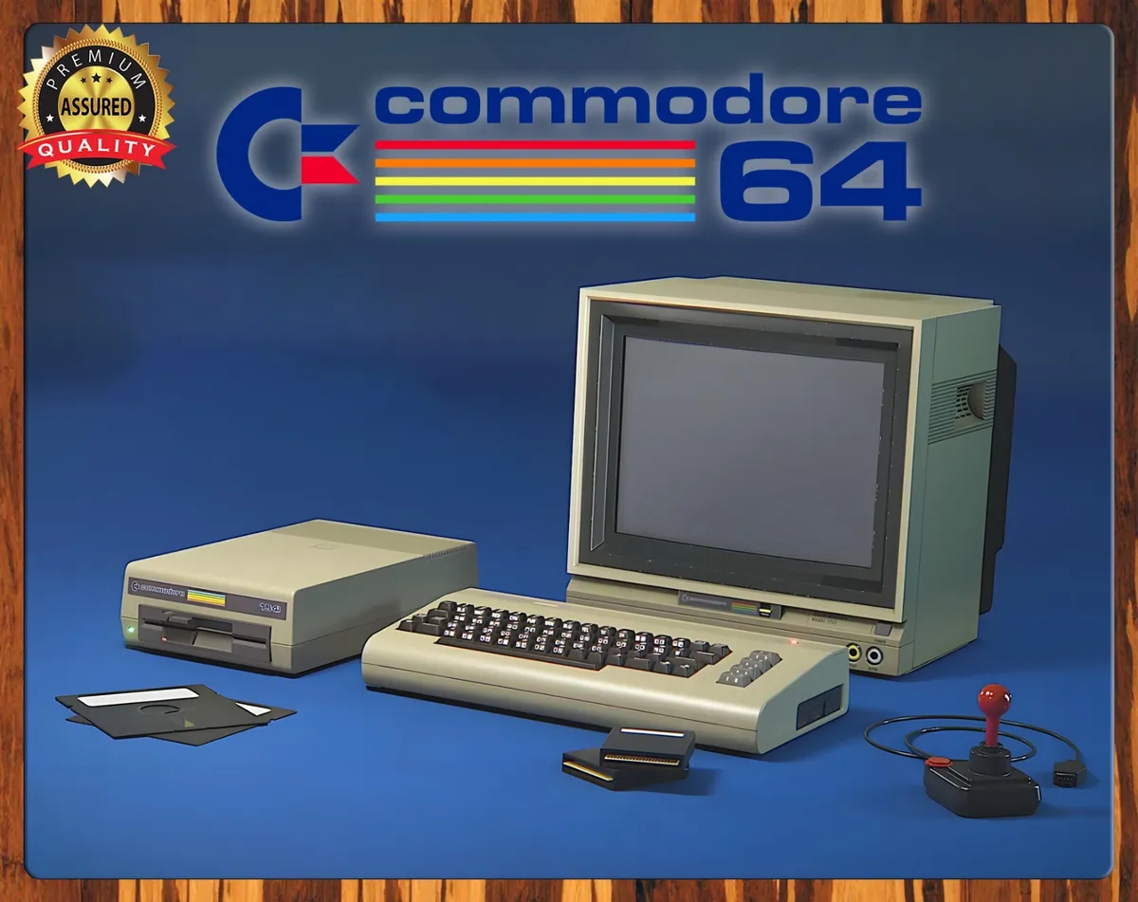
First Computer Experiences …
https://history-computer.com/computers-in-the-1980s

Slide 5

Is this the Future?
https://www.youtube.com/watch?v=FZc4dxlqJjs

Slide 6


SWEN422 Team
Dr Jennifer Ferreira
Lecturer
Teaching weeks 8-11
Office: CO230
Office hours: TBD
jennifer.ferreira@vuw.ac.nz
Dr Craig Anslow
Course Coordinator & Lecturer
Teaching weeks 1-7 and 12
Office: CO260
Office hours:
Wednesdays 1510-1600
Fridays 1300-1400
craig.anslow@vuw.ac.nz

Slide 7
Online Spaces
SWEN422 Home Page
https://ecs.wgtn.ac.nz/Courses/SWEN422_2025T1/
Lecture Schedule
https://ecs.wgtn.ac.nz/Courses/SWEN422_2025T1/LectureSchedule
TimeTable
https://ecs.wgtn.ac.nz/Courses/SWEN422_2025T1/TimeTable
VStream/Panopto for recording lectures
https://nuku.wgtn.ac.nz/courses/27199/external_tools/115
Nuku for announcements, questions, class discussion
https://nuku.wgtn.ac.nz/courses/27199
ECS Assessment System for assignment submissions:
https://apps.ecs.vuw.ac.nz/submit/SWEN422
Student Discord?

Slide 8
In Person Lectures
Wednesday 14:10 - 15:00 Laby LT 118
Friday 14:10 - 15:00 Murphy LT 101
Kelburn Campus Map: https://www.wgtn.ac.nz/about/campuses-facilities/campuses/kelburn/kelburn-campus-map.pdf

Slide 9

Course Readings
Relevant readings will be provided on the lecture slides
Access readings through the university library
https://www.wgtn.ac.nz/library
Or the reading list (Talis)
https://rl.talis.com/3/victoria/lists/FB33E0C5-EBFF-66B4-9B80-4B5F1F3A9FCA.html
Recommended Reading: HCI Book
https://hcibook.com/

Slide 10
Assignments
Assignment | Due | Week | %
Assignment 1: Group Project | Friday 11 April | 7 | 40
Assignment 2: Essay | Friday 23 May | 11 | 30
Assignment 3: Report | Wednesday 11 June | 14 | 30
https://ecs.wgtn.ac.nz/Courses/SWEN422_2025T1/Assignments

Slide 11
Slip Days and Extensions
Students have three slip days across the course that will be granted automatically.
Work submitted after slip days without an extension will have its mark reduced by a shrinking cap of 10% per day.
Extensions may be granted by the course coordinator by applying for an extension through the ECS submission system.

Slide 12

Using ChatGPT in assignments
SWEN422 is AI Green
Students are encouraged to use AI tools to assist in learning and production of content.
Students need to reference the technology they are using and will be assessed assuming full access to AI tools.

Slide 13
Using ChatGPT in Assignments
WARNING:
Low quality prompts = low quality results
Results are sometimes false/erroneous
AI is a tool and must be acknowledged in your work to preserve academic integrity
https://www.linkedin.com/posts/emollick_i-added-an-ai-policy-to-my-syllabus-we-activity-7021676210443145216-FVhy

Slide 14
Humans ----- Computers
HCI
Humans
Computers
Physiology
Visual System
Cognitive performance
Human Performance Modelling
Psychology
Mental state
Consciousness
Sociology
Social Context
Hardware
Physical world
Tangible components
System performance modelling
Firmware
Controllers
Signal processing
Software
Instructions as Data
Modifiable

Slide 15
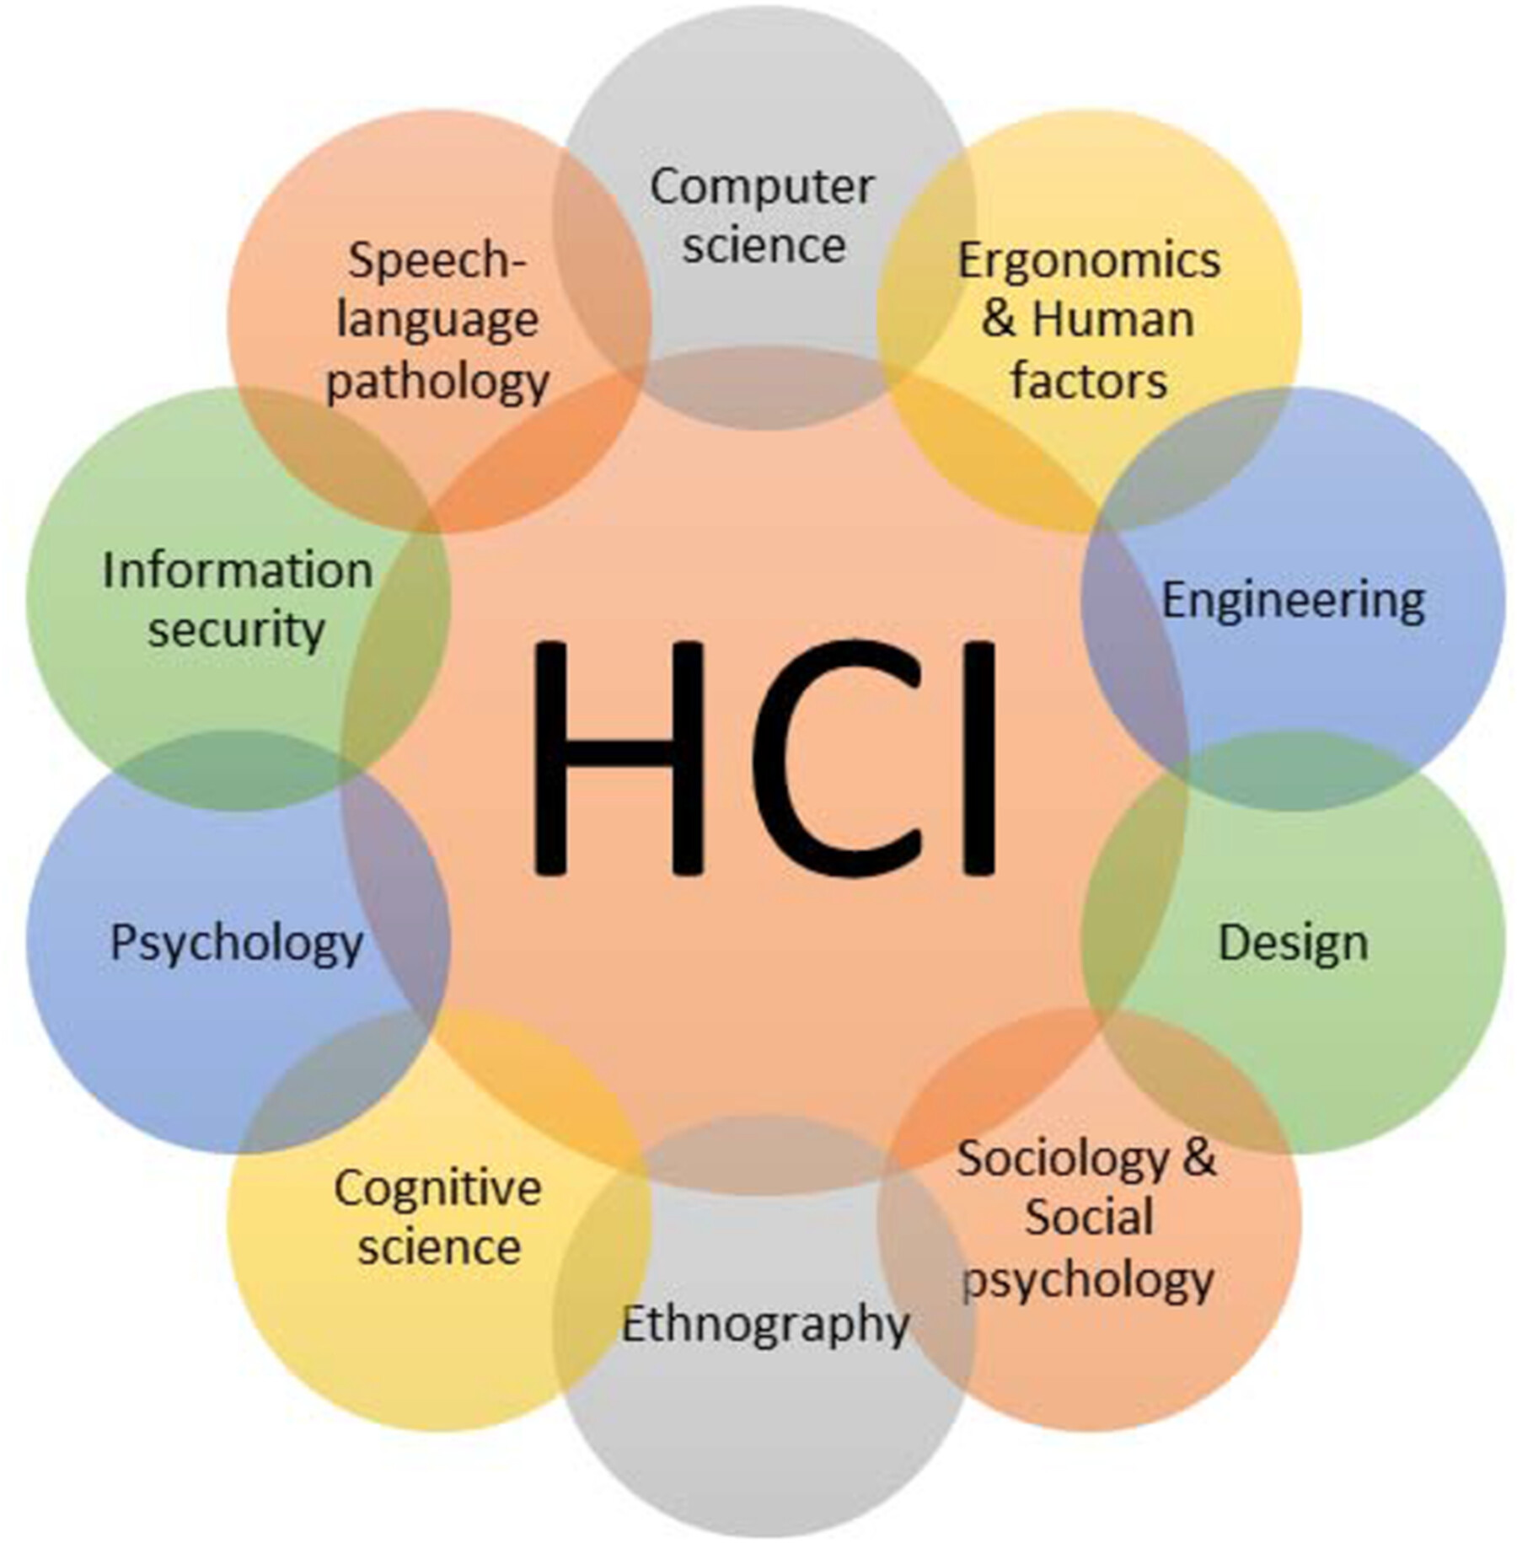
Chakraborty, Biplab & Sarma, Debajit & Bhuyan, Manas & MacDorman, Karl. (2017). A Review of Constraints on Vision-based Gesture Recognition for Human-Computer Interaction. IET Computer Vision. 12. 10.1049/iet-cvi.2017.0052.
Notes:
Interdisciplinary / multi-disciplinary

Slide 16
What is HCI
Human Computer Interaction (HCI) is the study of how people interact with computers and to what extent computers are or are not developed for successful interaction with human beings.
https://hcibook.com/

Slide 17
Goals of HCI
Produce usable and safe systems, as well as functional systems. In order to produce computer systems with good usability, developers must attempt to:
understand the factors that determine how people use technology
develop tools and techniques to enable building suitable systems
achieve efficient, effective, and safe interaction
put people first
https://hcibook.com/

Slide 18
Goals of HCI
Underlying the whole theme of HCI is the belief that people using a computer system should come first.
Their needs, capabilities and preferences for conducting various tasks should direct developers in the way that they design systems.
People should not have to change the way that they use a system in order to fit in with it
The system should be designed to match their requirements.
https://hcibook.com/

Slide 19
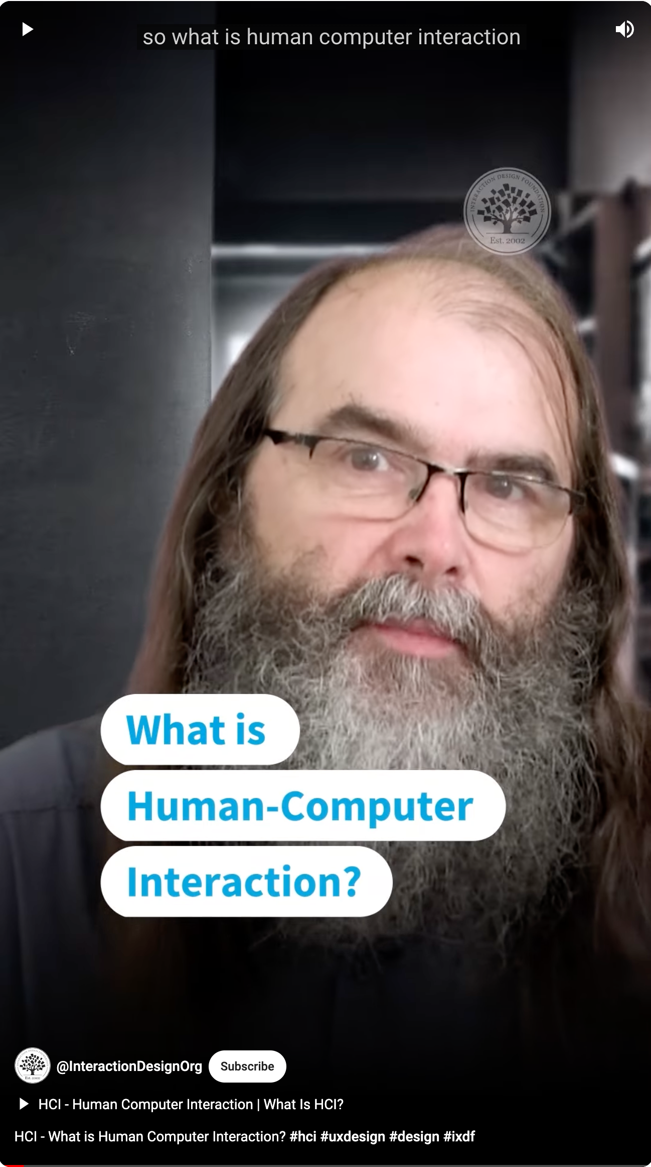
What is HCI?
Academic discipline (research)
developing empirical understandings of users,
theorising about design/users
HCI researchers
Applied discipline (practice)
industry-focused
building products or services
User experience designers, interaction designers
https://www.youtube.com/shorts/TlsTIreGR4g
https://www.youtube.com/watch?v=cK3YXzvfZIE
https://www.youtube.com/watch?v=yNzLBI0wsGU

Slide 20
Research
Methodology – How you do something
Disciplines have standard approaches
HCI – Multidisciplinary
Computer Science
Psychology
Information Science
Physiology
Anthropology
…….

Slide 21
Types of Research
Scientific Method
Hypothesis testing
Look to prove something is wrong
Assume “everything is the same” and reject that possibility
Action Research
Diagnose a problem
Intervention with analysis
Observational
See what people are doing
Good for suggesting research, weak for advice.

Slide 22
A Reminder of Some Terminology
Quantitative
Math/stats measurement of something.
Could be a numeric combination of subjective opinions.
Qualitative
Analysis of phenomena often with non-numerical observation, interviews, or other complex data.
Could include coding of language

Slide 23
Many dimensions within
Observational
Ethnographic Research
Embedded in the community
Observations
Grounded theory
Collect data before making assumptions
Let the data speak
Phenomenological
Interviews to find common themes
…..

Slide 24
Contributions
Empirical Research – experiments, observations
Artefact Contributions – actual new tools
Methodological Contributions – new ways to investigate
Theoretical Contributions – definitions, frameworks, principles, …
Datasets – rigorously collected/compiled corpora
Surveys – meta-analysis of existing research, new interpretations
Opinions – Reinterpretation of existing research
https://interactions.acm.org/archive/view/may-june-2016/research-contribution-in-human-computer-interaction https://dl-acm-org.helicon.vuw.ac.nz/doi/fullHtml/10.1145/2907069

Slide 25
Common HCI Research Themes
Understanding people
UX design and evaluation
Input/output methods
Visual design and visualization
Games
Learning
Ethics
AR/VR/XR experiences
Explainable AI
Health technologies
Wearable devices
Etc.

Slide 26
Class Representatives
Class Representative
https://www.youtube.com/watch?v=TdADUaxh-Qk
Learn more about it here and our Class Rep will need to submit the form online:
https://www.vuwsa.org.nz/class-representatives/
Class Rep Policy
https://www.wgtn.ac.nz/documents/policy/academic/class-representative-policy.pdf
And now for election time!

Slide 27
Further Reading
HCI Book: https://hcibook.com/
Usability Engineering: https://dl.acm.org/doi/10.5555/2821575
https://www.lri.fr/~mackay/pdffiles/DIS97.Triangulate.pdf
MacKenzie, I. S. (2012). Chapter 1- Historical Context. In Human-computer interaction: An empirical research perspective. Pp 1-26.
https://www.interaction-design.org/

