Slide 1
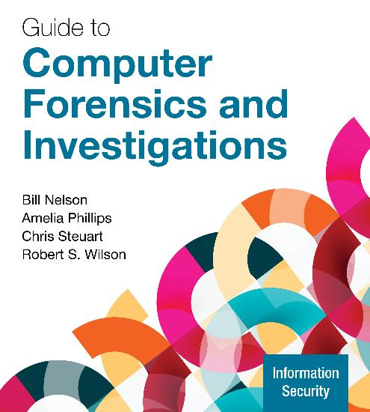
CYBR 472 Cybercrime investigation
Module: Email and Social Media Investigations
Week 9, 2025
Nelson/Phillips/Steuart/Wilson, Guide to Computer Forensics and Investigations, 7th Edition. ©2025 Cengage Learning, Inc. All Rights Reserved. May not be scanned, copied or duplicated, or posted to a publicly accessible website, in whole or in part.

Slide 2
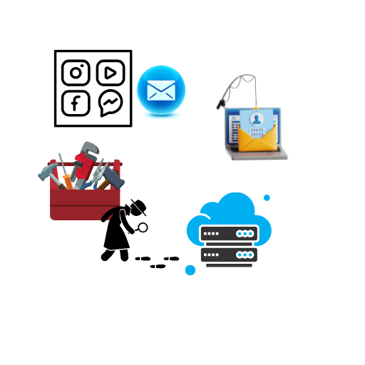
Learning Objectives
By the end of this module, you should be able to:
Explain role of email & social media in investigations
Describe client and server roles in email
Describe tasks in investigating email crimes and violations
Explain the use of email server logs
Describe some specialized email forensics tools
Explain how to apply digital forensics methods to investigate social media communications and channel-based messaging tools
Notes:
This module explains how to trace, recover, and analyze email messages by using both forensics tools designed for investigating email and general-purpose tools, such as disk editors. Email is a major means of communication, and email programs differ in how and where they store and track email. Some are installed separately from the operating system (OS) and require their own directories and information files on the local computer. Others take advantage of existing software, such as web browsers, and install no additional software on the client computer. In this module, you see how email programs on the server interact with email programs on the client, and vice versa. You also learn how to recover deleted email from a client computer, regardless of the email program used, and how to trace an email back to the sender. In addition, because many people communicate through social media sites, such as Facebook, Instagram, LinkedIn, Snapchat, and TikTok, this module also provides an overview of various social media platforms and applications and how they can be used to solve crimes.

Slide 3
Exploring the Role of Email in Investigations
Investigators need to know how to examine and interpret the unique content of email messages
Phishing emails contain links to text on a webpage
  The goal is to get personal information from the recipient
Pharming takes readers to a fake website
Spoofing occurs by changing header info to disguise the sender
Investigators can use the Enhanced/Extended Simple Mail Transfer Protocol (ESMTP) number in the message’s header to check for legitimacy of email (next slide)

Slide 4
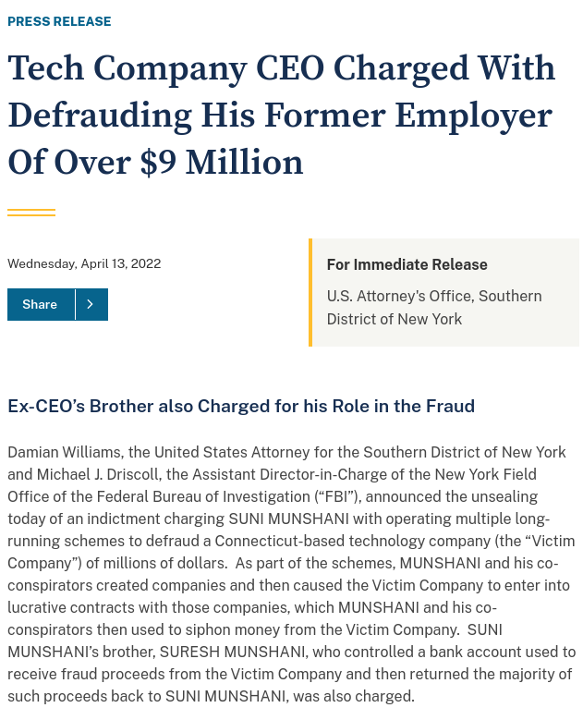
Example - Spoofing
Munshani calimed received email CEO of Signal Lake Venture Fund instructing him to buy of $25 million purchase options
Signal Lake Venture Fund denied this and said their email servers had no record of email
Munshani used text editor to alter previous email from the CEO
Enhanced/Extended Simple Mail Transfer Protocol (ESTMP) number added by email server was identifical for both emails
Notes:
A landmark lawsuit involving spoofing email occurred in February 2001 in the Superior Court of Massachusetts: Suni Munshani v. Signal Lake Venture Fund II, LP et al. Spoofing involves transmitting an email message with its header information altered so that its point of origin appears to be from a different sender. In this case, Suni Munshani claimed he received an email from the CEO of Signal Lake Venture Fund instructing him to purchase options (financial warrants) for a total of $25 million. Signal Lake Venture Fund investigated its email servers and didn’t find the email Munshani claimed he received.
In preparation for the trial, Signal Lake Venture Fund conducted a discovery demand for all of Munshani’s email. Because of the sensitive information he had on his email server, the court appointed an impartial discovery firm to examine the email. The firm found that Munshani had used a text editor to alter an email the CEO of Signal Lake Venture Fund had actually sent. The clue that the other email was a fake was the Enhanced/Extended Simple Mail Transfer Protocol (ESMTP) number in the message’s header, which is unique to each message an email server transmits. The email Munshani claimed was a legitimate message instructing him to purchase options had the same ESMTP value as the other message the CEO sent. This level of examination revealed that Munshani committed fraud. For more information on this case, see justice.gov/usao-sdny/pr/tech-company-ceo-charged-defrauding-his-former-employer-over-9-million.
Cannot have same number because incremented each time email sent.

Slide 5
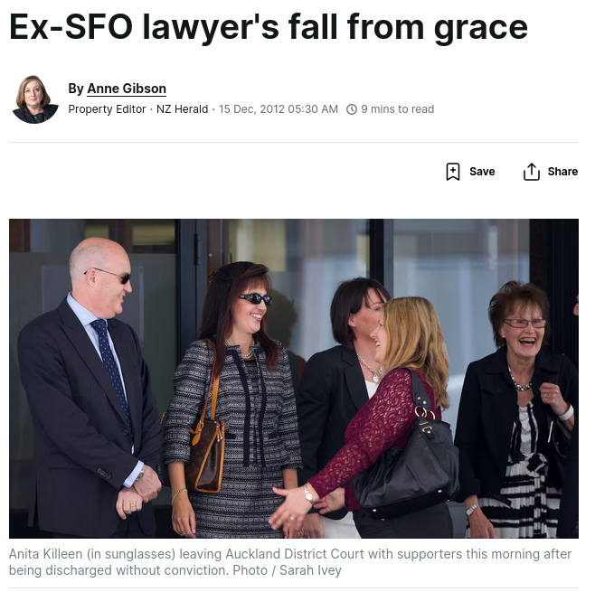
Example – Fake “leaked” email
Lawyer accused of send fake email to media to make ex-boss look bad.
Computer, cellphone data and ipad searched for keywords related to email.
Found had forwarded email to hotmail but no other evidence.
Guilt implied by analysis of email contents and similarity to her previous writing.
Cost of the digital forensics investigation $50k.
Notes:
BACKGROUND
Annita Killeen was the chief prosecutor for the Serious Fraud Office in 2010.
She lost her job in 2010 as part of a round of redundancies.
November 25 – facing three charges – relating to computer equipment and forged documents sent to the media in an apparent smear exchange against the man who made her redundant, SFO chief executive Adam Feely.
He was already facing negative publicity over the way he had celebrated the laying of criminal charges against Bridgecorp's now-jailed Rod Petricevic by drinking champagne belonging to Bridgecorp directors with his staff. The story was based on an email written by him and sent to staff saying it had been "a fantastic week" because of the prosecutions against Bridgecorp and other high-profile investigations, including one of Five Star Finance.
The Herald and the National Business Review received a copy of another email allegedly written by Feeley. It suggested he wanted to convene a meeting to toast an inevitable implementation of his draft organisation review. The implications were that the restructuring had been predetermined and was therefore unfair and prejudicial to the staff made redundant.
WHAT HAPPENED
Her computer was cloned, her cellphone data and iPad searched for particular phrases or words that appeared in the fake email.
Nothing was found, police said that they would search devices using software that could recover documents from web-based email systems.
It was noted she had sent a work email to her Hotmail accont on May 28, 2010.
Nothing was found but an expert engaged by PwC that the forged email was likely to be a composite of emails.
Judge found that it appeared she had altered the work email and sent it to the media.
She pleaded guilty to forgery and was discharged without conviction because judge accepted submissions that she suffered a rare psychological reaction to a fertility drug.

Slide 6
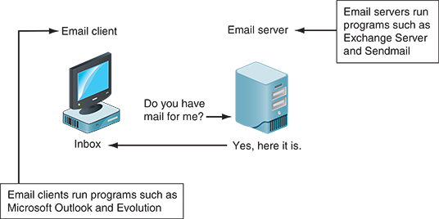
Exploring the Client and Server Roles in Email (1 of 2)
Messages distributed from a central server to many connected client computers is a configuration called client/server architecture
Protocols – POP, IMAP, SMTP, Exchange and HTTP/S(webmail)
Many companies are migrating their email services to the cloud, for example we use Microsoft Office Outlook provided as part of Microsoft 365

Slide 7
Exploring the Client and Server Roles in Email (2 of 2)
Email services differ in how client accounts are assigned, used and managed and how users access their emails
An intranet email system is specific to a company and typically uses a naming convention
  Corporate: jsmith@somecompany.com
  Public: itty_bitty@gmail.com
Tracing corporate emails is easier because accounts use standard names the administrator establishes and users
Private emails are harder because the user can manage their own usernames and control access to their mailboxes

Slide 8
Investigating Email Crimes and Violations
Goals when investigating email crimes should include the following:
  Find out who is behind the crime
  Collect the evidence
  Present your findings to build a case
Know the applicable laws relating to email
  Privacy Act (2020), Unsolicited Electronic Messages Act 2007 (UEMA), Crimes Act 1961 (s249, 250, 252), Search and Surveillance Act 2012, Harmful Digital Communications Act 2015 and Evidence Act 2006 (s135-138)
Notes:
New Zealand Laws for Email and Electronic Communications:
1. Privacy Act 2020
Governs collection, use, and disclosure of personal information
Applies to email content and metadata
Requires lawful purpose for collecting email data
Includes principles for storing and securing personal information
2. Unsolicited Electronic Messages Act 2007 (UEMA)
Prohibits unsolicited commercial electronic messages (spam)
Defines what constitutes consent for commercial emails
Sets penalties up to $500,000 for serious breaches
Applies to emails sent from or received in New Zealand
3. Crimes Act 1961 (relevant sections)
Section 249: Accessing computer system for dishonest purpose
Section 250: Damaging or interfering with computer system
Section 252: Accessing computer system without authorization
Criminal penalties for unauthorized email access or interception
4. Search and Surveillance Act 2012
Regulates how law enforcement can access electronic communications
Requires warrants for intercepting private communications
Sets rules for production orders for email records
Governs surveillance device warrants for monitoring communications
5. Harmful Digital Communications Act 2015
Addresses cyberbullying and online harassment via email
Defines "harmful digital communications"
Provides civil enforcement and criminal penalties
Established Netsafe as approved agency for complaints
6. Evidence Act 2006
Sections 135-138: Rules for admissibility of electronic records
Establishes requirements for authenticating electronic evidence
Covers business records and computer-generated evidence
Important for email evidence in court proceedings

Slide 9
Key Legal Points
Must comply with Privacy Act Principles
Law enforcement needs appropriate warrants
Companies should have clear email policies
Evidence must meet authentication requirements
International cooperation often needed for cross-border cases
Notes:
Must comply with Privacy Act principles "When investigating emails in New Zealand, we must follow the 13 Privacy Principles. This means only collecting email data for lawful purposes, ensuring it's relevant to the investigation, and protecting it from unauthorized access. Investigators need to balance their need for information with individuals' privacy rights."
Law enforcement needs appropriate warrants "Police and other agencies can't just access someone's emails freely. Under the Search and Surveillance Act, they need specific warrants - either a search warrant for stored emails or an interception warrant for real-time monitoring. Emergency provisions exist but require post-approval from a judge within 3 days."
Companies should have clear email policies "Organizations need written policies about email monitoring and investigation. These should explain when and how employee emails may be accessed, who can authorize searches, and what happens with findings. Clear policies help avoid privacy breaches and ensure investigations are legally defensible."
Evidence must meet authentication requirements "Email evidence needs proper authentication to be admissible in court. Under the Evidence Act, we must prove the email is genuine, hasn't been altered, and came from the claimed sender. This involves preserving metadata, maintaining chain of custody, and potentially using expert testimony to verify technical details."
International cooperation often needed for cross-border cases "Many email services are hosted overseas - Gmail in the US, for example. This requires working through Mutual Legal Assistance Treaties (MLATs) or direct cooperation with foreign law enforcement. The Budapest Convention on Cybercrime helps facilitate this cooperation, though the process can be time-consuming."

Slide 10
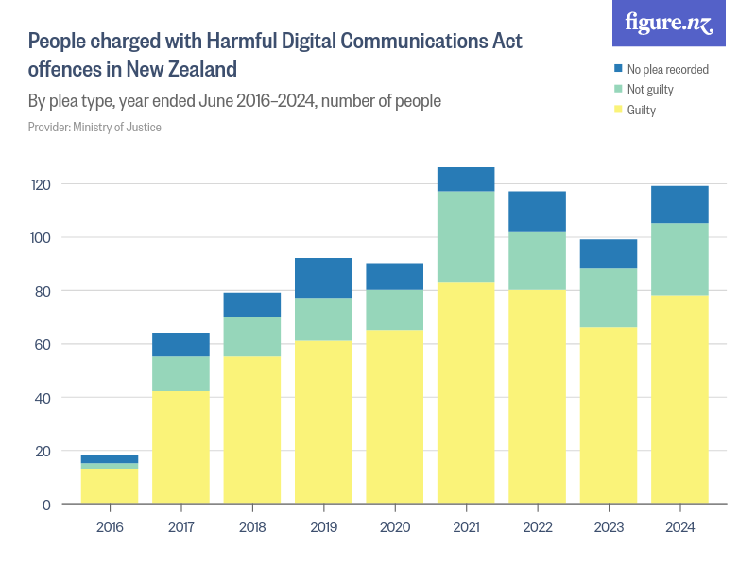
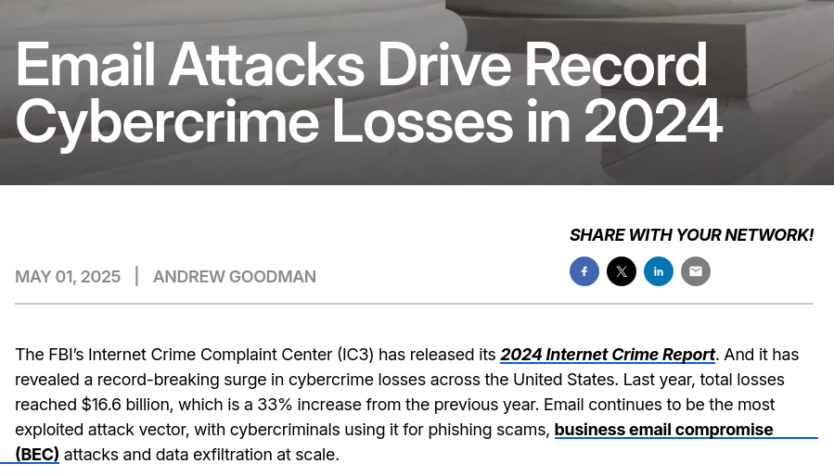
Role of Emails in Investigations
Communications linking suspect to crime or policy violation
Example crimes:
  Drug importation and similar cases
  Extortion
  Sexual harrassment
  Business email compromise
  ... Etc.
Notes:
Committing crimes with email is common, and investigations often find communications that link suspects to a crime or policy violation through email. For example, some people use email when committing crimes such as narcotics trafficking, extortion, sexual harassment, stalking, fraud, child abduction, terrorism, child pornography, and so on. Because email is a major communication medium, any crime or policy violation can involve email as well as text messages and social media communication.
Obviously also applies to other things like social media but email is still widely used.
https://www.proofpoint.com/us/blog/email-and-cloud-threats/email-attacks-drive-record-cybercrime-losses-2024

Slide 11
Understanding Forensic Linguistics
Forensic Linguistics is a field where language and law intersect
The field is divided into the following four categories:
  Language and law, language in the legal process, language as evidence, and research/teaching
It trains people to listen to voice recordings to determine who’s speaking or to read email to determine authenticity
Related to the concept of attribution of authorship in malware investigations etc.
Artificial intelligence (AI) may make it more difficult for forensics linguists to correctly identify the author of some emails
Notes:
In the article “How Forensic Linguistics Can Aid Investigations,” Liz Martinez explores what forensic linguistics can and can’t do (securityinfowatch.com/security-executives/article/12078050/how-forensic-linguistics-can-aid-investigations). What’s most important to know is that the field of forensic linguists is accepted in many courts around the globe as a valid science. A linguist can determine a speaker’s original dialect and sometimes even where a person is from based on phrases they use. Forensic linguistics has been used in some cases to determine whether a suicide note is authentic or has been faked, and it can be used to analyze text messages and social media communications, too. What forensic linguistics can’t do yet is determine an author’s veracity. Forensic linguistics encompasses civil cases, criminal cases, cyberterrorism cases, and other legal proceedings. In 2023, the median income for a forensic linguist is approximately U.S. $93,000 per year. There are several bachelor’s and master’s degrees in this field.
The NZ case touches on this, they looked at the emails to determine whether she may have written them herself.

Slide 12
Examining Email Messages
Access victim’s computer or mobile device to recover the evidence
Using the victim’s email client, find and copy any potential evidence
  Access protected or encrypted material and print emails
You need a warrant for a criminal investigation
You may need to guide the victim on the phone to open and copy email including headers
Headers include unique identifying numbers and other useful metadata
Revrse search engines can be used to investigate a given email address
Notes:
Once you have identified that a company violation or crime involving email has been committed your will need to access the emails.
Note you want to include the email header that contains unique identifying numbers such as the IP adress and the details of the server that sent the message.
For a corporate investigation check whether the compeny policy allows you access.
Earlier in this module, you read about the Munshani case, which was solved by an investigator examining an email header. As you probably know, an email consists of the header, the email, and the closing. The header contains the date and time, the sender, the recipient, the subject line, and information about the route the email took through email servers. In the Munshani case, the investigator was able to determine that the suspect email was fake because its ESMTP ID was identical to one used for another email that had been sent previously. UNIX servers assign unique codes to emails based on the precise date and time they are sent, so no two ESMTP IDs are the same. In addition, there was no record of the suspect email on the company’s email server.
Headers also tell us the route emails took through servers, this might help us determine who really sent the email or the sender’s location.

Slide 13
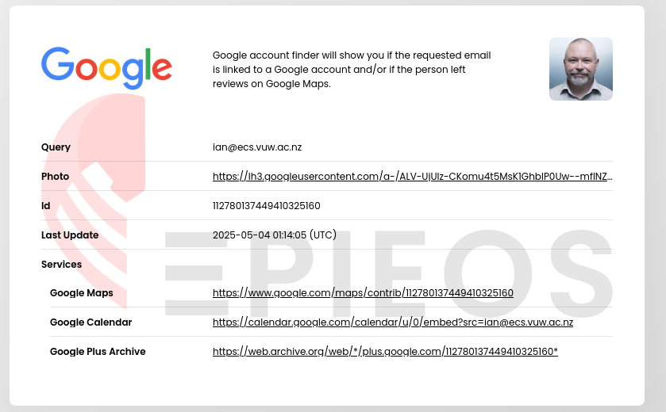
Reverse Email Lookup
Notes:
https://epieos.com/?r=1
A reverse email lookup is a process of finding information about a person or organization using their email address as the starting point.

Slide 14
Copying an Email Message
As part of an email investigation, you need to copy and print the email involved in the crime or policy violation
  You might also want to forward the message as an attachment to another email address
With many GUI email programs, you can copy an email by dragging it to a storage medium or by saving it in a different location
This is a very manual and time consuming approach, better to use a specialised forensic tool

Slide 15
Viewing Email Headers (1 of 2)
Investigators should learn how to find email headers
After you open email headers, copy and paste them into a text document so that you can read them with a text editor
Become familiar with as many email programs as possible
  Often more than one email program is installed
Each email program/webmail application will have its own way of viewing email headers, for example:
  Gmail – open “more” next to reply arrow, show original
  Yahoo – click three dot ellipsis and click view raw message

Slide 16
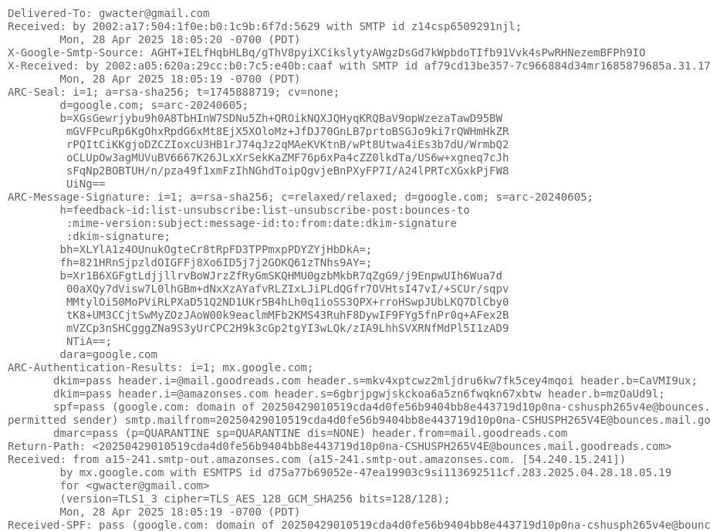
Viewing Email Headers (2 of 2)
GMAIL

Slide 17
Examining Email Headers (1 of 2)
Headers contain useful information
The main piece of information you’re looking for is the originating email’s domain or IP address
Other helpful information includes the following:
  Date and time the message was sent
  The file names of any attachments
  Unique message number (if it’s supplied)

Slide 18
Examining Email Headers (2 of 2)
1.Return-Path: <cr-superior@outlook.com>
2.Received: from NAM04-CO1-obe.outbound.protection.outlook.com (mail-oln040092010080.outbound.protection.out
(using TLSv1 with cipher AES256-SHA (256/256 bits))
(No client certificate requested)
by mtafw-aad05.mx.aol.com (Internet Inbound) with ESMTPS id 708E3700008C
for <b_aspen@aol.com>; Mon, 10 Jul 2017 18:33:12 -0400 (EDT)
3.DKIM-Signature: v=1; a=rsa-sha256; c=relaxed/relaxed; d=outlook.com;s=selector1; h=From:Date:Subject:Message-ID:Content-Type:MIME-Version;bh=1rZUozDUrSt47+58KxEkYZkL84z9Xa5pdHS+eLR66fc=;b=gaIykGSHrAUEF2RXwl1P99hjSSA++U4ov0ar6361aUQ0ng2y66ARHrNonxnEWhJ1tKgLXdgpUofKBmH5UTZjYdRJx4q26nZWYoF8o1bQ7h30Gby
4.Received: from SN1NAM04FT054.eop-NAM04.prod.protection.outlook.com(10.152.88.54) by SN1NAM04HT232.eop-NAM04.prod.protection.outlook.com(10.152.89.67) with Microsoft SMTP Server (version=TLS1_2,cipher=TLS_ECDHE_RSA_WITH_AES_256_CBC_SHA384_P384) id 15.1.1240.9; Mon, 10Jul 2017 22:33:04 +0000
5.Received: from DM3PR14MB1033.namprd14.prod.outlook.com (10.152.88.60) bySN1NAM04FT054.mail.protection.outlook.com (10.152.89.2) with Microsoft SMTPServer (version=TLS1_2, cipher=TLS_ECDHE_RSA_WITH_AES_128_CBC_SHA256_P256) id15.1.1240.9 via Frontend Transport; Mon, 10 Jul 2017 22:33:04 +0000
6.Received: from DM3PR14MB1033.namprd14.prod.outlook.com ([10.166.159.17]) byDM3PR14MB1033.namprd14.prod.outlook.com ([10.166.159.17]) with mapi id15.01.1240.020; Mon, 10 Jul 2017 22:33:03 +0000
Lines 1 and 2 - two servers email passed through
Line 3 - DKIM-Signature
Lines 4 through 6 - more servers
Notes:
The email header in Figure 13-3 supplies useful information. Lines 1 and 2 show two of the servers the message passed through. Line 3 shows “DKIM-Signature,” which stands for DomainKeys Identified Mail (dkim.org). It’s a way to verify the names of domains that a message is flowing through, and it was developed to help cut down on spam. Lines 4 through 6 show other servers the message passed through. Typically, these lines are followed by the From, To, Subject, and Date fields in the email.
If there were an attachment, it would be listed in a later line. An attachment can be any type of file, from a program to a picture. If a message includes an attachment, investigate it as a supporting piece of evidence. If you’re working with the victim, the attachment will likely still be attached to the email. If you’re investigating a suspect’s computer, remember to work with the copied version of the email. On a suspect’s computer or a forensic image, search for the attached file with a forensics tool or the OS’s Search or Find feature to determine whether the file was saved and still exists on the drive. If you’re investigating an email attachment with an unfamiliar file extension, such as .mdf, you can search the Internet to find out what program creates a file of this type.

Slide 19
Examining Additional Email Files
Email messages are saved on the client computer or left on the server
Microsoft Outlook uses .pst and .ost files
Most email programs also include an electronic address book, calendar, task list, and memos
In web-based email, messages are displayed and saved as webpages in the browser’s cache folders
  Many web-based email providers also offer instant messaging (IM) services but those messages may not be saved
You may have to search the pagefile.sys to find message fragments

Slide 20
Tracing an Email Message
Determining message origin is referred to as “tracing”
Contact the administrator responsible for the sending server
  You can use a registry site to find the point of contact:
    www.arin.net
    www.internic.com
    www.google.com
Verify your findings by checking network email logs against email addresses
Large organisations may hide administrator details
Notes:
As part of an investigation, you may need to determine an email’s origin by further examining the header with one of many free Internet tools. Determining message origin is referred to as “tracing.” In this section, you learn about some Internet lookup tools that can be used to trace where an email originated.
For example, if a company is listed in an email address, you can visit the company’s site to find out who administers the domain. If the point of contact isn’t listed on the website or the domain doesn’t have a website, you need to use a registry site, such as one of the following, to determine the point of contact:
arin.net—Use the American Registry for Internet Numbers (ARIN) to map an IP address to a domain name and find the domain’s point of contact.
internic.com—As with arin.net, you use this site to find a domain’s IP address and point of contact.
Whois.net—This site allows you to look up when a site was registered, who the registered contact is, and the IP address.
Note that large organisations such as mi
Using one of these websites, you should be able to find the suspect’s full email address, such as jim.shu@superiorbicycles.biz, and contact information. Keep in mind that the suspect might have posted false information, so verify your findings by checking network email logs against email addresses, as described in the next section. You can also use a search engine to look for more information and additional postings on discussion boards.

Slide 21
Tracing an Email Message
Consider DM3PR14MB1033.namprd14.prod.outlook.com
This is a hostname, so use outlook.com
host –t MX outlook.com will reveal mailserver hostname
dig TXT _dmarc.outlook.com will tell us about the Domain-based Authentication Reporting & Conformance information
  _dmarc.outlook.com. 300 IN TXT "v=DMARC1; p=none; sp=quarantine; pct=100; rua=mailto:rua@dmarc.microsoft; ruf=mailto:ruf@dmarc.microsoft; fo=1"
Notes:
This is a DMARC (Domain-based Message Authentication, Reporting & Conformance) DNS TXT record for outlook.com. Let me break down what each part means:
_dmarc.outlook.com. - The DNS record name that indicates this is a DMARC policy
300 - TTL (Time To Live) in seconds - how long DNS resolvers should cache this record
IN - Internet class (standard for most DNS records)
TXT - Record type (text record)
"v=DMARC1; p=none; sp=quarantine; pct=100; rua=mailto
@dmarc.microsoft; ruf=mailto
@dmarc.microsoft; fo=1" - The DMARC policy itself
Breaking down the DMARC policy components:
v=DMARC1 - Version identifier (DMARC version 1)
p=none - Policy for the main domain (outlook.com) - "none" means monitor only, don't reject or quarantine
sp=quarantine - Policy for subdomains - emails failing DMARC checks should be quarantined
pct=100 - Apply the policy to 100% of messages
rua=mailto:rua@dmarc.microsoft - Send aggregate reports to this email address
ruf=mailto:ruf@dmarc.microsoft - Send forensic (failure) reports to this email address
fo=1 - Generate forensic reports if any authentication mechanism fails (SPF or DKIM)

Slide 22
Using Network Email Logs (1 of 2)
Router logs record all incoming and outgoing traffic
  Use these logs to determine the path a transmitted email has taken
Firewalls filter email traffic
  Firewalls logs track Internet traffic destined for other networks
  Use these logs to verify whether the email passed through the firewall
You can use text editors or specialized tools to view logs
Notes:
You can use network logs for more information that will help track emails.
In particular, did the email come from an internal or external source.
Network administrator can provide these logs.

Slide 23
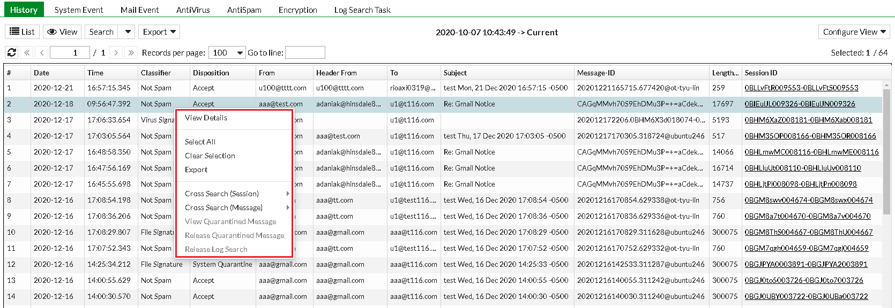
Using Network Email Logs (2 of 2)
Example of Fortigate email logs
Notes:
The Log submenu includes the following tabs, one for each log type:
History: Where you can view the log of sent and undelivered SMTP email messages.
System Event: Where you can view the log of administrator activities and system events.
Mail Event: Where you can view the log of normal email delivery activities.
AntiVirus: Where you can view the log of email detected as infected by a virus.
AntiSpam: Where you can view the log of email detected as spam.
Encryption: Where you can view the log of IBE encryption. For more information about using IBE, see .
Log Search Task: Where you can configure and view the log results of advanced searches. For more information, see .

Slide 24
Understanding Email Servers and Server Logs (1 of 2)
An email server contains software that uses email protocols for its services and maintains logs you can examine and use in your investigation
Some email servers use databases that store users’ emails, and others use a flat file system
Some servers are set up to log email transactions by default; others have to be configured to do so
Administrators usually set email servers to continuous logging mode
Notes:
Although administrators do usual set servers to continous logging mode – an issue to be aware of is log rotations, to save space only a certain number of days are kept on the server, good practice is to remove the older logs and back them up to some alternate long term storage location. This means though that the investigation will require extra time to restore these.

Slide 25
Understanding Email Servers and Server Logs (2 of 2)
Email logs generally identify the following:
  Email messages an account received
  Sending IP address
  Date and time the server received the email and when the client computer accessed the email
  Email contents and system-specific information
After identifying the source of the email, contact the suspect’s network email administrator as soon as possible
  Copies of client’s emails might also be recorded even if deleted
Notes:
When containing suspect’s network email administrator be aware that if they are an email provider such as an ISP, that they may not keep keep logs for more than 30 days this is because they deal with much larger volumes of traffic compared to a single organisation.
In addition to logging email traffic, email servers maintain copies of clients’ email, even if the users have deleted messages from their inboxes. Some email servers don’t completely delete messages until the system is backed up. Sometimes the email administrator can recover deleted email without restoring the entire email server, but some email servers require recovering the entire server to retrieve one deleted message.

Slide 26
Examining UNIX/Linux Email Server Logs (1 of 2)
Common UNIX email servers: Postfix and Sendmail
Both handle SMTP email routing and delivery
Both use /etc/syslog.conf for configuration to control what and where events are logged
The configuration file for Sendmail is /etc/sendmail.cf
Postfix has two configuration files
  master. cf and main.cf (found in /etc/postfix)
Notes:
There are dozens of email server progams but postfix and sendmail are the most common.
Postfix was designed as a secure replacement for sendmail which has become a legacy system although its was roughly 50-50 until the early 2000s with postfix increasing share since 2010s.

Slide 27
Examining UNIX/Linux Email Server Logs (2 of 2)
/var/log/maillog records SMTP, POP3, and IMAP4 communications
  Contains an IP address and time stamp that you can compare with the header of the email the victim received
Default location for storing log files is /var/log
  An administrator can change the log location
  Use the find or locate command to find them
Check UNIX man pages for more information

Slide 28
Examining Microsoft Email Server Logs (1 of 3)
Microsoft Exchange Server (generally called Exchange)
  It uses an Exchange database and is based on the Microsoft Extensible Storage Engine (ESE)
In older versions of Exchange, useful files in an investigation were .edb database files and checkpoint files
To retrieve Exchange logs, use the following PowerShell script:
  GetTransactionLogStats.psl -Gather

Slide 29
Examining Microsoft Email Server Logs (2 of 3)
Exchange servers can also maintain a log called tracking.log that tracks messages
  If the Message Tracking feature has been enabled and the email administrator selects verbose (detailed) logging, you can see the timestamp, IP address of the sending computer, and the email’s contents or body
Another log used for troubleshooting and investigating the Exchange environment is the troubleshooting log
  Use Windows Event Viewer to view this log

Slide 30
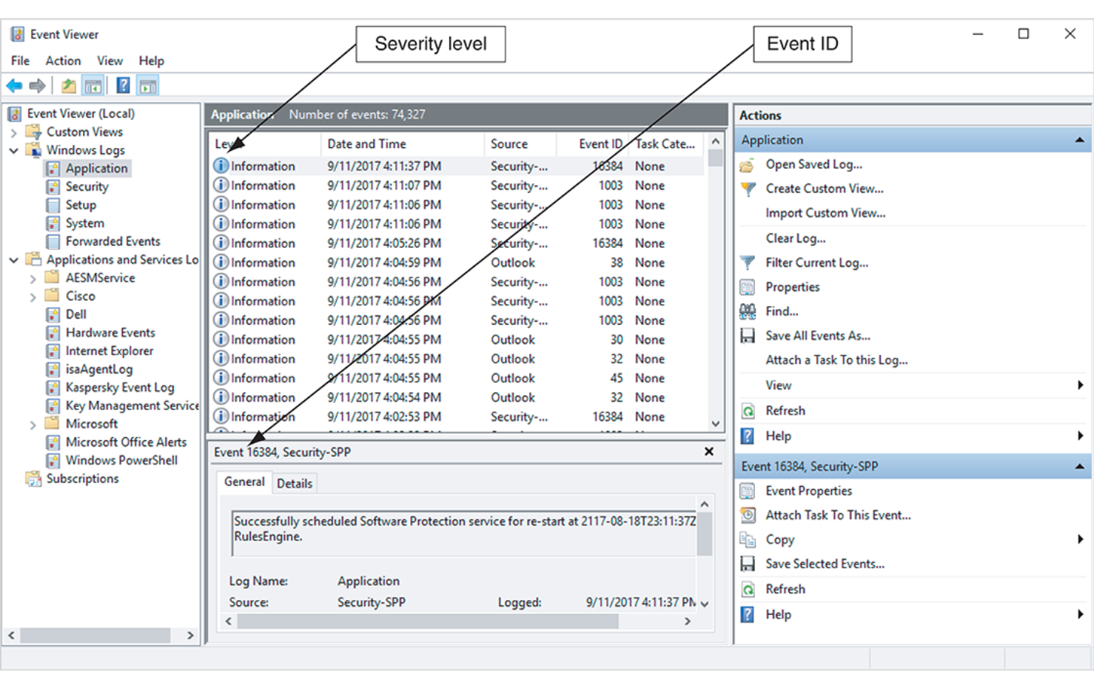
Examining Microsoft Email Server Logs (3 of 3)
Viewing a log in Event Viewer
Notes:
An Event Viewer window. It lists the options of the applications under Windows logs. The application field has a table with five columns titled level, date and time, source, event I D, and task. The level field with its corresponding event and security I P P is highlighted by arrows. The action field is on the right, with the highlighted application and event 16384 security S P P. The general field is at the bottom of the window and includes the log name, source, and logged.

Slide 31
Using Specialized Email Forensics Tools (1 of 3)
Some useful email recovery tools include the following:
  DataNumen for Outlook and Outlook Express
  FINALeMAIL for Outlook Express and Eudora
  Sawmill-Novell GroupWise for log analysis
  MailXaminer for multiple email formats and large data sets
  Fookes Aid4Mail and MailBag Assistant
  Paraben Email Examiner
  Exterro FTK for Outlook and Outlook Express

Slide 32
Using Specialized Email Forensics Tools (2 of 3)
Forensics tools enable you to find the following:
  Email database files
  Personal email files
  Offline storage files
  Log files
An advantage of using data recovery tools:
  You don’t need to know how email servers and clients work to extract data from them

Slide 33
Using Specialized Email Forensics Tools (3 of 3)
After you compare email logs with messages, you should verify the following information:
  Email account, message ID, IP address, and date and time stamp to determine whether there’s enough evidence for a warrant
  Evidence that probable cause crime was committed, evidence links suspect to the crime, justification for seizing suspect’s computer equipment
Document the methods and tools used to make copies of emails so it can be repeated by others
Some tools provide useful time saving funcions like bulk restoration of deleted emails
Notes:
In the context of digital forensics, this passage describes the process of validating email evidence before taking legal action. Let me break down what this means:
Email Log Comparison Process:
Investigators examine email server logs (from Sendmail, Postfix, or other MTAs)
They compare these logs with actual email messages collected as evidence
They're looking for consistency between what the logs show and what the messages contain
Key Elements to Verify:
Email Account:
Confirm sender/recipient addresses match between logs and messages
Verify the account actually exists on the server
Check for spoofed or forged email addresses
Message ID:
Unique identifier for each email (found in headers)
Must match between server logs and email headers
Helps track the email's path through servers
IP Address:
Source IP where the email originated
Intermediate server IPs in the delivery chain
Can help identify the actual sender's location
Date and Timestamp:
When the email was sent, received, and processed
Must be consistent across logs and message headers
Critical for establishing timeline of events
Forensic Purpose: This verification process serves to:
Establish authenticity of the email evidence
Create a chain of custody for the digital evidence
Build probable cause for a search warrant
Ensure the evidence will be admissible in court
Legal Threshold: The investigator must determine if this verified evidence provides:
Probable cause that a crime was committed
Evidence linking the suspect to the crime
Justification for seizing the suspect's computer equipment
Next Steps (if warrant threshold is met):
Prepare warrant application with verified evidence
Obtain judicial approval for the warrant
Serve the warrant and seize equipment
Conduct forensic analysis of seized devices

Slide 34
Using a Hex Editor to Carve Email Messages
Few vendors have products for analyzing email in systems other than Microsoft
Common formats are:
  Multipurpose Internet Mail Extensions (MIME) format
    Used by vendor-unique email file systems, such as Microsoft .pst or .ost
    mbox format stores emails in flat plaintext files
In these cases you might use a hex editor to carve emails out of existing files

Slide 35
Recovering Outlook Files
A forensics examiner recovering email messages from Outlook may need to reconstruct .pst files and messages
With many advanced forensics tools, deleted .pst files can be partially or completely recovered
You might need to repair the files first though before you can do this
The scanpst.exe recovery tool comes with Microsoft Office
  It can repair .ost files as well as .pst files

Slide 36
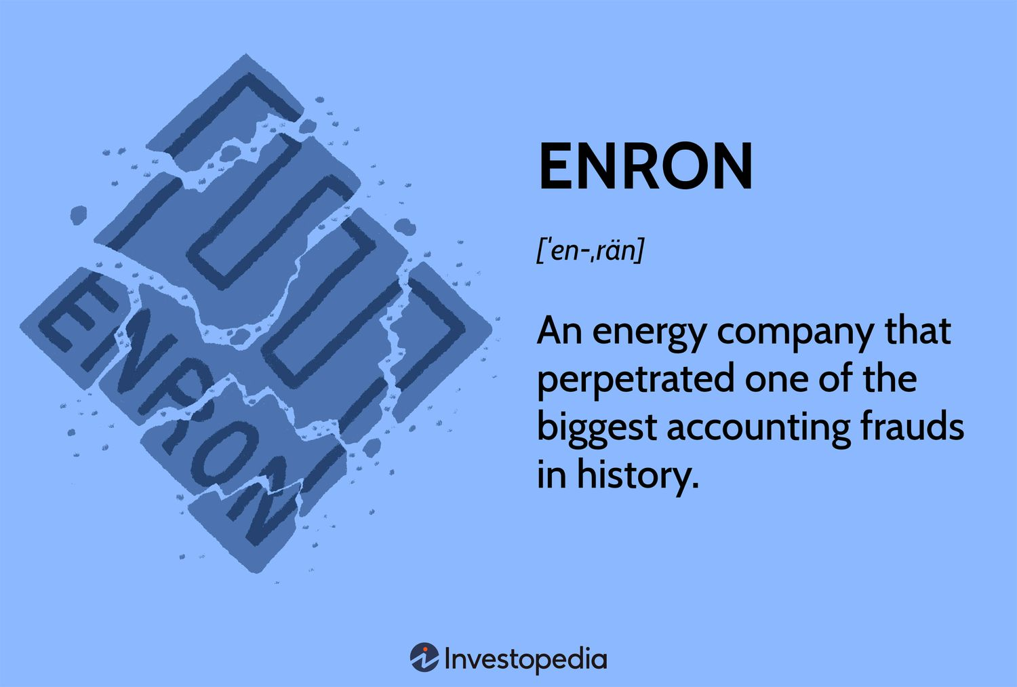

Case Study: Enron
Enron was energy company became subject of one of the largest accounting frauds in US history
Bankruptcy of $63.4 billion
Fradulant accounting practices to inflate revenues and hide debt
Executives held responsible but many others implicated including the big four firm Arthur Andersen (founded 1913)
Notes:
One major and very well-publicized case involving corporate email is the Enron case, which required retrieving thousands of emails as part of the discovery process at a time when few policies for collecting this information existed. When the Electronic Discovery Reference Model (EDRM; www.edrm.net) group acquired the right to store and distribute these emails for research purposes, it discovered how much personally identifiable information they contained. Another company worked with the EDRM to correct the problem by removing the personal information. In the end, more than 10,000 emails were collected

Slide 37

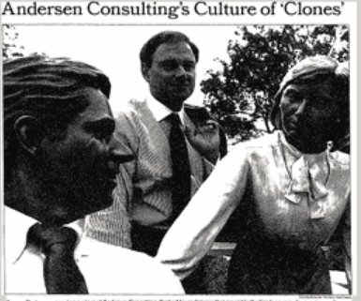
Case Study: Enron
Two tonnes of paper documents were shredded, 30,000 e-mails and computer files deleted as part of a coordinated coverup
  Some shredded files reconstructed
  Deleted emails and files recovered from backup
Claimed it was part of document rentention policy
Company collapsed around mid-2002
Notes:
One major and very well-publicized case involving corporate email is the Enron case, which required retrieving thousands of emails as part of the discovery process at a time when few policies for collecting this information existed. When the Electronic Discovery Reference Model (EDRM; www.edrm.net) group acquired the right to store and distribute these emails for research purposes, it discovered how much personally identifiable information they contained. Another company worked with the EDRM to correct the problem by removing the personal information. In the end, more than 10,000 emails were collected

Slide 38
Email Case Studies
In the Enron Case, more than 10,000 emails contained the following personal information:
  60 containing credit card numbers
  572 containing thousands of Social Security or other identity numbers
  292 containing birth dates
  532 containing information of a highly personal nature
    Such as medical or legal matters
Notes:
One major and very well-publicized case involving corporate email is the Enron case, which required retrieving thousands of emails as part of the discovery process at a time when few policies for collecting this information existed. When the Electronic Discovery Reference Model (EDRM; www.edrm.net) group acquired the right to store and distribute these emails for research purposes, it discovered how much personally identifiable information they contained. Another company worked with the EDRM to correct the problem by removing the personal information. In the end, more than 10,000 emails were collected.
As a regular part of doing business, Enron employees sent internal emails with spreadsheet attachments containing personal information about employees and customers. Now, spreadsheets are typically password-protected or encrypted, but these documents were not protected in any way.

Slide 39
Applying Digital Forensics Methods to Social Media Communications and Channel-Based Messaging Tools (1 of 2)
A social media platform is an online service that provides a virtual environment where people can create and share text, pictures, and videos
The types of information that can be found on social media includes:
  Evidence of cyberbullying and witness tampering
  A company’s position on an issue
  Whether intellectual property rights have been violated
  Who posted information and when
Notes:
The number of cases involving social media has continued to grow over the years, and social media evidence is often used to substantiate one party’s claims. For example, in an early intellectual property case involving social media, evidence gathered from the public side of an employee’s LinkedIn profile showed that she had copied thousands of records from her company laptop to a USB drive and started working at a competing company before quitting her job (“Elephant in the Room: Case Studies of Social Media in Civil and Criminal Cases,” Mark Lanterman, blog.x1discovery.com/2014/06/10/elephant-in-the-room-case-studies-of-social-media-in-civil-and-criminal-cases). In his article on social media forensics (http://mashable.com/2012/02/13/social-media-forensics),

Slide 40
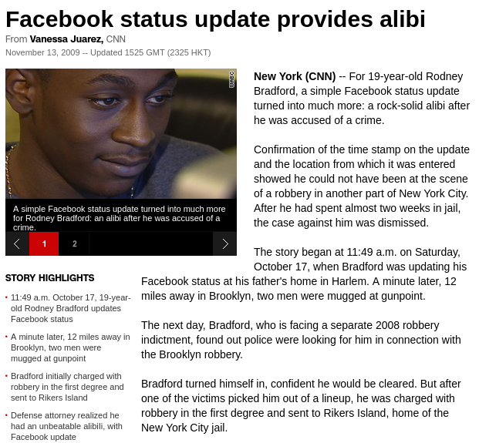
Applying Digital Forensics Methods to Social Media Communications and Channel-Based Messaging Tools (2 of 2)
Social media can often substantiate a party’s claims
Widely used by law enforcement groups in the US (88%) to find evidence of crimes and suspects
Authenticating the media post can be done by the company
Authenticating that the post is really by the person who it claims to be is complicated especially given fake news
Notes:
Todd Piett noted that 88% of the law enforcement groups surveyed use social media as a tool for doing background checks, corroborating data, verifying alibis, and finding suspects and witnesses. For example, in one case, a 19-year-old was accused of a crime, but police were able to use his Facebook posts as proof he was somewhere else when the crime occurred (edition.cnn.com/2009/CRIME/11/12/facebook.alibi/index.html).
A challenge with using social media data in court is authenticating the author and the information. In this age of accusations of “fake news,” investigators must be careful to verify their data.
In “Authentication of Social Media Evidence: 2 Cases to Know” (law360.com/articles/897947/authentication-of-social-media-evidence-2-cases-to-know), Beth Rose examines what constitutes “discoverable” versus “admissible” by examining the case U.S. v. Brown, in which the prosecutor presented enough circumstantial evidence to prove that Facebook chats had been written by the defendant. The defendant claimed the chats couldn’t be authenticated and, therefore, couldn’t be used in court. However, Facebook could authenticate that the chats had taken place and gave a certificate of authenticity, as it was a normal business record. In addition, the other people involved in the case (who were minors) could testify as to the content of the chats and state they had met the defendant in person. Four of the five chats were allowed as admissible in court. Things have not changed that much in the last decade, although one of the newer issues that has emerged is the recording of crimes and posting them onto various social media platforms. And now police have body cams that become public record.

Slide 41
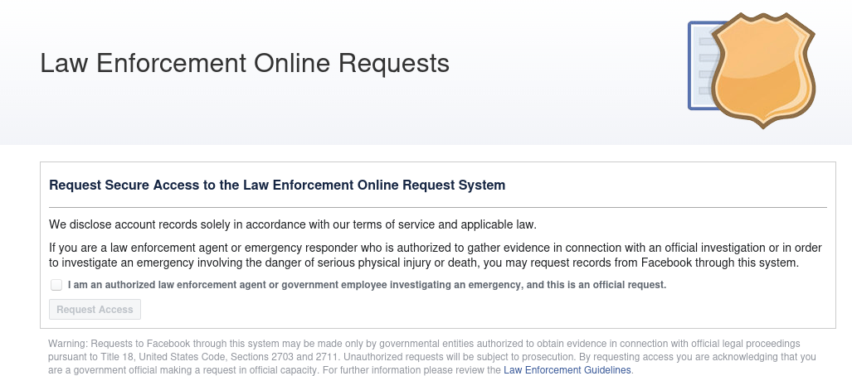
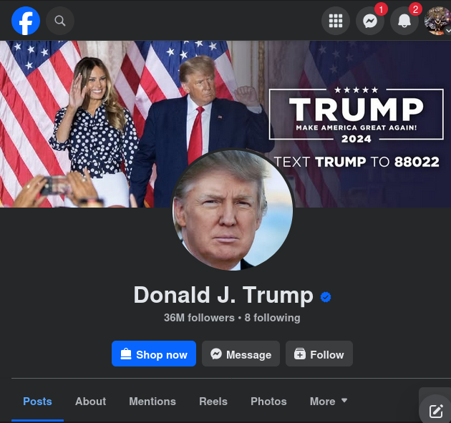
Example – Facebook (US)
Neoprint data – contact info, status update history, mini-feed, wall posts, notes, shares, friendslist, groups, events, videos.
Photoprint data – all photos uploaded by user or where they are tagged that have not been deleted
Basic subscriber – user ID number, email address, date and time account creation, IP address, recent logines and mobile phone number
Phone data – GPS, Facebook can ping the app on your phone
Notes:
https://warrantbuilder.com/facebook-search-warrants/

Slide 42
Example – Facebook (NZ)
Process: (1) search warrant through Search & Surveillance, (2) Mutual Legal Assistance relied upon, (3) Wait several months to years.
Can request same data categories but there are some requirements:
  “reasonable grounds”
  Offence must be punishable by imprisonment
  Approval from NZ courts AND foreign jurisdiction
  Subject to US privacy laws first
Notes:
Legal Framework & Process
Key Legislation
Search and Surveillance Act 2012 - Primary authority for search powers
Mutual Assistance in Criminal Matters Act 1992 (MACMA) - International cooperation
Privacy Act 2020 - Protects personal information rights
Process for NZ Law Enforcement
Must obtain search warrant through New Zealand courts under Search & Surveillance Act
For Facebook/Meta data, must use MACMA process for international assistance
Requests processed through MLAT (Mutual Legal Assistance Treaty) channels
Average response time: Several months to over a year
Key Differences from US System
No direct access to Meta's Law Enforcement Portal
Must go through formal diplomatic channels (MACMA)
Significantly longer processing times
Higher legal threshold required
Evidence Collection & Limitations
What NZ Police Can Request
Same Data Categories Available
Basic Subscriber Information
Neoprint & Photoprint data
IP logs and access records
Location data from mobile app
MACMA Requirements
Must show "reasonable grounds" under S&S Act 2012
Offence must be punishable by imprisonment
Must demonstrate necessity for investigation
Requires approval from NZ courts AND foreign jurisdiction
Challenges for NZ Law Enforcement
Process Limitations
No direct submission to Meta's portal
Extended timeframes (6-12+ months typical)
Multiple approval layers required
Limited ability to obtain emergency disclosures
Technical Considerations
Same identification requirements (User ID, not vanity name)
Must document last active date
Currency conversion issues for paid content
Time zone differences in logs
Meta's New Zealand Presence
No local data storage requirement
All requests processed through US systems
Limited local representation
Subject to US privacy laws first

Slide 43
Social Media Forensics on Mobile Devices
The majority of social media clients use mobile devices to access channels
Evidence artifacts vary depending on the social media channel and the device
Forensics analysis shows that iPhone and Android devices yielded the most information, and much of the data was stored in SQLite databases
Encryption is a barrier with modern smarphones requiring correct passcode/PIN
Biometrics additional complication of extra layer of security
Autodeletion of messages means time pressure on collection
Arms race between smartphone manufacters and companies such as Cellibrite

Slide 44
What can police officers ask for
Police in New Zealand
  Court (Dotcom v Attorney-General 2014) suggest passwords might be protected by privilege
  Can ask nicely and apply to court on case-by-case basis and document refusals for court consideration
Other jurisdictions
  UK can compel passwords (up to 5 years prison)
  Australia compel with penalties for refusal
  US divided on this matter and Canada similar to NZ

Slide 45
What can customs officers ask for
Customs and Excise Act 2018 – section 228
  Customes can require travellers to provide passwords/access
  Applies to phones, laptops, tablet and storage devices
  No warrant required and lower “reasonable suspicion” threshold
  Fine up to $5,000 for refusing access
  Potential arrest for obstruction

Slide 46
Forensics Tools for Social Media Investigations
Software for social media forensics continues to be developed
  Not many tools are available now
There are questions about how the information these tools gather can be used in court or in arbitration
Using social media forensics software might also require getting the permission of the people whose information is being examined
You need a warrant or subpoena to ask a social media site to produce its records

Slide 47
Investigating Channel-Based Messaging Tools
Slack is a communications tool that allows groups and companies to set up private and public discussion channels
Another popular social chat platform is Discord
There was a recent case involving a young National Guardsmen who used Discord to distribute classified documents
Tools such as Magnet Axiom can be used by corporate investigators to perform investigations on some of these platforms
  More tools will certainly become available over time

Slide 48
Summary
Now that the lesson has ended, you should be able to:
Explain the role of email and social media in investigations
Describe client and server roles in email
Describe tasks in investigating email crimes and violations
Explain the use of email server logs
Describe some specialized email forensics tools
Explain how to apply digital forensics methods to investigating social media communications and channel-based messaging tools

