Slide 1
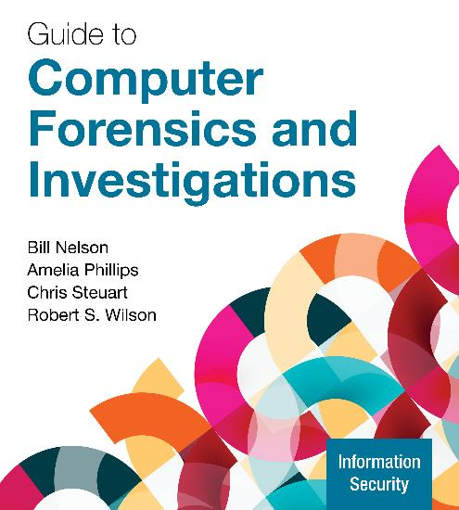
Guide to Computer Forensics and Investigations, 7e
Week 6: Working with Microsoft File Systems and the Windows Registry
Nelson/Phillips/Steuart/Wilson, Guide to Computer Forensics and Investigations, 7th Edition. ©2025 Cengage Learning, Inc. All Rights Reserved. May not be scanned, copied or duplicated, or posted to a publicly accessible website, in whole or in part.
Notes:
Welcome to Week 5 of our Cybercrime Investigations course
Today we'll be covering Microsoft File Systems and the Windows Registry
These concepts are fundamental to digital forensic investigations involving Windows systems

Slide 2
Microsoft File Systems & Windows Registry
By the end of this module, you should be able to:
Explain the purpose and structure of file systems
Describe Microsoft file structures
Explain the structure of FAT disks
Explain the structure of NTFS disks
Describe whole disk encryption
Explain how the Windows Registry works
Identify Windows artifacts

Slide 3
What is a File System?

Slide 4
Introduction to File Systems
A file is a collection of related information
File systems reside on secondary storage
Provides efficient and convenient access to disks
Allows data to be stored, located, and retrieved
Critical aspect affecting performance, reliability, and security
Examples: NTFS, FAT (Windows), ext4, XFS (Linux)
Notes:
A file is a collection of related information
File systems reside on secondary storage
Provides efficient and convenient access to disks
Allows data to be stored, located, and retrieved
Critical aspect affecting performance, reliability, and security
Examples: NTFS, FAT (Windows), ext4, XFS (Linux)

Slide 5
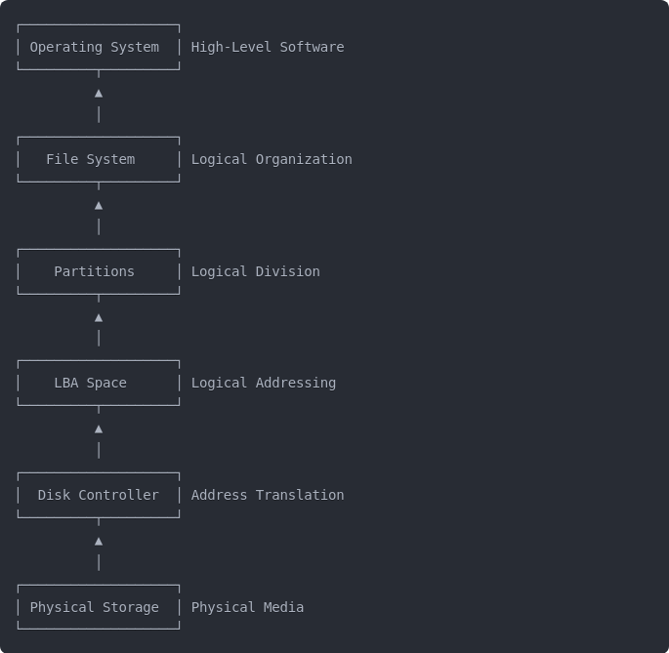
Understanding File Systems
Notes:
The boot process traverses multiple layers of abstraction, and understanding these layers helps clarify how everything fits together. At the lowest level, we have the physical storage media - the actual magnetic platters, NAND cells, or other physical technology. The disk controller plays a crucial role as the translator between the physical world and logical addressing. It abstracts away the physical geometry of the storage device, handling sector remapping, error correction, and translating logical requests into physical operations. Above the controller is the LBA (Logical Block Addressing) space, which creates a linear addressing scheme that the rest of the system can work with. Partitions divide this LBA space into logical sections. Each partition can contain a file system that organizes data into files and directories. Finally, the operating system sits at the top, working primarily with files rather than directly with blocks or physical locations. The boot process is remarkable because it must navigate upward through these layers, starting with almost no context and gradually building enough structure to eventually load the operating system. The controller's initialization in the earliest boot phase is essential - without it functioning properly, the system cannot access any data on the storage device.

Slide 6
Understanding File Systems
A file system provides an OS a road map to data on a disk
The type of file system an OS uses determines how data is stored on the disk
When you need to access a suspect’s computer to acquire or inspect data, you should be familiar with both the computer’s OS and file systems
Notes:
File systems are roadmaps that help the operating system locate data on storage devices. Without understanding file systems, you cannot reliably recover deleted files, identify tampering, or establish timelines of digital activity. Different operating systems use different file systems, which organize data in unique ways that affect forensic analysis. When conducting investigations, you must understand both the target computer's OS and its file systems to properly acquire and analyze data without risking corruption or misinterpretation.
EXAMPLE: When investigating data theft, understanding NTFS metadata helps determine exactly when files were copied to USB drives

Slide 7
2. Understanding Disk Drives

Slide 8
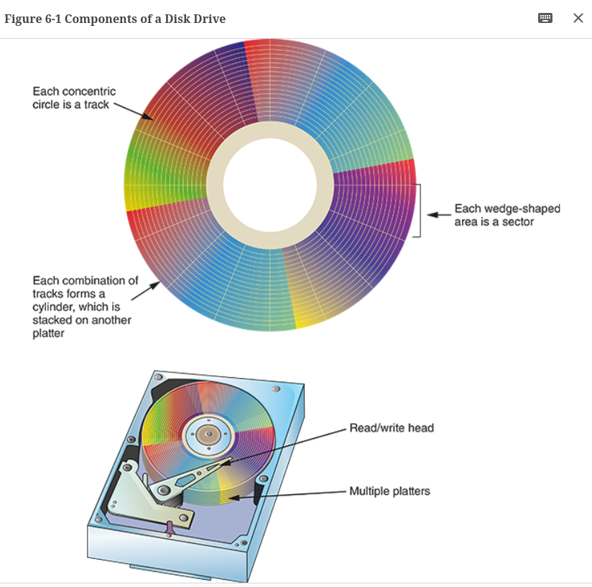
Understanding Disk Drives #1
Mechanical hard disk drives are made up of one or more platters coated with magnetic material
Disk drive components include the following
Geometry – refers to a disk’s logical structure
Head
Tracks
Cylinders
Sectors
Notes:
Hard drives are the most common form of mass storage.
Let's look at magenetic first.
Hard drives consist of platters coated with magnetic material organized by read/write heads, tracks, cylinders, and sectors. Uses magnetism to record data, similar to the magnetic tape used to listen to music as a child. If we need to find a piece of data, the disk will rotate to the location where the information is recorded, and the magnetic head will sense the magnetism to read the data.
Understanding the physical structure of storage media is essential because it directly impacts how data persists even after deletion. This physical persistence is a fundamental principle that makes digital forensics possible in the first place. The disk "geometry" refers to the logical organization of data on these platters and affects how data is accessed and stored, which can impact forensic analysis, especially in cases involving data hiding or recovery.
EXAMPLE: Your knowledge of physical storage helps explain to juries how deleted data can persist in unallocated space

Slide 9
Understanding Disk Drives #2
Properties handled at the drive’s hardware or firmware level include the following:
Zone bit recording (ZBR) is how most manufacturers deal with the fact that a platter’s inner tracks have a smaller circumference
Track density is the space between each track
Areal density is the number of bits in one square inch of a disk platter
Head and cylinder skew are used to improve disk performance
Notes:
Technical properties like zone bit recording, track density, and areal density affect how data is physically stored on disk drives. Zone bit recording compensates for the fact that outer tracks are physically longer than inner tracks, allowing for more efficient use of disk space by varying the number of sectors per track. Track density refers to how closely tracks are placed together on the platter, with higher density allowing more data storage but increasing risks of corruption. These properties determine how and where data is physically stored, which directly impacts your ability to recover evidence during forensic investigations.
EXAMPLE: When recovering evidence from damaged drives, understanding zone bit recording explains why outer tracks contain more recoverable data

Slide 10
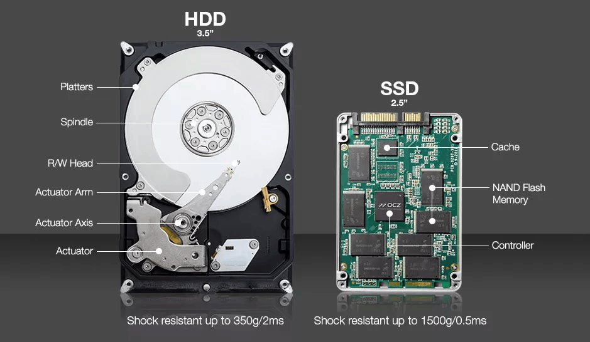
Understanding Disk Drives #3
Solid-state drives (SSD) are array of solid-state electronic memory.
Electronic chips and circuit boards rather than mechanical devices.
Compared to HDDs:
Less reliable long term
Faster access
Shock resistant.
Notes:
SSDs are hard disks made of an array of solid-state electronic memory chips. It consists of a control unit, a storage unit (FLASH chip, DRAM chip), and a cache unit. Unlike mechanical hard disks, which consist of mechanical components such as disks and magnetic heads, the entire SSD structure consists of electronic chips and circuit boards instead of mechanical devices.

Slide 11
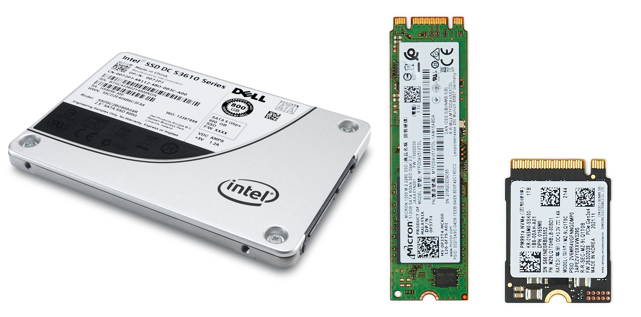
Understanding Disk Drives #4
Drives come in different form factors
3.5-inch SATA
2.5-inch SATA
M.2
NVMe PCIe
Notes:
3.5-inch SATA: Commonly used in desktops, these drives are easy to install, widely compatible, and bigger in size.
2.5-inch SATA: Commonly used in laptops and some desktops, these drives are easy to install and widely compatible.
M.2: An increasingly popular form factor for SSDs that connects directly to the motherboard, offering higher speeds and compact size.
PCIe: SSDs that connect via PCIe slots on the motherboard, providing even faster speeds suitable for high-performance applications and gaming.

Slide 12
3. Low-level Access to Data Stored on Drives

Slide 13
Disk Controller
Disk controllers act as intermediaries between operating systems and storage devices, translating commands into device-specific instructions
Modern storage systems use Logical Block Addressing (LBA) to represent data locations as sequential numbers, replacing the older CHS system
UEFI has largely replaced traditional BIOS in modern computers, offering improved boot times and support for larger storage devices
Disk controllers manage error detection and correction, improving data reliability through techniques like ECC
The transition from CHS to LBA addressing occurred primarily in the 1990s, removing artificial storage capacity limitations
Notes:
A disk controller is a specialized hardware component that manages the communication between a computer and its storage devices (such as hard drives, SSDs, or optical drives). It acts as the intermediary layer that translates commands from the computer's operating system into specific instructions that the storage device can understand and execute.
Here's what a disk controller does:
Command processing: Receives read/write commands from the operating system and translates them into device-specific instructions
Data transfer: Manages the flow of data between the computer's memory and the storage device, often using DMA (Direct Memory Access) to improve efficiency
Address translation: Converts logical addresses (LBA) used by the operating system into physical locations on the storage media
Error handling: Detects and corrects errors using techniques like ECC (Error Correction Code)
Caching: May implement buffer memory to improve performance by temporarily storing frequently accessed data
Protocol management: Handles communication protocols like SATA, SAS, NVMe, or older standards like IDE/ATA
Power management: Controls spin-up/spin-down operations and other power states of the storage device
Disk controllers can exist in several forms:
Integrated on the motherboard (most common in modern systems)
On expansion cards (like RAID controllers)
Built directly into the storage device itself (particularly in modern SSDs)
As part of a dedicated storage subsystem in enterprise environments
Modern disk controllers are sophisticated pieces of hardware that often contain their own processors, firmware, and memory to handle their operations independently from the main CPU.

Slide 14
LBA Basics
Linear addressing system for storage devices
Replaces older CHS (Cylinder-Head-Sector) addressing
Each data block assigned sequential number starting from 0
Standard block size: 512 bytes or 4KB
Notes:
LBA (Logical Block Addressing) revolutionized storage access by creating a simple linear model. Instead of the computer needing to understand complex disk geometry with cylinders, heads, and sectors, LBA presents storage as a straightforward array of numbered blocks. Think of it like addressing apartments in a building with a single sequential number rather than floor-room combinations. This simplified addressing scheme removed arbitrary size limitations and greatly improved compatibility across systems.

Slide 15
LBA Implementation in Disk Controllers
Disk controller firmware handles LBA-to-physical translation
Abstracts physical media geometry from the system
Enables advanced features (wear leveling, bad sector remapping)
Same interface to layer above disk controller for both mechanical and solid-state drives
Notes:
Inside every storage device is a controller that acts as a translator. When it receives an LBA from the system, its firmware calculates the exact physical location where that data lives. This creates a crucial abstraction layer that hides the messy details of how data is physically arranged. For SSDs, this is particularly important as it enables wear leveling and garbage collection without the operating system needing any awareness of these processes.

Slide 16
LBA and UEFI Storage Access
LBA (Logical Block Addressing) provides sequential numbering of data blocks (0,1,2...)
Disk controllers translate LBA to physical locations on storage media
UEFI sends standardized LBA commands to storage controllers
Controllers handle the complexity of physical data arrangement
Data flows: UEFI → LBA command → controller translation → physical access → low-level direct memory access (DMA) transfer
Notes:
LBA revolutionized storage access by replacing the complex CHS (Cylinder-Head-Sector) model with a simple linear addressing scheme. Each data block gets a sequential number, creating an abstraction layer that hides physical disk geometry.
Modern storage controllers are sophisticated intermediaries that receive LBA commands from UEFI and translate them to physical locations. This translation happens entirely within the controller's firmware, enabling advanced features like wear leveling in SSDs without system awareness.
UEFI, unlike legacy BIOS, communicates directly with controllers using modern protocols (AHCI, NVMe), eliminating legacy compatibility layers. When accessing data, UEFI determines which LBA contains needed information, sends the command to the controller, which then retrieves data from the physical location and transfers it to system memory via DMA.
This elegant abstraction allows operating systems and firmware to interact with storage using a consistent model regardless of the underlying technology, whether it's a traditional hard drive or modern SSD.

Slide 17
4. Role of Partitions
Notes:
Today we'll explore what partitions are, how they work at a technical level, and why they're important in modern computing systems. Whether you're new to storage technology or looking to deepen your understanding, this overview will provide you with a clear picture of how partitions function as a critical layer in storage architecture.

Slide 18
Defnition & Basic Concept
Disk Partition: A logical division of a physical storage device
Segments a single physical disk into multiple sections
Each section functions as an independent unit
Appears to the operating system as separate disks
Notes:
A disk partition is fundamentally a way to divide a single physical storage device into multiple logical sections. Think of it like dividing a large room into smaller rooms with walls – the overall space is the same, but now it's organized into separate functional areas. When the operating system interacts with these partitions, it treats each one as if it were a completely separate disk, even though they all exist on the same physical hardware. This abstraction is powerful because it creates boundaries between different types of data and systems.

Slide 19
Technical Characteristics
Fixed Boundaries: Defined by specific LBA (Logical Block Address) ranges
Independent File Systems: Each partition can use different formats
NTFS, ext4, FAT32, etc.
Isolation: Changes in one partition don't affect others
Notes:
At a technical level, partitions are defined by specific ranges of Logical Block Addresses or LBAs. These are essentially the sequential numbering system used to locate data on modern storage devices. Each partition has a defined starting LBA and ending LBA that establishes its boundaries. One of the most powerful features of partitions is that each can contain a completely different file system. For example, you might have one partition formatted with NTFS for Windows, another with ext4 for Linux, and perhaps a FAT32 partition for cross-platform data sharing. This isolation means that operations in one partition generally don't affect data in others, providing stability and separation.

Slide 20
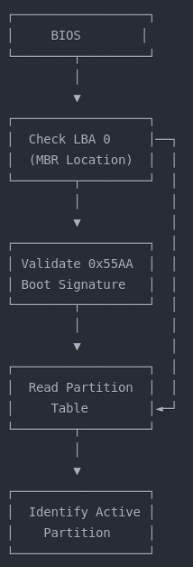
Booting the Operating System.
Power-On Self-Test (POST)
Hardware component detection and initialization
Setting up the system memory map
Determining boot devices based on configured priority
Transition to boot device access
Notes:
The boot process begins with the BIOS (Basic Input/Output System) or modern UEFI (Unified Extensible Firmware Interface). This firmware is stored in non-volatile memory on the motherboard and is the first code executed when the computer powers on. During initialization, the system performs POST checks to verify hardware functionality, initializes components, creates a memory map, and identifies boot devices according to the configured boot order. This initial firmware provides the foundation for accessing storage devices where the operating system resides.
This basic diagram shows the initial steps of the boot process. After BIOS initialization, the system reads LBA (Logical Block Address) 0, which contains the Master Boot Record or MBR. The BIOS validates the boot signature (0x55AA) to confirm this is a bootable device. It then reads the partition table to identify the active partition marked with the boot flag. This foundational sequence establishes where to find the bootable code that will continue the process.

Slide 21
Master Boot Record (MBR) Structure
MBR (Master Boot Record)
Traditional scheme
Located at LBA 0 (first 512 bytes of the storage device)
Structure:
446 bytes: Boot code (executes during boot process)
64 bytes: Partition table (4 entries of 16 bytes each)
2 bytes: Boot signature (0x55AA)
Limited to 4 primary partitions
Maximum addressable disk size of 2TB (with 512-byte sectors)
Notes:
The Master Boot Record is a critical structure located at the very beginning of the storage device (LBA 0). Its 512 bytes contain three key components: the executable boot code, a partition table with up to four entries, and a boot signature for validation. The boot code contains the initial instructions executed after BIOS hands off control. The partition table describes the disk's organization, with each 16-byte entry containing information about partition type, size, and location. The MBR scheme has limitations, including a maximum of 4 primary partitions and a 2TB size limit, which led to the development of the GPT partitioning scheme used with UEFI systems.

Slide 22
Partition Table and Types (MBR)
Primary Partitions
Maximum of 4 in traditional MBR
One can be marked as "active" (bootable)
Extended Partition
Acts as a container for logical partitions
Allows overcoming the 4-partition limit
Logical Partitions
Created within the extended partition
Can contain data or bootable content
Have their own boot sectors but cannot be marked "active" in MBR
Notes:
The partition table defines how a disk is organized into separate sections. With MBR partitioning, you can have up to four primary partitions, with one typically marked as "active" with the boot flag (0x80) to indicate which partition contains the bootable operating system. To overcome the four-partition limitation, one primary partition can be designated as an extended partition, which serves as a container for multiple logical partitions. Each logical partition has its own boot sector but cannot be directly booted from BIOS - only a primary partition can be marked as active. This partitioning scheme determines where file systems are located and where boot files can be found.

Slide 23
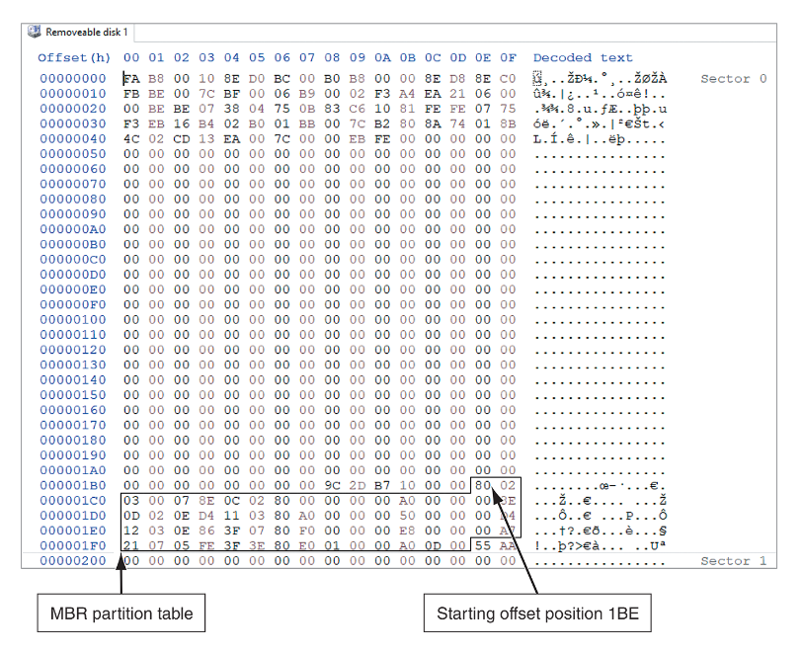
Disk Partitions (2 of 5)
Figure 6-3 The MBR Sector of a Disk Drive Viewed from a Hexadecimal Editor
Notes:
The MBR partition table typically starts at offset 1BE in hexadecimal and contains four 16-byte entries describing the disk's partitions. Understanding how to read an MBR in hexadecimal is a foundational forensic skill because it contains the roadmap to all data on the disk. These entries provide critical information about each partition, including its type, size, and location, which is essential for forensic analysis and recovery of data from specific partitions.
EXAMPLE: Manual examination of hexadecimal values in corrupted MBRs can reveal partitions with evidence that standard software misses

Slide 24
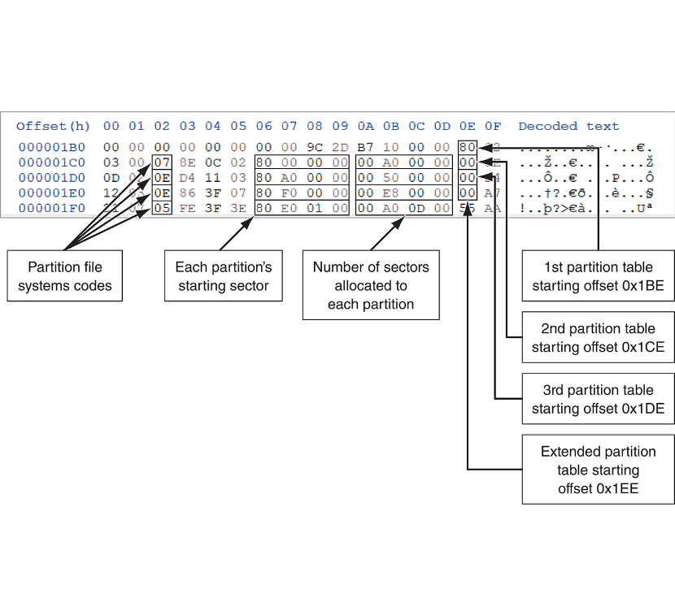
Disk Partitions (3 of 5)
Figure 6-4 A closeup of the partition table section of the MBR
The partition table section for the M B R has the partition file systems codes for offset 02, each partition's starting sector from offsets 06 to 09, number of sectors allocated to each partition for offsets 0 A to 0 D, first partition table starting offset 0 times 1 B E, second partition table starting offset 0 times 1 C E, third partition table starting offset 0 times 1 D E, and extended partition table starting offset 0 times 1 E E.
Notes:
Partition table entries contain key information including partition file system codes at offset 02, starting sector information at offsets 06-09, and number of sectors allocated to each partition at offsets 0A-0D. The ability to interpret partition table entries is critical for forensic investigators because suspects often manipulate these values to hide partitions. Knowing exactly what each byte represents allows you to identify inconsistencies that reveal deliberately concealed data and recover information from specific partitions.
EXAMPLE: Detailed analysis can reveal when suspects modify file system codes to hide partitions from automated tools

Slide 25
GUID Partition Table (GPT) Structure
Modern replacement for MBR used with UEFI systems
Structure:
LBA 0: Protective MBR (for backward compatibility)
LBA 1: Primary GPT Header
Contains disk GUID, partition entry count, and location
Checksum for self-verification
LBA 2-33: Partition Entry Array
Supports up to 128 partitions by default
Each entry is 128 bytes (vs. 16 bytes in MBR)
Last LBAs: Backup GPT Header and Partition Array
Provides redundancy for data recovery
Notes:
The GUID Partition Table (GPT) is the modern partition scheme designed to work with UEFI systems. Unlike MBR, which is constrained to a single 512-byte sector, GPT spreads its data across multiple sectors for greater resilience and capability. GPT begins with a Protective MBR at LBA 0 that prevents legacy tools from mistakenly overwriting the GPT structures. The actual GPT header resides at LBA 1, containing crucial information like the disk's unique GUID, the number of partition entries, their size, and checksums for integrity verification.
The Partition Entry Array typically occupies LBAs 2-33, providing space for 128 partitions by default (compared to MBR's limit of 4 primary partitions). Each partition entry is 128 bytes, allowing for much more detailed information including unique partition GUIDs, type GUIDs, partition names, and attributes. GPT also maintains a backup copy of both the header and partition array at the end of the disk, providing redundancy if the primary structures become corrupted. This redundancy is one of GPT's key advantages over MBR.

Slide 26
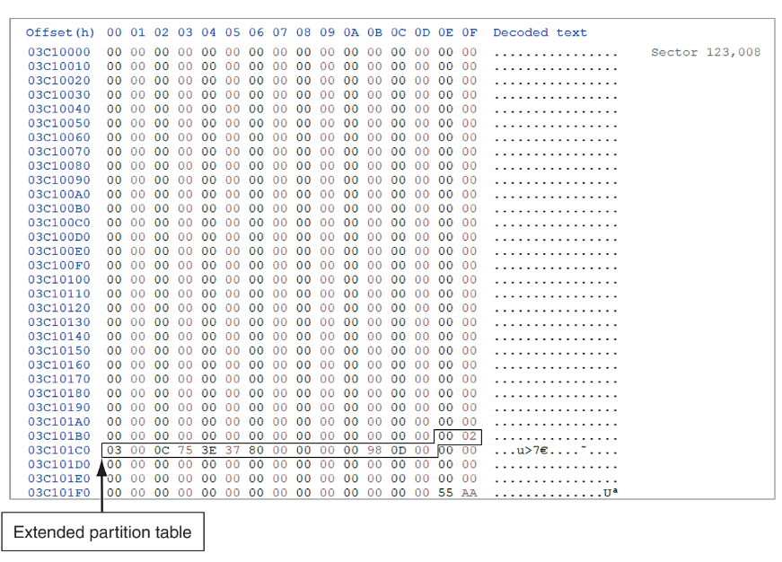
Disk Partitions (4 of 4)
Figure 6-9 NTFS partition boot sector
The partition table section for the M B R has an extended partition table for row 03 C 101 C 0 and offsets 00 to 0 F.
Notes:
NTFS partition boot sectors viewed in a hexadecimal editor reveal vital file system parameters that determine how data is organized within the partition. The ability to interpret boot sectors is essential because incorrect interpretation can lead to misidentified file locations or completely failed data recovery attempts. The data shown includes extended partition tables and offset information that is crucial for understanding the partition's structure and for recovering data from it.
EXAMPLE: In ransomware cases, manually analyzing and repairing damaged boot sectors can restore access to critical business data

Slide 27
GPT versus MBR Partitioning
Capactity improvements
Supports disks larger than 2TB (up to 9.4ZB theoretical limit)
Up to 128 partitions by default (extensible t more)
Reliability features
CRC32 checksums verify data integrity
Backup partition table end of disk
Additional capabilities
Human-readable partition names
More flexible boot mechanism
Notes:
GPT addresses several limitations of the older MBR partitioning scheme. While MBR is limited to addressing 2TB disks (with standard 512-byte sectors), GPT can address disks up to 9.4 zettabytes in size—far beyond current storage technology. The 128 partition limit eliminates the need for the extended/logical partition workaround required with MBR.
Reliability is significantly improved with GPT. Each partition entry includes CRC32 checksums that detect data corruption, and the backup partition table at the end of the disk provides redundancy if the primary table is damaged. Each partition has a unique GUID, preventing ID conflicts that can occur with MBR systems.
GPT also provides enhanced functionality with human-readable partition names and specific type GUIDs that precisely identify the partition's purpose. Unlike MBR, GPT doesn't use an "active" partition flag—the UEFI firmware directly reads the EFI System Partition (ESP) to find bootable .efi files. This provides a more flexible boot mechanism that supports multiple operating systems more cleanly.
This slide directly relates to Slide 6 on MBR partitioning—it shows the evolution of partition technology and highlights why modern systems have moved away from the MBR limitations to the more capable GPT structure.

Slide 28
Forensic Implications
Someone who wants to hide data can create hidden partitions between partitions on a disk drive
On disk drives with multiple partitions, there are small unused spaces between partitions called the partition gap
Data can also be hidden at the end of a disk by declaring a smaller number of bytes than the actual drive size
To access a hidden partition or the ending section of a drive, a disk editor can activate the hidden partition by updating the partition table
Notes:
Hidden partitions can be created between normal partitions to conceal data from casual observation. Partition gaps, which are small unused spaces between partitions, can be exploited to hide data or malware. Data can also be hidden at the end of a disk by declaring a smaller capacity than actually exists, creating unallocated space. Forensic examiners can use disk editors to access these hidden areas by updating the partition table, revealing concealed evidence.
EXAMPLE: In exploitation cases, systematic examination of disk structure can reveal hidden partitions in gaps between normal partitions

Slide 29
5. FAT Filesystem

Slide 30
Examining FAT Disks
The File Allocation Table (FAT) is the file structure database that Microsoft originally designed for floppy disks
The FAT database is typically written to a disk’s outermost track and contains file names, directory names, date and time stamps, the starting cluster number, and file attributes
There are three current FAT versions
FAT16, FAT32, and exFAT (used for mobile personal storage devices)
Cluster sizes vary according to the hard disk size and file system
Notes:
The File Allocation Table (FAT) was Microsoft's original file system design for floppy disks but remains critically important in forensics because it's still the most common file system used on portable storage devices. The FAT database is typically stored on a disk's outermost track and contains file information like names, directories, timestamps, starting cluster, and attributes. Current FAT versions include FAT16, FAT32, and exFAT (used for mobile storage devices), each with unique characteristics that affect forensic analysis.
EXAMPLE: Understanding how FAT marks deleted files (with E5 in filename's first byte) enables recovery of deleted files from formatted drives

Slide 31
Drive Slack Space
Microsoft OSs allocate disk space for files by clusters, resulting in drive slack
Drive slack is unused space in a cluster between the end of an active file’s content and the end of the cluster
Drive slack includes the following:
RAM slack – in newer Windows OSs, before data is written to disk, the RAM slack is zeroed out and contains no data
File slack – the remaining sectors within the last disk cluster beyond RAM slack is referred to as a file slack
Notes:
Microsoft operating systems allocate disk space in cluster units, which can create unused "slack space" between the end of a file's content and the end of its final cluster. Slack space analysis often reveals some of the most valuable evidence in an investigation because it contains fragments of deleted files, unsaved documents, and system memory that the suspect doesn't know still exists. RAM slack (in newer Windows versions) is zeroed out before writing to disk, but file slack can contain remnants of previous files, making it a key area for forensic analysis.
EXAMPLE: Examination of slack space can reveal fragments of deleted document drafts that contradict suspect claims

Slide 32
File Fragmentation
An unintentional side effect of FAT16 allowing large clusters was that it reduced fragmentation as cluster size increased
When you run out of room for an allocated cluster, the OS allocates another cluster for your file
As files grow and require more disk space, assigned clusters are chained together
As some files are created and deleted, the chain can be broken or fragmented
Notes:
An unintended benefit of FAT16's large clusters was reduced fragmentation, but as files grow and require more space than their allocated cluster can provide, the OS allocates additional clusters. These assigned clusters are chained together as files grow, and when files are created and deleted over time, these chains can become fragmented across the disk. Understanding file fragmentation is essential for forensic investigators because fragmented files require special recovery techniques to reconstruct deleted file fragments.
EXAMPLE: Understanding cluster chains allows manual reconstruction of fragmented deleted files that standard recovery tools can't fully recover

Slide 33
Deleting FAT Files
In a FAT file system, when a file is deleted, the OS inserts a HEX E5 value replacing the first letter of the filename
This value tells the OS that the file is no longer available and a new file can be written to the same cluster location
Data in the file remains on the disk drive
The area of the disk where the deleted file resides becomes unallocated disk space
It is now available to receive new data from newly created files or other files needing more space
Notes:
When a file is deleted in FAT systems, the OS inserts a hexadecimal E5 value in place of the first letter of the filename, signaling that the file is no longer available and the space can be overwritten. Importantly, the actual file data remains on the disk until overwritten by new data, which is why forensic examiners can often recover "deleted" files. This understanding of FAT deletion is fundamental to digital forensics because it explains why deleted files can be recovered, allowing investigators to recover evidence that suspects believe is permanently gone.
EXAMPLE: Knowledge of FAT deletion mechanics enables recovery of hundreds of confidential documents from USB drives

Slide 34
6. NTFS Filesystem

Slide 35
Exploring NTFS Disks (1 of 2)
NT File System (NTFS) was introduced with Windows NT
It is still the primary file system for Windows 10 and 11
Improvements over FAT file systems include the following:
NTFS provides more information about a file
NTFS gives more control over files and folders
NTFS was Microsoft’s move toward a journaling file system
It records a transaction before the system carries it out
Notes:
NT File System (NTFS) was introduced with Windows NT and is still the primary file system for Windows 10/11, providing more detailed file information and greater control over files and folders than FAT. It was Microsoft's move toward a journaling file system, which records transactions before executing them to improve reliability and recovery from crashes. Understanding NTFS is absolutely essential for modern forensic investigators because it's the dominant file system in most professional environments, with a complex structure that both preserves more evidence and provides more places for suspects to hide data.
EXAMPLE: The NTFS journal allows recovery of document access times even when suspects modify timestamps

Slide 36
Exploring NTFS Disks (2 of 2)
In NTFS, everything written to the disk is considered a file
On an NTFS disk, the first data set is the Partition Boot Sector
Next is Master File Table (MFT) also referred to as $MFT
NTFS results in much less file slack space
Clusters are smaller for smaller disk drives
NTFS also uses Unicode, which is an international data format
Notes:
In NTFS, everything written to disk is considered a file, with the first data structure being the Partition Boot Sector, followed by the Master File Table ($MFT). NTFS creates less file slack space than FAT and uses smaller clusters for smaller drives, improving storage efficiency. The "everything is a file" concept in NTFS is crucial to understand because it means system structures that contain valuable forensic evidence can be accessed and analyzed using the same techniques you use for regular files, and NTFS uses Unicode, allowing support for international character sets.
EXAMPLE: NTFS's Unicode support correctly preserves multilingual filenames in international investigations

Slide 37
NTFS System Files (1 of 3)
$MFT contains information about all files on the disk, including the system files the OS uses
In the $MFT, the first 15 records are reserved for system files
Records in the $MFT are called metadata
In the NTFS $MFT, all files and folders are stored in separate records of 1024 bytes each
Each record contains file or folder information
A field within $MFT is referred to as an attribute ID
Notes:
he $MFT contains information about all files on the disk, including system files, with the first 15 records reserved for system files. Records in the $MFT are called metadata, and each file and folder is stored in a separate 1024-byte record containing detailed information. The Master File Table is the single most important structure for NTFS forensic analysis because it contains a complete inventory of every file with extensive metadata, and even after files are deleted, their MFT records often remain, providing crucial evidence about what existed on the system.
EXAMPLE: MFT metadata examination can reveal timestamps of deleted files, contradicting suspect claims about file creation

Slide 38
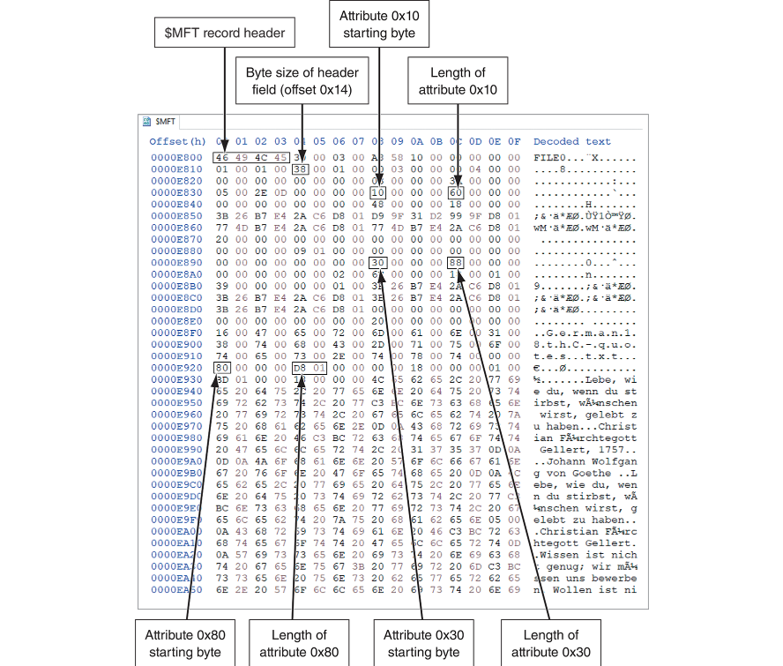
NTFS System Files (2 of 3)
Figure 6-13 Attribute ID locations in the $MFT record
Notes:
MFT records contain attribute IDs that store different types of file metadata, with specific areas for various types of information. Understanding the specific layout of MFT attributes is critical because these attributes contain timestamps, file names, security information, and data locations that can prove a suspect's actions. Visual analysis of actual MFT structures is an essential forensic skill because theoretical knowledge isn't enough in real investigations - forensic examiners must be able to interpret what they see in hex editors when manual analysis is required.
The following parts are labeled in the hexadecimal table:
Dollar M F T record header,
Byte size of header field (offset 0 times 14),
Attribute 0 times 10 starting byte,
Length of attribute 0 times 10,
Attribute 0 times 80 starting byte,
Length of attribute 0 times 80,
Attribute 0 times 30 starting byte,
and Length of attribute 0 times 30. a
EXAMPLE: Knowledge of attribute structure can reveal timestamp manipulation by comparing $STANDARD_INFORMATION and $FILE_NAME attributes

Slide 39
NTFS System Files (3 of 3)
File or folder information is typically stored in one of two ways in an $MFT record: resident and nonresident
Each cluster on a partition has its own unique address
In NTFS, each address is called a logical cluster number (LCN)
LCNs are sequentially numbered from the beginning of a partition to the last cluster of the partition
Once the first LCN address is written to the $DATA attribute, it becomes the file’s virtual cluster number (VCN)
Notes:
File information is stored in either resident (within MFT) or nonresident (in clusters) form in $MFT records, with each cluster on a partition having a unique logical cluster number (LCN). LCNs are numbered sequentially from the beginning to the end of a partition, and when an LCN address is written to the $DATA attribute, it becomes a virtual cluster number (VCN). Understanding the resident vs. nonresident distinction is essential because small files (under ~1KB) are often stored entirely within the MFT record itself, meaning even when a suspect deletes these files, they may remain fully intact in the MFT.
EXAMPLE: Small files stored as resident data often remain intact in MFT even when deleted, providing complete recovery

Slide 40
MFT Structures for File Data (1 of 3)
For the header of all $MFT records, the record fields of interest are as follows:
At offset 0x00 - the $MFT record identifier FILE
At offset 0x1C to 0x1F - size of the $MFT record
At offset 0x14 - length of the header (indicates where the next attribute starts)
At offset 0x32 and 0x33 - the update sequence array, which stores the last 2 bytes of the first sector of the $MFT record
Notes:
MFT record headers contain critical fields including the $MFT record identifier "FILE" at offset 0x00, the size of the $MFT record at offset 0x1C to 0x1F, the header length at offset 0x14, and the update sequence array at offset 0x32 and 0x33. Understanding the MFT record header structure is crucial because it contains the "signature" that validates MFT entries - without this knowledge, you can't differentiate between active files, deleted files, and corrupted entries. This distinction is vital for avoiding misinterpretation of file status and preventing missed critical evidence.
EXAMPLE: Validating "FILE" signatures helps identify intact records in corrupted volumes, enabling recovery of critical log files

Slide 41
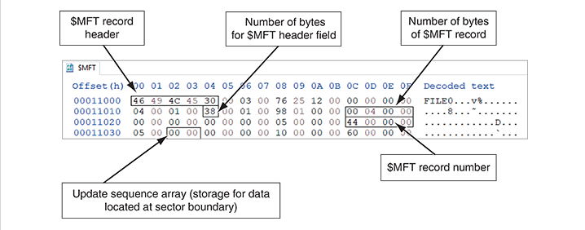
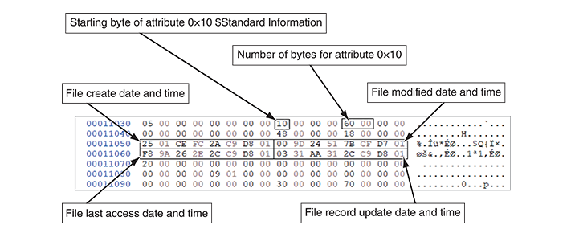
MFT Structures for File Data (2 of 3)
Figure 6-17 A $MFT header
Figure 6-18 Attribute 0x10: Standard Information
Notes:
Attribute 0x10 contains standard file information such as creation time, modification time, access time, and file attributes like read-only or hidden status. Visual analysis of actual MFT structures is an essential forensic skill because theoretical knowledge isn't enough in real investigations. Forensic examiners must be able to interpret what they see in hex editors when manual analysis is required to recover critical evidence that automated tools miss, particularly when examining standard file information for timeline construction.
EXAMPLE: Manual examination of MFT structures can recover timeline information when automated tools fail

Slide 42
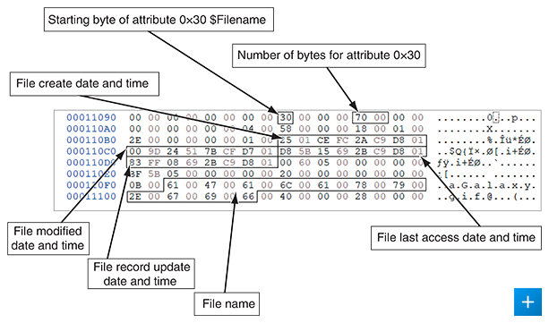
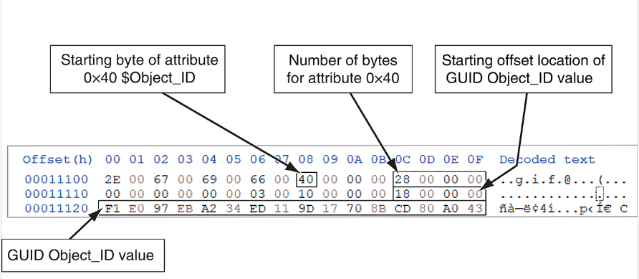
MFT Structures for File Data (3 of 3)
Figure 6-19 Attribute 0x30: $Filename
Figure 6-20 Attribute 0x40: $Object_ID
Notes:
Attribute 0x30 contains filename information including the file's name, size, and a separate set of timestamps, while Attribute 0x40 contains object ID information that helps identify files and directories. The Filename attribute (0x30) is particularly valuable in forensic investigations because it often preserves the original filename and timestamps even when a suspect has renamed files or manipulated the standard information timestamps. This "shadow record" can reveal attempts to disguise incriminating files and provides a secondary source of timeline information that suspects often overlook when attempting to cover their tracks.
EXAMPLE: Filename timestamps in Attribute 0x30 can reveal discrepancies with manipulated standard information timestamp

Slide 43
Interpreting Data Runs (1 of 2)
A data run describes how and where file data is physically stored on a disk
Data runs have the following components:
The first component declares how many bytes in the attribute field are needed to store the values for the second and third components
The second component stores the number of clusters assigned to the data run
The third component contains the starting cluster address value, VCN(0)
Notes:
In NTFS, when a file is stored on disk, its data may be divided across multiple clusters that aren't necessarily contiguous. A data run is essentially a description of a contiguous sequence of clusters allocated to store a portion of a file.
Data runs in NTFS have three key components: how many bytes are needed to store values for the other components, the number of clusters assigned to the data run, and the starting cluster address value (VCN(0)). Understanding data runs is critical for advanced forensic recovery because they provide the exact mapping of where file data is physically stored on disk. Without this knowledge, you cannot reconstruct fragmented files or recover data from corrupted file systems where directory information is damaged. Data runs are essential for locating files that have been deliberately fragmented to hinder recovery.
EXAMPLE: Manual interpretation of data runs can recover database fragments when directory structures are corrupted

Slide 44
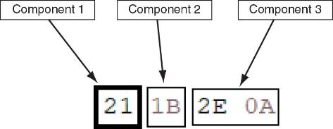
Interpreting Data Runs (2 of 2)
Figure 6-24 Data run components
Notes:
Hexadecimal values in data runs represent the three components mentioned previously
EXAMPLE: Manual decoding of data run values enables reassembly of fragmented files that automated tools can't reconstruct

Slide 45
The $I30 System File
When the number of new files or subfolders increases in a folder, Windows creates an $I30 file to store the additional new files’ or folders’ information
The $I30 files contain useful artifacts for an investigation
The $I30 file may contain residual information of its name, byte size, and date-time values for a deleted file
Listings for deleted files are relocated to the end of the $I30 file
Deleted files are labeled as index slack (INDX slack)
Notes:
$I30 index files can contain traces of deleted files even after MFT entries are reallocated
EXAMPLE: Examining INDX slack can reveal filename records matching known contraband, proving files existed on the system

Slide 46
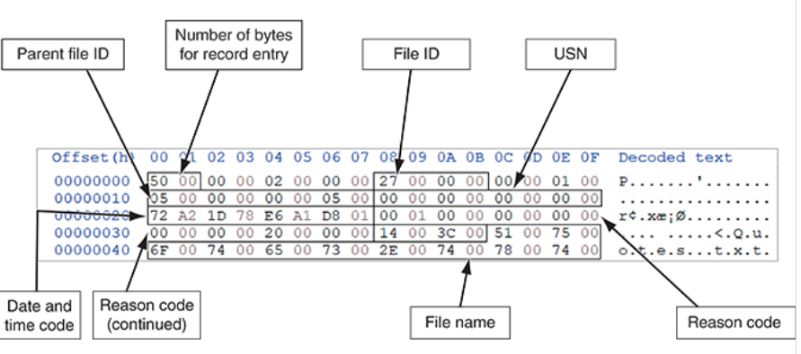
$UsnJrnl System File
The Update Sequence Number Journal ($UsnJrnl) provides a log of actions performed on a file
Figure 6-31 Hexadecimal view of a $J file
Notes:
The Update Sequence Number Journal logs all file actions and is difficult to falsify
EXAMPLE: $UsnJrnl entries can prove suspects accessed and modified files despite their deletion of standard logs

Slide 47
Prefetch (1 of 2)
To help reduce the time it takes to load an application into memory in Windows, Microsoft has implemented the Prefetch function
The first time an application is run, the OS will create a prefetch file for it
The next time the application is run, Windows preloads the necessary links to other data or executable files into memory
The contents of a prefetch file can reveal the following:
When an application was installed, how many times the application had been run, dates and time it was run, and data that was accessed by the application
Notes:
Windows creates prefetch files to improve application load times, providing evidence of program execution
EXAMPLE: Prefetch files can show exactly when and how many times data extraction tools were run prior to data theft

Slide 48
Prefetch (2 of 2)
To examine the contents of a prefetch file, download the PECmd.exe tool
PECmd.exe will display the following information:
Source file path, creation, modified, and last access date and time
Source file’s executable name and hash
Byte size of the source file
Windows OS version of the computer
The number of times and when the application has run
Volume information
Notes:
PECmd.exe extracts prefetch data including file paths, timestamps, and run counts
EXAMPLE: Prefetch analysis can reveal suspicious patterns like late-night database access followed by compression utilities

Slide 49
NTFS Alternate Data Streams (1 of 2)
Alternate data streams are methods by which data can be appended to existing files
They can obscure valuable evidentiary data, intentionally or by coincidence
In NTFS, an alternate data stream becomes an additional file attribute
It allows the file to be associated with different applications
You can only tell whether a file has a data stream attached by examining that file’s MFT entry
Notes:
Alternate data streams allow data to be appended to existing files, invisible to standard browsers
EXAMPLE: Examination can uncover confidential documents hidden as alternate streams in innocent-looking image files

Slide 50
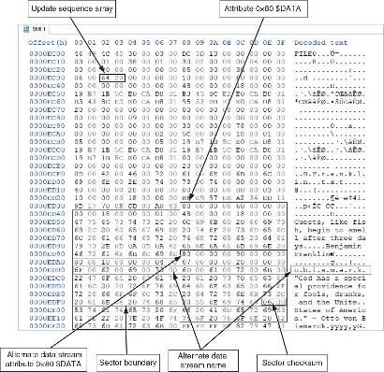
NTFS Alternate Data Streams (2 of 2)
Figure 6-32 A resident text alternate data stream
Notes:
Alternate data streams appear as additional $DATA attributes in MFT records
EXAMPLE: Manual examination can reveal hidden market information attached to wallpaper files in insider trading cases

Slide 51
Example: NTFS Alternate Data Streams
DOS command - create an alternative data stream
DOS command – display the alternative data stream
Notes:
DOS commands can create and display alternate data streams
EXAMPLE: These commands can demonstrate to juries how suspects hide malicious scripts in seemingly innocent files

Slide 52
NTFS Compressed Files
NTFS provides compression similar to FAT DriveSpace 3 (a Windows 98 compression utility)
With NTFS, files, folders, or entire volumes can be compressed
Most forensics tools can uncompress and analyze compressed Windows data
Forensics tools might have difficulty with third-party compression utilities, such as the .rar format
Notes:
NTFS provides native compression for files, folders, or volumes
EXAMPLE: Understanding compression allows proper decompression of financial data that appears unusable in raw disk views

Slide 53
NTFS Encrypting File System (1 of 2)
Encrypting File System (EFS) was introduced with Windows 2000
Uses public key and private key methods of encrypting files, folders, or disk volumes
When EFS is used in Windows 2000 and later, a recovery certificate is generated and sent to the local Windows administrator account
Users can apply EFS to files stored on their local workstations or a remote server
Notes:
EFS uses public/private key encryption with recovery certificates for administrators
EXAMPLE: Knowledge of recovery certificates allows legal decryption of evidence using the recovery agent

Slide 54
NTFS Encrypting File System (2 of 2)
The recovery Key Agent implements the recovery certificate, which is in the Windows administrator account
Windows administrators can recover a key in two ways: through Windows or from a command prompt
Commands available from a command prompt include the following:
cipher
copy
Notes:
Recovery Key Agent implements the recovery certificate through Windows or command prompt
EXAMPLE: Working with domain administrators to use recovery keys maintains proper chain of custody while enabling access

Slide 55
Deleting NTFS Files
When a file is deleted in Windows NT and later, the OS renames it and moves it to the Recycle Bin
You can restore it from the Recycle Bin
You can also use the del (delete) MS-DOS command
This method eliminates the file from the MFT listing in the same way FAT does
Notes:
Windows moves deleted files to the Recycle Bin where they can be restored
EXAMPLE: Recycle Bin examination can reveal files deleted immediately after investigation announcements, showing consciousness of guilt

Slide 56
7. RFS and Encryption

Slide 57
Resilient File System Overview
Resilient File System (ReFS) is designed to address very large data storage needs, such as the cloud
The following features are incorporated into ReFS’s design:
Maximized data availability
Improved data integrity
Designed for scalability
ReFS uses disk structures similar to the MFT in NTFS
Notes:
ReFS is designed for large-scale storage with improved data availability and integrity
EXAMPLE: ReFS knowledge enables manual recovery from enterprise systems that standard tools can't process

Slide 58
Understanding Whole Disk Encryption
Personal identity information (PII) and trade secrets caused by computer theft has become more of a concern
Whole disk encryption tools offer the following features:
Preboot authentication
Full or partial disk encryption with secure hibernation
Advanced encryption algorithms
Key management function
To examine an encrypted drive, decrypt it first
Notes:
Whole disk encryption requires pre-boot authentication and must be decrypted before examination
EXAMPLE: Memory dumps from running systems can capture encryption keys in RAM, enabling legal access to encrypted drives

Slide 59
Examining Microsoft BitLocker
BitLocker is Microsoft’s utility for protecting drive data
Hardware and software requirements are as follows:
A computer capable of running Windows Vista or later
The TPM microchip, version 1.2 or newer
A computer BIOS compliant with Trusted Computing Group (TCG)
Two NTFS partitions
The BIOS configured so that the hard drive boots first before checking other bootable peripherals
Notes:
BitLocker is Microsoft's built-in encryption requiring NTFS partitions and TPM hardware
EXAMPLE: Knowledge of recovery mechanisms allows working with IT to obtain recovery keys backed up to Active Directory

Slide 60
Examining Third-Party Disk Encryption Tools
BitLocker can only encrypt NTFS drives
If you want to encrypt a FAT drive, you need a third-party solution
Available third-party WDE utilities include the following:
BROADCOM
Endpoint Encryption
Jetico BestCrypt Volume Encryption
Notes:
FAT drives require third-party encryption solutions like BestCrypt and Endpoint Encryption
EXAMPLE: Recognizing encrypted volume signatures can lead to court orders requiring password disclosure

Slide 61
8. Windows Registry

Slide 62
Understanding the Windows Registry
Registry is a database that stores hardware and software configuration information, network connections, user preferences, and setup information
The Registry can contain valuable evidence for an investigation
Viewing the Registry files from a static acquisition requires special tools such as FTK Registry Viewer or forensics applications such as Autopsy, X-Ways Forensics, and others
Notes:
The Registry stores system configuration, network settings, and user preferences
EXAMPLE: USB connection records and LastVisitedMRU entries can prove unauthorized access despite deleted files

Slide 63
Data Types in the Registry
The Registry is a hierarchical structured database that contains the following data types:
Keys that are like folders on a disk partition
Subkeys that contain values like data and reference to files
The data types found in keys and subkeys are shown in Table 6-11 in the text
Notes:
Registry uses hierarchical keys and subkeys containing various data types
EXAMPLE: Understanding binary data formats enables decoding of license information to confirm software piracy

Slide 64
Exploring the Organization of the Windows Registry (1 of 2)
Table 6-12 Registry file locations and purposes
File name and location | Purpose of file
Users\user-account\Ntuser.dat | User-protected storage area; contains the list of most recently used files and desktop configuration settings
Windows\system32\config\Default.dat | Contains the computer’s system settings
Windows\system32\config\SAM.dat | Contains user account management and security settings
Windows\system32\config\Security.dat | Contains the computer’s security settings
Windows\system32\config\Software.dat | Contains installed programs’ settings and associated usernames and passwords
Windows\system32\config\System.dat | Contains additional computer system settings
Windows\system32\config\systemprofile | Contains additional ntuser information
Notes:
Key Registry files include Ntuser.dat, SAM.dat, and System.dat in specific locations
EXAMPLE: Direct extraction of System.dat can reveal backdoor services invisible on running systems

Slide 65
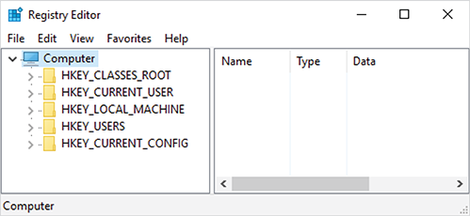
Exploring the Organization of the Windows Registry (2 of 2)
Figure 6-34 Viewing HKEYs in Registry Editor
Notes:
The Registry Editor shows main hives like HKEY_CURRENT_USER and HKEY_LOCAL_MACHINE
EXAMPLE: Focused examination of user hives can identify which specific account accessed confidential documents

Slide 67
Windows Forensics Artifacts (1 of 3)
In addition to the $I30, $MFT, $UsnJrnl, and Prefetch files used by Windows, the following are other data files that might contain digital evidence:
hiberfile.sys – where Windows stores volatile data (RAM) when Windows is suspended
Internet history files
pagefile.sys – similar to hiberfile.sys in that it also stores RAM data
Recycle.Bin
Notes:
Key artifacts include hiberfile.sys, internet history, pagefile.sys, and Recycle Bin
EXAMPLE: Analysis of pagefile.sys and hiberfile.sys can reveal browser sessions and document fragments despite clearing attempts

Slide 68
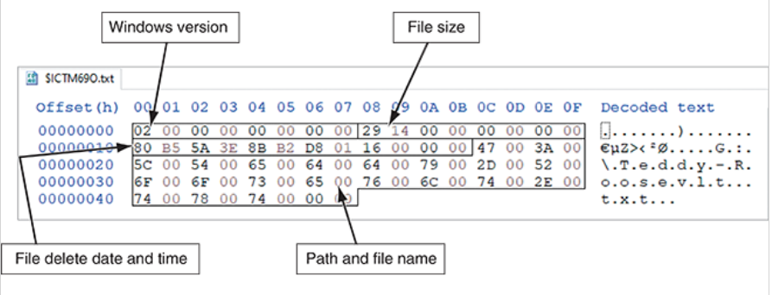
Windows Forensics Artifacts (2 of 3)
Figure 6-35 $MFT record of Recycle Bin file
Figure 6-36 $Recycle.Bin metadata record
A screenshot of several folders in the Recycle Bin. The numbers succeeding the S dash 1 dash 5 dash 21 initial is the S I D number (670105763).
The partition table section for the M B R of a recycle bin metadata record. The following parts are labeled in the hexadecimal table: Windows version, File size, File delete date and time, and Path and file name.
Notes:
Recycle Bin metadata includes SID numbers that link deleted files to specific users
EXAMPLE: SID analysis can prove which user account deleted financial transaction files on shared computers

Slide 69
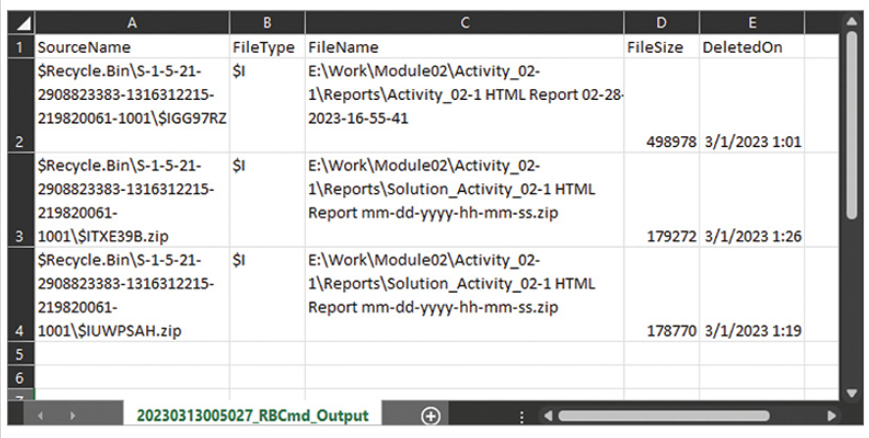
Windows Forensics Artifacts (3 of 3)
Figure 6-37 RBCmd.exe metadata output
A screenshot of an Excel window. A table lists the source name, file type, file name, file size, and deleted on. The file is of a recycle bin metadata output.
Notes:
RBCmd.exe extracts Recycle Bin metadata including file names, sizes, and deletion timestamps
EXAMPLE: Timeline analysis can reveal patterns of document deletions immediately following USB connections

