Slide 1
Introduction to Operating Systems

Slide 2
What do operating system do
Notes:
A computer system may be organized in a number of different ways, which we can categorize roughly according to the number of general-purpose processors used.

Slide 3
What is an Operating System
A program that acts as an intermediary between a user of a computer and the computer hardware
Operating system goals:
Execute user programs and make solving user problems easier
Make the computer system convenient to use
Use the computer hardware in an efficient manner

Slide 4
Forensic Relevance
OS determines how data is stored, processed, and accessed
OS artifacts provide critical evidence
OS design affects what data persists after system use
Understanding OS internals enables:
Recovery of deleted files
Analysis of memory dumps
Interpretation of logs and system artifacts
Timeline reconstruction
Notes:
For forensic examiners, understanding operating systems is fundamental. The OS determines where and how data is stored on disk, what information persists in memory, and what logs are created during system operation. OS artifacts like registry entries, event logs, prefetch files, and swap space often contain crucial evidence. Different operating systems handle file deletion, memory management, and logging differently, which directly impacts evidence preservation and recovery techniques. A forensic examiner without OS knowledge would miss significant evidence or might incorrectly interpret the artifacts they find.

Slide 5
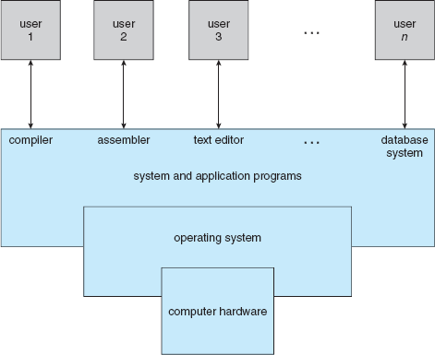
Computer System Structure
Four components
1. Hardware
2. Operating system
3. Application programs
4. Users
Notes:
Computer system can be divided into four components:
Hardware – provides basic computing resources - CPU, memory, I/O devices
Operating system - Controls and coordinates use of hardware among various applications and users
Application programs – define the ways in which the system resources are used to solve the computing problems of the users - Word processors, compilers, web browsers, database systems, video games
Users - People, machines, other computers

Slide 6
Operating System Definition
No one general definition of an operating system.
Exist to make hardware usable.
Common goals are resource allocation and control.
OS is a resource allocator
Manages all resources
Decides between conflicting requests for efficient and fair resource use
OS is a control program
Controls execution of programs to prevent errors and improper use of the computer
Notes:
Operating systems exist because they offer a reasonable way to solve the problem of creating a usable computing system. The fundamental goal of computer systems is to execute user programs and to make solving user problems easier. Toward this goal, computer hardware is constructed. Since bare hardware alone is not particularly easy to use, application programs are developed. These programs require certain common operations, such as those controlling the I/O devices. The common functions of controlling and allocating resources are then brought together into one piece of software: the operating system.

Slide 7
Operating System Components
Kernel – one program running all the time
System programs – associated with the operating system but not part of the kernel
Application program – all programs associated with the operation of the system
Is the web browser part of the operating system?
Notes:
In addition, we have no universally accepted definition of what is part of the operating system. A simple viewpoint is that it includes everything a vendor ships when you order "the operating system." The features included, however, vary greatly across systems. Some systems take up less than 1 megabyte of space and lack even a full-screen editor, whereas others require gigabytes of space and are entirely based on graphical windowing systems. A more common definition, and the one that we usually follow, is that the operating system is the one program running at all times on the computer—usually called the kernel. (Along with the kernel, there are two other types of programs: systems programs, which are associated with the operating system but are not part of the kernel, and application programs, which include all programs not associated with the operation of the system.)
The matter of what constitutes an operating system has become increasingly important. In 1998, the United States Department of Justice filed suit against Microsoft, in essence claiming that Microsoft included too much functionality in its operating systems and thus prevented application vendors from competing. For example, a Web browser was an integral part of the operating systems. As a result, Microsoft was found guilty of using its operating-system monopoly to limit competition.

Slide 8
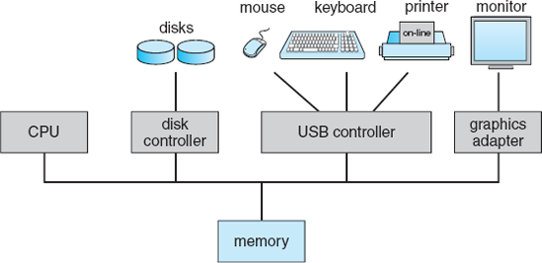
Computer System Organization
Notes:
Before we can explore the details of how computer systems operate, we need general knowledge of the structure of a computer system.
A modern general-purpose computer system consists of one or more CPUs and a number of device controllers connected through a common bus that provides access to shared memory (). Each device controller is in charge of a specific type of device (for example, disk drives, audio devices, and video displays). The CPU and the device controllers can execute concurrently, competing for memory cycles. To ensure orderly access to the shared memory, a memory controller is provided whose function is to synchronize access to the memory.

Slide 9
System Boot Process
Bootstrap program stored in firmware (ROM/EPROM)
Basic steps:
Run hardware diagnostics
Initialize system components
Load operating system kernel
Start OS execution (“init” process)
Wait for an event to occur
Forensic implications:
Boot process logs
Firmware modifications
Early-launch malware
Notes:
The boot process initializes hardware and loads the operating system. For forensic examiners, this process has several important implications. Boot logs may record system initialization details and errors. Firmware modifications can create persistent malware that survives operating system reinstallation. Bootkits modify the boot process to load malicious code before security controls activate. Early-launch malware starts before anti-malware solutions, making it particularly dangerous. Understanding the normal boot process for a system helps examiners identify abnormalities that may indicate compromise. Specialized forensic techniques are required to analyze firmware and boot code for unauthorized modifications.

Slide 10
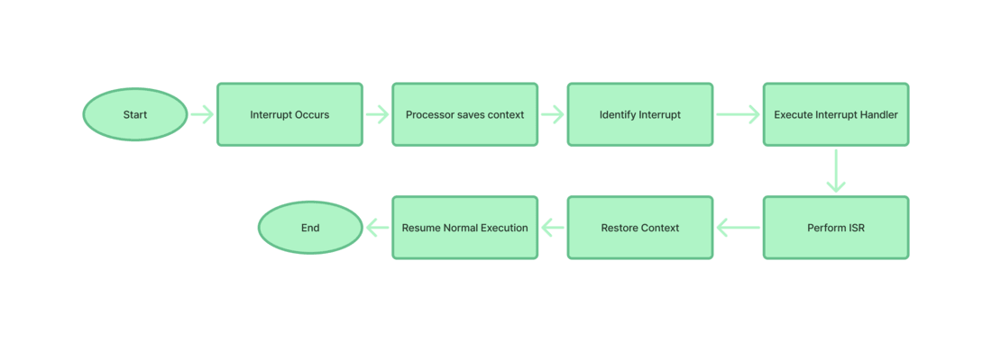
OS Events Cause Interrupts
Notes:
Event-related software or hardware can trigger the issuance of interrupt signals. A sort of interrupt called a software interrupt is one that is produced by software or a system as opposed to hardware. Traps and exceptions are other names for software interruptions. They serve as a signal for the operating system or a system service to carry out a certain function or respond to an error condition. Generally, software interrupts occur as a result of specific instructions being used or exceptions in the operation. In our system, software interrupts often occur when system calls are made In a hardware interrupt, all the devices are connected to the Interrupt Request Line. A single request line is used for all the n devices. To request an interrupt, a device closes its associated switch. When a device requests an interrupt, the value of INTR is the logical OR of the requests from individual devices. Step 1:- Any time that an interrupt is raised, it may either be an I/O interrupt or a system interrupt. Step 2:- The current state comprising registers and the program counter is then stored in order to conserve the state of the process. Step 3:- The current interrupt and its handler is identified through the interrupt vector table in the processor. Step 4:- This control now shifts to the interrupt handler, which is a function located in the kernel space. Step 5:- Specific tasks are performed by Interrupt Service Routine (ISR) which are essential to manage interrupt. Step 6:- The status from the previous session is retrieved so as to build on the process from that point. Step 7:- The control is then shifted back to the other process that was pending and the normal process continues.

Slide 11
Computer-System organization

Slide 12
Intruction-Execution Cycle
Proposed by John von Neumann architecture 1945
Stored-program concept
Data and instructions
Same memory
Fetch-decode-execute cycle
CPU receives next instruction from memory (RAM)
Control unit interprets instruction in terms of what data to use and the operation to perform
CPU performs the operation
Notes:
Von Neumann Architecture - the foundation of modern computers
KEY COMPONENTS:
CPU (Central Processing Unit)
Control Unit: Fetches/decodes instructions
ALU: Performs calculations and logic
Registers: PC, MAR, MDR, ACC, CIR (high-speed CPU storage)
Memory: Single space storing both data and instructions
I/O Devices: Interface with external world
System Bus: Communication pathway connecting all components
KEY CONCEPTS:
Stored-Program Concept: Data and instructions in same memory
Fetch-Decode-Execute Cycle: Basic operation pattern of all computers

Slide 13
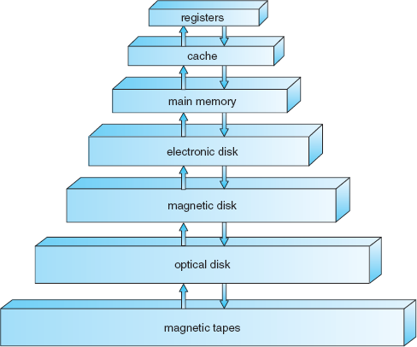
Storage Hierarchy
Registers
Cache
Main memory (RAM)
Electronic disk (SSD)
Magnetic disk (HDD)
Optical disk
Magnetic tape
Notes:
Computer systems organize storage in a hierarchy from fastest and most expensive (registers, cache) to slowest and least expensive (disks, tape). For forensic examiners, understanding this hierarchy helps identify where relevant data might be found. Volatile storage (registers, cache, RAM) contains current system state but is lost when power is removed. Non-volatile storage (disks, SSDs) preserves data between power cycles. Different storage technologies leave different artifacts - for example, SSDs use wear-leveling and TRIM, which complicate forensic recovery compared to traditional HDDs. Each level in the hierarchy may contain unique evidential value.

Slide 14
I/O Structure
Storage is one type of many I/O devices
Large portion of OS code manages I/O
Critical for system reliability and performance
General computers have CPUs and device controllers connected by common bus
Device controllers manage specific device types
OS has device drivers providing uniform interfaces
Notes:
Storage is only one of many types of I/O devices within a computer. A large portion of operating-system code is dedicated to managing I/O, both because of its importance to the reliability and performance of a system and because of the varying nature of the devices. Next, we provide an overview of I/O.
A general-purpose computer system consists of CPUs and multiple device controllers that are connected through a common bus. Each device controller is in charge of a specific type of device. Depending on the controller, more than one device may be attached. For instance, seven or more devices can be attached to the small computer-systems interface (SCSI) controller. A device controller maintains some local buffer storage and a set of special-purpose registers. The device controller is responsible for moving the data between the peripheral devices that it controls and its local buffer storage. Typically, operating systems have a device driver for each device controller. This device driver understands the device controller and presents a uniform interface to the device to the rest of the operating system.

Slide 15
Computer-System ARCHITECTURE
Notes:
A computer system may be organized in a number of different ways, which we can categorize roughly according to the number of general-purpose processors used.

Slide 16
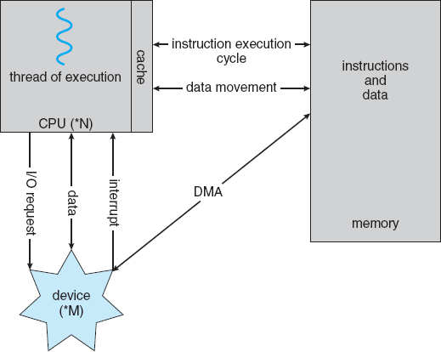
Single-Processor Systems
Most computers are single processor especially if count embedded systems
CPU executing general-purpose instructions
Special-purpose processors as well – disk, keyboard, graphics controllers
Handle device IO for the main CPU
Notes:
In addition, we have no universally accepted definition of what is part of the operating system. A simple viewpoint is that it includes everything a vendor ships when you order "the operating system." The features included, however, vary greatly across systems. Some systems take up less than 1 megabyte of space and lack even a full-screen editor, whereas others require gigabytes of space and are entirely based on graphical windowing systems. A more common definition, and the one that we usually follow, is that the operating system is the one program running at all times on the computer—usually called the kernel. (Along with the kernel, there are two other types of programs: systems programs, which are associated with the operating system but are not part of the kernel, and application programs, which include all programs not associated with the operation of the system.)
The matter of what constitutes an operating system has become increasingly important. In 1998, the United States Department of Justice filed suit against Microsoft, in essence claiming that Microsoft included too much functionality in its operating systems and thus prevented application vendors from competing. For example, a Web browser was an integral part of the operating systems. As a result, Microsoft was found guilty of using its operating-system monopoly to limit competition.

Slide 17
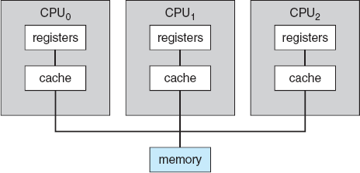
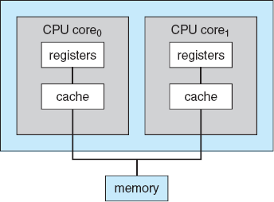
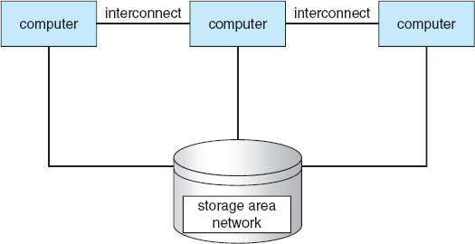
Multi-Processor Systems
Multiprocessor – multiple CPUs
Increased throughput, economies of scale, increased reliability
Sharing computer bus
Multicore – multiple cores same CPUs
Advantages of multiprocessor
Less energy consumption
Clustered – multiple CPUs
Connected by network rather than bus
Cloud computing or high-performance computing
Notes:
In addition, we have no universally accepted definition of what is part of the operating system. A simple viewpoint is that it includes everything a vendor ships when you order "the operating system." The features included, however, vary greatly across systems. Some systems take up less than 1 megabyte of space and lack even a full-screen editor, whereas others require gigabytes of space and are entirely based on graphical windowing systems. A more common definition, and the one that we usually follow, is that the operating system is the one program running at all times on the computer—usually called the kernel. (Along with the kernel, there are two other types of programs: systems programs, which are associated with the operating system but are not part of the kernel, and application programs, which include all programs not associated with the operation of the system.)
The matter of what constitutes an operating system has become increasingly important. In 1998, the United States Department of Justice filed suit against Microsoft, in essence claiming that Microsoft included too much functionality in its operating systems and thus prevented application vendors from competing. For example, a Web browser was an integral part of the operating systems. As a result, Microsoft was found guilty of using its operating-system monopoly to limit competition.

Slide 18
Operating System Structure

Slide 19
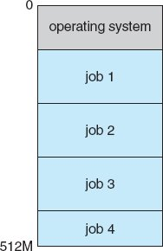
Multiprogramming
First OSes were for mainframes running jobs overnight like payroll etc.
Multiprogramming
Keeps multiple programs in memory simultaneously
CPU always has a job to execute
Increases CPU utilization
Jobs remain in the job pool on disk until allocated to memory
When one job needs to wait for I/O, CPU switches to another job
Notes:
Multiprogramming was developed for maintrames. It addresses the fact that a single program can't keep both CPU and I/O devices busy. When one program must wait (like during I/O operations), the CPU switches to another program instead of sitting idle. Think of it like a lawyer handling multiple cases - when one case is waiting for documents, they work on another case.

Slide 20
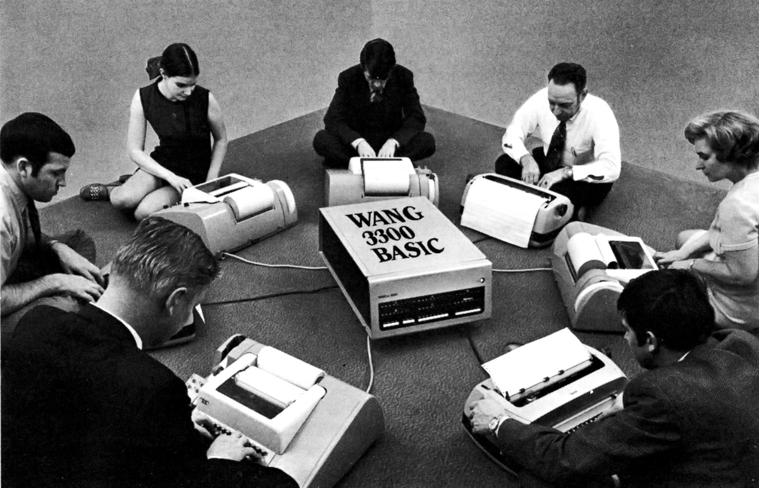
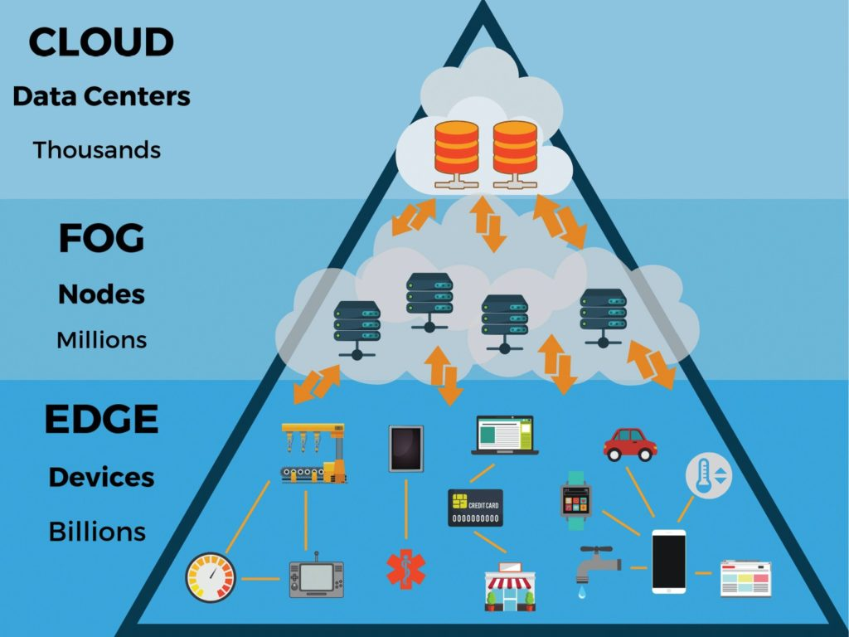
Multitasking (time-sharing)
Need for interactive computing, mainframes accessed over network (originally dumb terminals, now cloud computing)
Multitasking
Add frequent CPU switching to multiprogramming
Fast enough so users can interact with program as it runs
Each program gets a small time slice making it appear user is alone
Switches as the level of milliseconds
Notes:
While multiprogramming was developed primarily to maximize CPU utilization in batch processing environments, time-sharing evolved specifically to create responsive interactive systems. The shift in focus from machine efficiency to user experience represents a fundamental change in computing philosophy that shaped modern operating systems.
Mechanism: Logical extension of multiprogramming that adds frequent CPU switching
Time-sharing builds on the foundation of multiprogramming but introduces a critical innovation: the frequency of CPU switching. This isn't simply a quantitative change but a qualitative one that transformed how we interact with computers. The underlying technical principles are similar, but the implementation priorities are different.

Slide 21
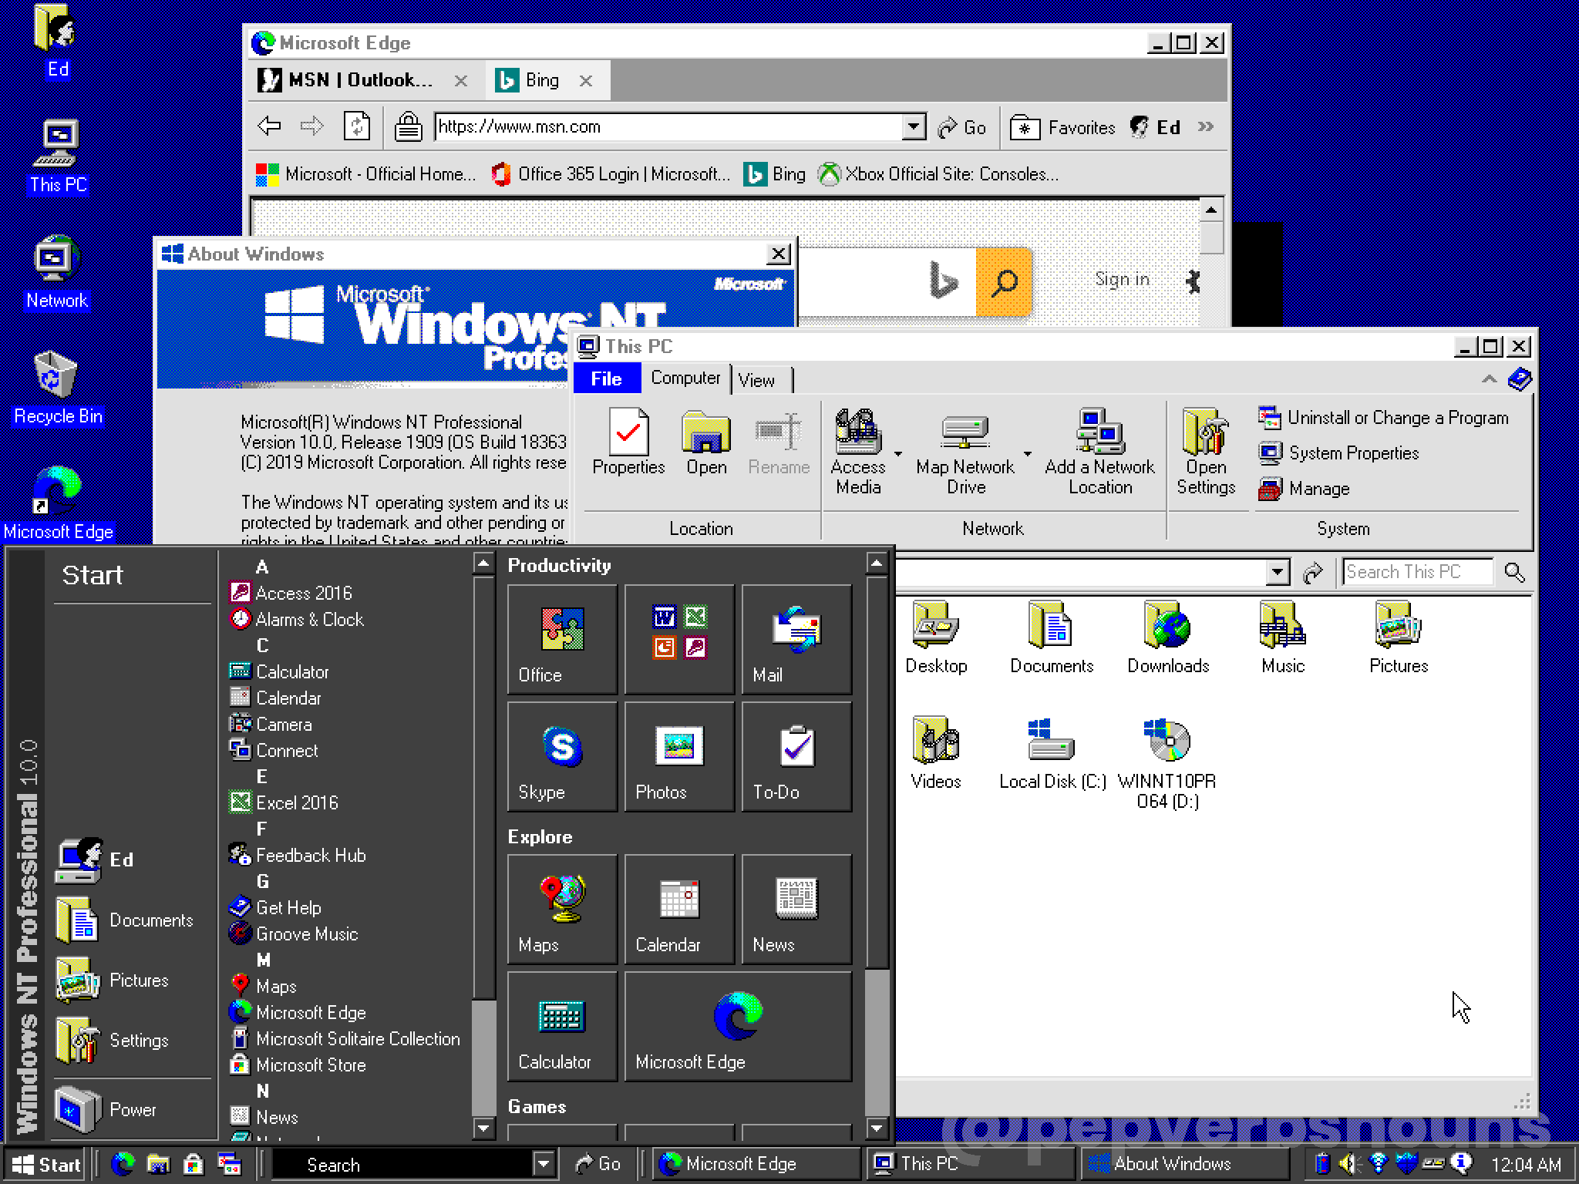
Multitasking for PCs
PCs were introduced as single user machines running multiple programs
Multitasking
Still multitasking but focus is on switching between programs
Switching usually driven by IO operations that run in the background
Examples – reading/writing to disk, accessing webservers and fog/cloud resources etc.
ThePhoto by PhotoAuthor is licensed under CCYYSA.
Notes:
While multiprogramming was developed primarily to maximize CPU utilization in batch processing environments, time-sharing evolved specifically to create responsive interactive systems. The shift in focus from machine efficiency to user experience represents a fundamental change in computing philosophy that shaped modern operating systems.
Mechanism: Logical extension of multiprogramming that adds frequent CPU switching
Time-sharing builds on the foundation of multiprogramming but introduces a critical innovation: the frequency of CPU switching. This isn't simply a quantitative change but a qualitative one that transformed how we interact with computers. The underlying technical principles are similar, but the implementation priorities are different.

Slide 22
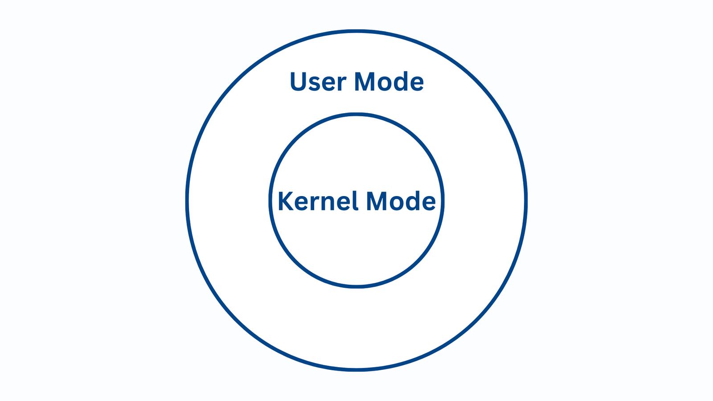
Dual-Mode Operations
System Integrity: Prevents user programs from interfering with OS operations
Mode Bit: Hardware distinction between kernel mode (0) and user mode (1)
Controlled Access: User programs enter kernel mode only through system calls
Error Containment: Problems in one program cannot affect other programs
Privileged Services: OS safely performs restricted operations on behalf of applications
Notes:
Since the operating system and the users share the hardware and software resources of the computer system, we need to make sure that an error in a user program could cause problems only for the one program running.
With sharing, many processes could be adversely affected by a bug in one program. For example, if a process gets stuck in an infinite loop, this loop could prevent the correct operation of many other processes.
In order to ensure the proper execution of the operating system, we must be able to distinguish between the execution of operating-system code and user-defined code. The approach taken by most computer systems is to provide hardware support that allows us to differentiate among various modes of execution.
At the very least, we need two separate modes of operation: user mode and kernel mode (also called supervisor mode, system mode, or privileged mode). A bit, called the mode bit, is added to the hardware of the computer to indicate the current mode: kernel (0) or user (1). With the mode bit, we are able to distinguish between a task that is executed on behalf of the operating system and one that is executed on behalf of the user. When the computer system is executing on behalf of a user application, the system is in user mode. However, when a user application requests a service from the operating system (via a system call), it must transition from user to kernel mode to fulfill the request. This is shown in Figure 1.10. As we shall see, this architectural enhancement is useful for many other aspects of system operation as well.

Slide 23
Switching between Modes
Boot Sequence: Hardware starts in kernel mode before OS loads user applications
Mode Switching: Interrupts and traps automatically switch from user mode to kernel mode
Protection Mechanism: OS always runs in kernel mode; user programs always in user mode
Privileged Instructions: Certain harmful operations executable only in kernel mode
Hardware Enforcement: Attempts to execute privileged instructions in user mode trap to OS
Notes:
At system boot time, the hardware starts in kernel mode. The operating system is then loaded and starts user applications in user mode. Whenever a trap or interrupt occurs, the hardware switches from user mode to kernel mode (that is, changes the state of the mode bit to 0). Thus, whenever the operating system gains control of the computer, it is in kernel mode. The system always switches to user mode (by setting the mode bit to 1) before passing control to a user program.
The dual mode of operation provides us with the means for protecting the operating system from errant users—and errant users from one another. We accomplish this protection by designating some of the machine instructions that may cause harm as privileged instructions. The hardware allows privileged instructions to be executed only in kernel mode. If an attempt is made to execute a privileged instruction in user mode, the hardware does not execute the instruction but rather treats it as illegal and traps it to the operating system.

Slide 24
How OS Maintains Control
CPU control: Timer ensures OS regains control from user programs
Implementation: Fixed/variable interrupts using clock and counter
Protection: Timer settings are privileged operations
Initialization: OS sets timer before running user programs
Time limits: Counter tracks allowed execution time
Notes:
CPU control: Timer ensures OS regains control The operating system must maintain ultimate control over the CPU to prevent user programs from monopolizing system resources. The timer mechanism is a hardware solution that guarantees the OS can regain control even if a user program enters an infinite loop or fails to make system calls.
Implementation: Fixed/variable interrupts using clock and counter Timers can generate interrupts at fixed intervals (e.g., 1/60 second) or variable intervals. Variable timers typically use a fixed-rate clock that decrements a counter. When the counter reaches zero, an interrupt occurs. For example, a 10-bit counter with a 1-millisecond clock can create interrupts from 1 to 1,024 milliseconds in 1-millisecond increments.
Protection: Timer settings are privileged operations Instructions that modify the timer are designated as privileged operations that can only be executed in kernel mode. This prevents user programs from disabling or manipulating the timer to avoid interruption. The timer's protection is crucial to the operating system's ability to maintain control.
Initialization: OS sets timer before running user programs Before transferring control to any user program, the operating system ensures the timer is properly configured to generate an interrupt. This creates a safety net that guarantees the OS will regain control regardless of the program's behavior.
Time limits: Counter tracks allowed execution time The OS can implement time limits for programs by initializing a counter with the maximum allowed runtime. For example, a program with a 7-minute limit would have its counter set to 420 seconds. The timer decrements this counter, and when it becomes negative, the OS can terminate the program for exceeding its time allocation.

Slide 25
Process Management

Slide 26
What is a Process?
Program in execution
Includes:
Program code (text section)
Data section
Process stack
Process Control Block (PCB)
Active entity with a program counter and resources
Notes:
A process is a program in execution, representing the active entity that requires CPU time, memory, files, and I/O devices. For forensic examiners, process analysis is critical because processes show what programs were running on a system. Even after a process terminates, artifacts of its execution remain in memory dumps, swap files, and system logs. Process creation timestamps can establish timelines, and process relationships (parent-child) can reveal how malware or other programs were executed on a system.

Slide 27
Process States and Transitions
New: Process is being created
Running: Instructions are being executed
Waiting: Process waiting for some event
Ready: Process waiting to be assigned to a processor
Terminated: Process has finished execution
Notes:
Processes move through various states during their lifecycle. Understanding these states helps forensic examiners interpret memory dumps and process listings captured during an investigation. A process in waiting state might indicate communication with external systems or devices. Long-running processes might suggest background activity like data exfiltration. Terminated processes may still have data in memory or swap space. The pattern of state transitions can reveal abnormal behavior indicative of malware or unauthorized activities.

Slide 28
Process Management Structures
Process Control Block (PCB) contains:
Process state
Program counter
CPU registers
CPU scheduling information
Memory management information
Accounting information
I/O status information
Notes:
The Process Control Block is a data structure containing all the information about a process. For forensic analysis, PCBs (or their remnants) found in memory dumps provide extensive information: what files the process accessed, what memory it used, its execution context, and its privileges. This information helps identify malicious processes, understand program behavior, and establish connections between different activities on the system. Even after a process terminates, PCB information may persist in memory or have been paged to disk.

Slide 29
Forensic Significance of Process Analysis
Reveals what programs were running
Shows when programs executed
Identifies parent-child relationships
Exposes unusual process behaviors:
Hidden processes
Unexpected parent processes
Unusual permissions or access
Suspicious names or locations
Notes:
Process analysis is a cornerstone of forensic examination. It allows investigators to determine what was running on a system at specific times, which is crucial for understanding user activities and potential attacks. Malware often uses unusual process characteristics: it may hide from process listings, use unexpected parent processes to launch (like Word launching cmd.exe), operate with elevated permissions, or use deceptive naming to appear legitimate. Understanding normal process behavior helps examiners quickly identify these anomalies. Process handles can also reveal what files and network connections were accessed, even if that activity was later concealed.

Slide 30
Operating System Services

Slide 31
Services for Users
User interface (GUI, CLI, batch)
Program execution
I/O operations
File system manipulation
Communications
Error detection and handling
Notes:
Operating systems provide several key services for users. From a forensic perspective, each service can generate valuable artifacts. The user interface can reveal user activities through command history or recently opened files. Program execution services manage what programs run on the system and when. I/O operations can leave traces of device usage. File system manipulation creates timestamps and metadata. Communications services may leave records of network connections. Error logs can reveal unusual activities or system tampering.

Slide 32
Services for System Efficiency
Resource allocation
Accounting and logging
Protection and security
Notes:
Besides user-facing services, operating systems provide services for efficient system operation. Resource allocation distributes CPU cycles, memory, and devices among users and processes. Accounting and logging track resource usage and system events - these logs are gold mines for forensic examiners. Protection and security mechanisms prevent unauthorized access, but may also record attempted violations. Understanding these services helps examiners identify normal system behavior versus potential malicious activity.

Slide 33
User-Operating System Interface

Slide 34
Command Interpreters
Allows users to directly issue commands
Often maintains command history
Examples: Windows Command Prompt, Unix/Linux shells
Forensic value:
Command history files
Timestamps of command execution
Evidence of specific activities
Notes:
Command interpreters (shells) get and execute user commands. For forensic examiners, these interfaces are valuable sources of evidence. Many shells maintain command history files (like .bash_history in Linux or ConsoleHost_history.txt in Windows PowerShell) that record user commands. These histories can reveal what actions a user performed, when they occurred, and what files were accessed. Even when history is disabled, command artifacts may persist in memory or swap files. Interpreting these artifacts requires understanding shell behavior and command syntax.

Slide 35
Graphical User Interfaces (GUIs)
Mouse-based window-and-menu systems with icons
Examples: Windows Explorer, Mac OS X Aqua, Linux KDE/GNOME
Forensic value:
Recently opened files lists
Jump lists (Windows)
Prefetch/Superfetch data
Thumbnail caches
Notes:
GUIs provide user-friendly interfaces where users interact through windows, menus, and icons. GUIs generate many artifacts useful for forensic analysis. Windows maintains lists of recently opened files, jump lists showing application usage, and prefetch data indicating program execution. macOS keeps similar records in .plist files and the QuickLook cache. These artifacts can reveal user activities even when traditional evidence has been deleted. GUI elements also frequently cache thumbnails of viewed content, which may persist long after the original files are removed.

Slide 36
Memory Management

Slide 37
Memory Management Basics
Manages primary memory (RAM)
Tracks what parts of memory are in use
Allocates and deallocates memory space
Maintains memory protection
Handles swapping between memory and disk
Notes:
Memory management is the OS component that manages the main memory (RAM). It keeps track of which processes are using which parts of memory, allocates memory to processes as needed, and reclaims memory when processes terminate. For forensic examiners, memory analysis is invaluable because RAM contains the current state of the system, including running processes, open files, network connections, encryption keys, and data that was never written to disk. Memory management mechanisms determine how long this data persists and where it might be found.

Slide 38
Memory Management Strategies
Contiguous allocation
Paging
Segmentation
Virtual memory
Combinations (paged segmentation)
Notes:
Different memory management strategies affect how processes use memory. Most modern systems use virtual memory with paging, where physical memory is divided into fixed-size blocks (pages) and processes’ address spaces are mapped to these pages. From a forensic perspective, these strategies determine how data is organized in memory dumps. Paging systems leave artifacts in page files or swap spaces when memory is moved to disk. These areas often contain valuable evidence like passwords, encryption keys, or data fragments that have been removed from active memory but not yet overwritten on disk.

Slide 39
Virtual Memory
Separates logical memory from physical memory
Allows programs to use more memory than physically available
Implementation:
Paging
Demand paging
Page replacement algorithms
Allocation of frames
Thrashing
Notes:
Virtual memory creates an abstraction that separates the memory addresses programs use from physical memory addresses. This allows the system to use disk space to extend the available memory. For forensic examiners, virtual memory systems create valuable evidence sources in page files or swap partitions. These files contain pages of memory that were moved to disk to free up physical memory. They often preserve data from terminated processes, contain sensitive information like passwords or encryption keys, and may hold fragments of files that were never intentionally saved to disk. Virtual memory analysis requires understanding how the specific OS implements address translation.

Slide 40
Memory Artifacts for Forensics
Process memory dumps
System RAM captures
Page/swap files
Memory-mapped files
Hibernation files
Crash dumps
Application memory caches
Notes:
Memory analysis yields numerous artifacts valuable to forensic examiners. Process memory dumps capture the state of individual processes. Full system RAM captures preserve the entire system state at a point in time. Page files or swap partitions contain memory pages moved to disk. Memory-mapped files may retain portions of file contents. Hibernation files save system memory state when a computer hibernates. Crash dumps created after system failures contain memory state information. Application caches like web browser memory caches may contain recently viewed content. These artifacts can reveal information never written to disk and may contain evidence after files are deleted or encrypted.

Slide 41
File System Management

Slide 42
File System Basics
Organizes and manages data on storage devices
Provides:
Logical view of data (files and directories)
Methods to create, modify, and delete files
Access control and protection
Backing up and recovery mechanisms
Notes:
File systems provide the structure for storing and organizing data on storage devices. They abstract the physical storage into logical structures like files and directories. For forensic examiners, understanding file systems is essential because they determine how and where data is stored, what happens when files are deleted, and what metadata is preserved about files. Different file systems (NTFS, ext4, APFS, etc.) handle these aspects differently, requiring examiners to understand the specific implementation details of each.

Slide 43
File System Implementation
File allocation methods:
Contiguous allocation
Linked allocation
Indexed allocation
Directory implementation
Free space management
Efficiency and performance mechanisms
Notes:
File systems use various methods to allocate space, implement directories, and manage free space. Contiguous allocation stores files in consecutive blocks, while linked and indexed allocation use pointers or tables. These implementation details affect what happens when files are deleted, modified, or recovered. For instance, in systems using indexed allocation (like NTFS or ext4), deleted file contents often remain until the space is reallocated, while metadata may be immediately altered. Understanding these mechanisms is crucial for file recovery and for determining if anti-forensic techniques were used to hide data.

Slide 44
File System Types and Characteristics
Windows: FAT, NTFS, ReFS
Unix/Linux: ext2/3/4, XFS, Btrfs
macOS: HFS+, APFS
Forensic significance of features:
Journaling
Shadow copies/snapshots
Alternate data streams
Symbolic links
Compression and encryption
Notes:
Different operating systems use different file systems with varying features. Windows systems primarily use NTFS with features like alternate data streams and the $MFT. Unix/Linux systems use ext4, XFS, or other file systems with different metadata structures. MacOS uses APFS with features like snapshots. For forensic examiners, each file system presents unique artifacts and recovery opportunities. Journaling systems keep logs of changes that can help reconstruct activities. Shadow copies and snapshots may preserve previous file versions. Alternate data streams can hide data. Understanding these differences is essential for thorough examinations and for identifying where critical evidence might be found.

Slide 45
Forensic Aspects of File Systems
File metadata (creation, modification, access times)
Deleted file recovery
File fragmentation and carving
Journal analysis
Volume shadow copies
Slack space
Unallocated space
Notes:
File systems provide rich forensic artifacts. Metadata includes timestamps that help establish timelines of activity. When files are deleted, their contents often remain recoverable until the space is reallocated. File carving techniques can recover files even when file system structures are damaged. Journal analysis can reveal recent file system activities. Volume shadow copies in Windows systems may preserve previous versions of files. Slack space (unused space at the end of allocated clusters) may contain fragments of previous files. Unallocated space often contains deleted files or deliberately hidden data. Interpreting these artifacts requires deep knowledge of how each file system implements its structures and operations.

Slide 46
Storage Management

Slide 47
Disk Management
Physical disk structure (platters, tracks, sectors)
Logical disk structure (partitions, volumes)
RAID configurations
Bad block management
Disk scheduling
Boot block and partition table
Notes:
Disk management involves organizing physical storage devices into logical structures. For forensic examiners, understanding disk structures is essential for data recovery and analysis. Partition tables show how the disk is organized and may reveal deleted or hidden partitions. Boot blocks contain code that initializes the system and may be modified by rootkits. RAID configurations spread data across multiple disks, requiring special handling during forensic acquisition. SSDs use different internal mechanisms than HDDs, including wear-leveling and garbage collection, which affect how data persists after deletion. These differences significantly impact forensic procedures and the potential for data recovery.

Slide 48
Mass Storage Management
Disk formatting
Partition schemes (MBR, GPT)
Volume management
File system mounting
Free-space management
Disk quotas
Notes:
Mass storage management involves preparing and organizing storage devices for use. Formatting creates the initial file system structures. Partition schemes like MBR or GPT define how the disk is divided. Understanding these structures helps examiners identify all data-containing areas on a device, including hidden or misnamed partitions. Volume management may combine multiple physical devices into logical volumes or create encrypted containers. Free-space management affects how deleted data persists. Each of these components can contain valuable forensic artifacts or may be manipulated to hide data, making thorough knowledge essential for comprehensive examinations.

Slide 49
Storage Forensic Implications
Different deletion behaviors on different media
SSD TRIM and wear-leveling challenges
Hidden partitions and volumes
Encrypted storage detection and handling
Backup and snapshot analysis
Artifact persistence varies by storage type
Notes:
Storage technologies have significant implications for forensic examination. HDDs typically preserve deleted data until overwritten, while SSDs may proactively erase deleted data due to TRIM commands and wear-leveling algorithms. Hidden partitions or volumes may contain concealed data. Encrypted storage requires specialized approaches. Backups and snapshots may contain historical data not available on the main system. Forensic examiners must adapt their techniques based on the specific storage technologies encountered and understand how each technology affects data persistence after deletion or system changes.

Slide 50
Virtual Machines

Slide 51
Virtual Machine Concept
Abstracts hardware to create multiple execution environments
Each VM runs its own operating system instance
A virtual machine monitor (VMM) manages VMs
Forensic implications:
VMs can hide activities from host OS
VM images contain complete systems
Volatile memory is critical for VM analysis
Snapshots may preserve historical states
Notes:
Virtual machines provide isolated environments that run their own operating systems on shared hardware. For forensic examiners, VMs present both challenges and opportunities. Activities within a VM may be invisible to the host system’s logs and monitoring. VM disk images are complete system containers that may need to be analyzed as separate evidence sources. VM memory often contains valuable evidence about the current state of the virtual system. VM snapshots can preserve historical system states, potentially containing evidence that would otherwise be lost. Identifying the presence of VMs and properly acquiring both their disk images and memory states is essential for comprehensive investigations.

Slide 52
Types of Virtualization
System virtualization (VMware, Hyper-V, VirtualBox)
Para-virtualization (modified guests, e.g., Xen)
Application virtualization (JVM, .NET CLR)
Forensic challenges:
Different acquisition requirements
VM escape detection
Encrypted VM containers
Ephemeral/disposable VMs
Notes:
Different virtualization types present unique forensic challenges. Full system virtualization products like VMware create complete system images that must be mounted and analyzed separately. Para-virtualization systems may store data differently and have unique artifacts. Application virtualization environments like Java VMs may contain evidence not stored elsewhere on the system. Forensic examiners must identify which type of virtualization is in use and adapt their procedures accordingly. “VM escape” techniques that allow access between virtual machines or to the host system leave distinct artifacts. Encrypted VM containers require specialized approaches, and temporary VMs that run from RAM may leave few traces after shutdown.

Slide 53
Forensic Analysis of Virtual Environments
Host-level artifacts:
VM configuration files
Host-side logs
Network traffic
Guest-level artifacts:
Full operating system artifacts
VM-specific identifiers
Memory analysis critical
Timestamps and correlation challenges
Notes:
Analyzing virtual environments requires examining both host-level and guest-level artifacts. Host systems maintain VM configuration files, logs of VM operations, and network traffic records. Guest systems contain all the normal operating system artifacts plus VM-specific identifiers and tools. Memory analysis is particularly important because VMs may run without writing data to persistent storage. Timestamp correlation between host and guest systems is often challenging due to time zone differences or system clock manipulation. Forensic examiners must establish clear relationships between host and guest activities to create accurate timelines of events across the virtual environment.

Slide 54
Conclusion

Slide 55
Why Understanding OS Internals Matters for Forensic Examiners
Determines where and how evidence is stored
Reveals what system actions create artifacts
Indicates what evidence persists after deletion
Enables:
More complete evidence recovery
Accurate timeline construction
Identification of anti-forensic techniques
Advanced analysis of system activities
Notes:
A deep understanding of operating system internals is crucial for effective forensic examination. The OS determines where data is stored, what metadata is preserved, and how long deleted information persists. OS knowledge enables examiners to recover more complete evidence, construct accurate timelines of system activity, identify attempts to hide evidence, and perform advanced analysis of complex system behaviors. Without this knowledge, examiners might miss critical evidence or misinterpret the artifacts they find. As systems become more complex and security-focused, the importance of OS expertise only increases for forensic professionals.

Slide 56
Key Takeaways for Forensic Analysis
Different OS designs create different artifacts
Understand normal OS behavior to spot anomalies
Look beyond obvious locations (file systems)
Process, memory, and storage analysis are complementary
OS protection mechanisms affect evidence preservation
OS evolution constantly changes the forensic landscape
Notes:
Forensic examiners should remember several key points about operating systems. Different OS designs leave different types of artifacts, requiring examiners to adapt their techniques. Understanding normal OS behavior is essential for identifying anomalies that might indicate malicious activity. Evidence extends far beyond file systems to include memory artifacts, process information, and system logs. Process, memory, and storage analysis techniques complement each other and should be used together for comprehensive investigations. OS protection mechanisms like access controls and encryption significantly affect what evidence is preserved and how it can be accessed. Finally, operating systems continue to evolve, requiring examiners to constantly update their knowledge and techniques.

Slide 57
Questions?
Notes:
This concludes our overview of operating systems and their importance to forensic examination. Are there any questions about the concepts we’ve covered?

