Slide 1
Geometric Semantic Genetic Programming
Semantic GP (SGP)
Why SGP
What is semantics in GP
Geometric Semantic GP (GSGP)
Fitness function and landscape
Geometric Semantic Operators
GSGP Methods
Exact GSGP
Approximate GSGP
Some other effects

Slide 2
Motivation for Semantic GP
GP: a blind syntactic search
Difficult to predict how the modification of program affect its behavior
Slightly change in program can dramatically change the behavior
Low relatedness between offspring and parents
Questions
How to make GP more aware of the effect of program behaviour?
How can search operators produce offspring which behave similarly to parents?

Slide 3
Semantics in GP
Given a set of examples T, |T| =n, the semantics of a program p is an ordered n-tuple of the outputs produced by p for the examples in T
Domain specific
a vector for numeric domains
+
x1
x2
y
result
2
5
10
7
x1
x2
3
3
9
6
6
2
12
8
semantics= [7, 6, 8]
target semantics=[10, 9, 12]

Slide 4
GP with Semantic awareness
Initialisation methods
Semantically distinct programs
Programs which consider the target semantics
Selection operators
Parents with distinct semantics
Search operators
Semantically-driven crossover and mutation
Semantic-aware crossover and mutation
Geometric semantic crossover and mutation

Slide 5
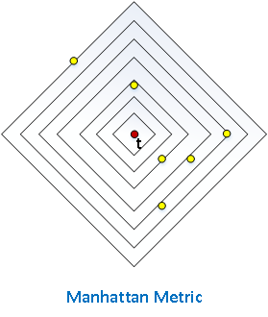
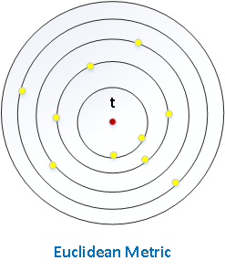
Geometric Semantic GP
Focus on geometric property of semantics and search directly on semantic space
Semantics of a program is a point in n-dimensional space
Fitness – distance between semantics
$fit\left(P\right)=\sqrt{\sum_{i=1}^{n}{{({s\left(p\right)}_{i}−t_{i})}^{2}}}$
(Euclidean metric)
$fit\left(P\right)=\sum_{i=1}^{n}{\left|{s\left(p\right)}_{i}−t_{i}\right|}$
(Manhattan metric)
Semantic Space
Fitness landscape is a cone landscape (unimodal)

Slide 6
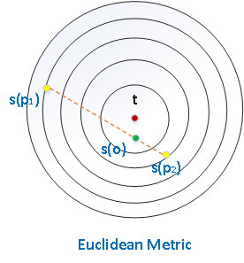
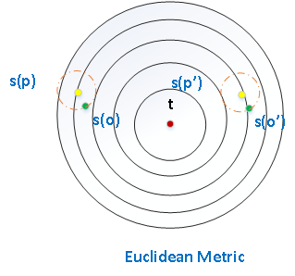
Genetic Operators in GSGP
Crossover
$\left\|s\left(p_{1}\right) ,s(p_{2}) \right\|=$
$\left\|s\left(p_{1}\right),s(o) \right\|$+$\left\|s\left(o\right) ,s(p_{2}) \right\|$
Offspring is at least not worse than the worst parent
Mutation
$\left\|s\left(p_{1}\right) ,s(p_{2}) \right\|≤r$
Offspring has similar semantics as its parents

Slide 7
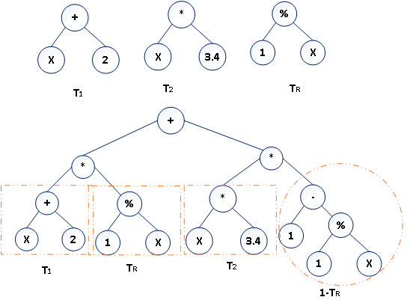
GSGP Methods
Exact GSGP (2012)
$T_{O}=\left(T_{1}∙T_{R}\right)+\left(T_{2}∙{(1−T}_{R})\right)$
where $T_{1}$ and $T_{2}$ are parent functions and $T_{R}$ is a random function $,T_{R} ε[0,1]$
$T_{O}=T+ms\left(T_{R1}−T_{R2}\right)$
where T is the parent function,
$T_{R1}$ and $T_{R2}$ are two random functions$,T_{R1,2} ε[0,1]$
Limitation
Unmanageable tree size
High computational cost
Poor interability of the evolved solution
exact geometric semantic crossover

Slide 8
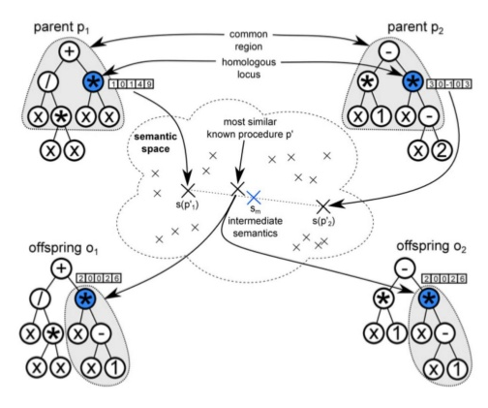
Approximate GSGP
Locally geometric crossover
approximate geometric recombination
at the level of homologous subprogram
Algorithm:
find the syntactic common region
select two homogenous node p1 and p2
calculate the midpoint sm of s(p1) and s(p2)
find a subprogram p’ in the library with the closest semantic distance from sm
replace p1 and p2 with p’

Slide 9
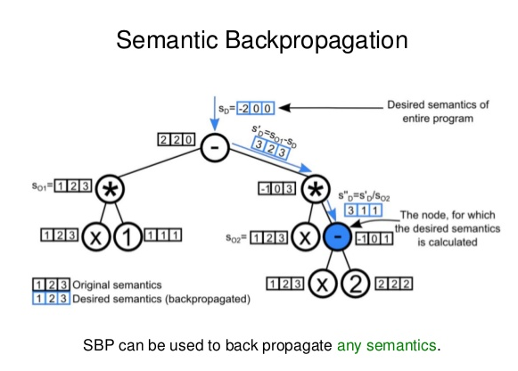
Semantic Backpropagation (SBP)
based GSGP
Approximately geometric crossover
Use SBP to match the midpoint on the segment
connecting the semantics of two parents
Random desire operator
Use SBP to match the target semantics
Is a geometric mutation operator

Slide 10
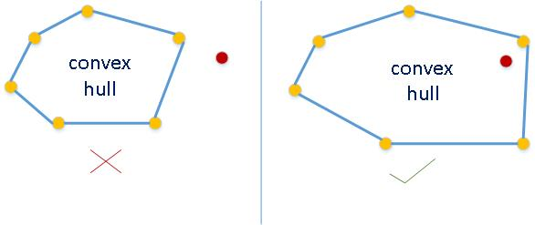
Some other effects in GSGP
For crossover, make sure a convex hull contains target semantics
Eliminate semantics duplicates

Slide 11
Thank you!

